Slide 1
Sampling and Analytical Method of Dechlorane Plus
and its Trend in Japan
Takeshi Nakano
Research Center for Environmental Preservation、
Osaka University
Notes:
２０１６年、日本環境化学会の当時の鈴木編集長から依頼を受けて、デクロランプラスの特集号を企画しました。
共著者としての論文も含めて、２０分で簡単に概要を説明させていただきます。なお、後半には海外の論文もいくつか紹介しておりますので、ご覧ください。
In 2016, 7years ago, we planned a special issue on Dechlorane Plus at the request of editor-in-chief Dr. Suzuki of the Japan Society for Environmental Chemistry. I will give a brief overview in 20 minutes, including the paper I am a co-author. Please note that in the latter half of the article, we have introduced some papers from overseas, so please take a look.

Slide 2
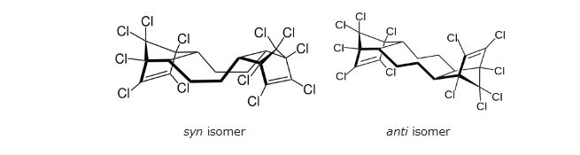
Dechlorane plus is a polychlorinated flame retardant produced by Oxychem. log P is 11.27±0.94.^{[2]}
It is produced by the Diels-Alder reaction of two equivalents of hexachlorocyclopentadiene with one equivalent of cyclooctadiene.
The syn and anti isomer are formed in the approximate ratio of 1:3.
１ ： ３
Notes:
まずはじめに、

Slide 3
Environmental concerns
Dechlorane plus was first found in the environment in 2006 in air around the Great Lakes.^{[5]} Since then, its environmental occurrence has been further documented in several studies including sediments of the Great Lakes;^{[6]} zooplankton, fish, and mussels in Lake Winnipeg and Lake Ontario;^{[7]} air and seawater from the Arctic to Antarctica;^{[8]} and Chinese air.^{[9]} In 2011, modeling data indicated that Dechlorane Plus may be persistent, bioaccumulative, and subject to long-range transport.^{[10]} The 2023 Conference of the Parties of the United Nations Stockholm Convention on Persistent Organic Pollutants took the decision to eliminate the use of Dechlorane Plus, by listing this chemical in Annex A to the Convention.^{[11]}
Dechlorane plus was added to the list of REACH Substances of Very High Concern on January 15, 2018.^{[12]}
Literature
ENVIRON Health Sciences Institute. "Dechlorane Plus High Production Volume (HPV) Chemical Challenge Program Test Plan. 201-15635" (PDF). Archived from the original (PDF) on 2012-10-23.
Wikipedia

Slide 4
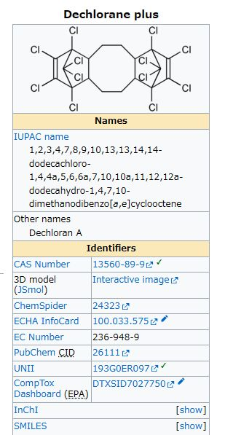
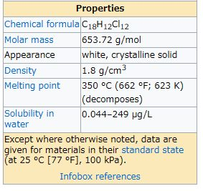

Slide 5
Chemical structure of DP and related chemicals
Environmental Levels of a Chlorinated Flame Retardant, Dechlorane Plus in Japan
Takanori Sakiyama et al
Notes:
Dechlorane Plus (DP) is a chlorinated flame retardant developed as an alternative for Mirex (Dechlorane) in the1960s, and was detected by Hoh et al. in the environment for the first time in 2006. Thereafter DP as an emerging substance began to be investigated around the world, but the data was not available in Japan until 2011. We investigated contamination levels of DP in the various environmental media in Japan using a high-resolution gas chromatograph/ mass spectrometer (HRGC/HRMS). The DP concentrations detected in Japan were 0.24-230 ng/g-dry in sediments, 1.7 ng/g-dry in soil, 74-270 ng/g-dry in outdoor dust (deposits adhering to windows and road sediments), 2.9-42 ng/g-dry in indoor dust, 0.082-1.2 ng/g-dry in plant leaves, and 5.5-8.0 pg/g-wet in vegetables. These results of our investigation indicated that various environmental matrices had been contaminated with DP, which was detected in high concentrations in deposits adhering to the outside of windows in Japan. In this study, it was found that DP concentrations of sediments in Japan were higher than in foreign countries, but levels in other media were comparable to other countries. DP concentrations in outdoor dust were higher than indoor dust, and it is suggested that DP mostly exists in outdoor environments in Japan. Mirex was present at low levels in most of the samples. Mirex was not used as a pesticide in Japan; therefore it may have been used as a flame retardant, Dechlorane. In outdoor samples (dust, soil and sediments), the ratio of an anti isomer of DP (fanti) was slightly higher than in commercial DP. Furthermore, fanti in indoor dust, plant leaves, and vegetables were lower than in outdoor samples, and were varied significantly

Slide 6
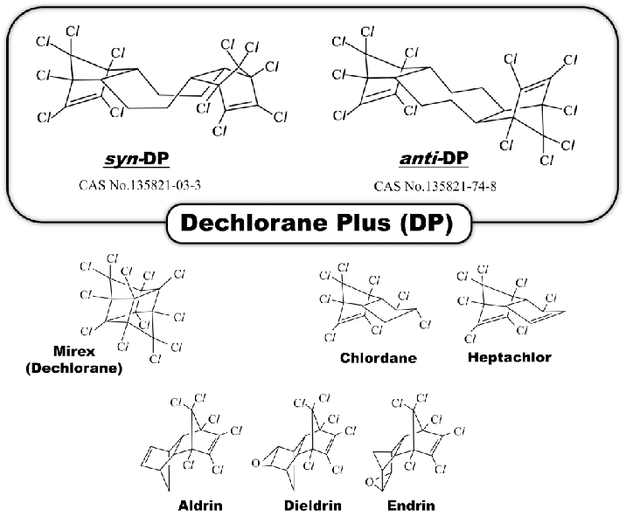
Takanori Saiyama et al, Environmental Chemistry 2016

Slide 7
Analytical scheme of DP and POPs
in environmental samples
Environmental Levels of a Chlorinated Flame Retardant, Dechlorane Plus in Japan
Takanori Sakiyama et al
Notes:
Dechlorane Plus (DP) is a chlorinated flame retardant developed as an alternative for Mirex (Dechlorane) in the1960s, and was detected by Hoh et al. in the environment for the first time in 2006. Thereafter DP as an emerging substance began to be investigated around the world, but the data was not available in Japan until 2011. We investigated contamination levels of DP in the various environmental media in Japan using a high-resolution gas chromatograph/ mass spectrometer (HRGC/HRMS). The DP concentrations detected in Japan were 0.24-230 ng/g-dry in sediments, 1.7 ng/g-dry in soil, 74-270 ng/g-dry in outdoor dust (deposits adhering to windows and road sediments), 2.9-42 ng/g-dry in indoor dust, 0.082-1.2 ng/g-dry in plant leaves, and 5.5-8.0 pg/g-wet in vegetables. These results of our investigation indicated that various environmental matrices had been contaminated with DP, which was detected in high concentrations in deposits adhering to the outside of windows in Japan. In this study, it was found that DP concentrations of sediments in Japan were higher than in foreign countries, but levels in other media were comparable to other countries. DP concentrations in outdoor dust were higher than indoor dust, and it is suggested that DP mostly exists in outdoor environments in Japan. Mirex was present at low levels in most of the samples. Mirex was not used as a pesticide in Japan; therefore it may have been used as a flame retardant, Dechlorane. In outdoor samples (dust, soil and sediments), the ratio of an anti isomer of DP (fanti) was slightly higher than in commercial DP. Furthermore, fanti in indoor dust, plant leaves, and vegetables were lower than in outdoor samples, and were varied significantly

Slide 8
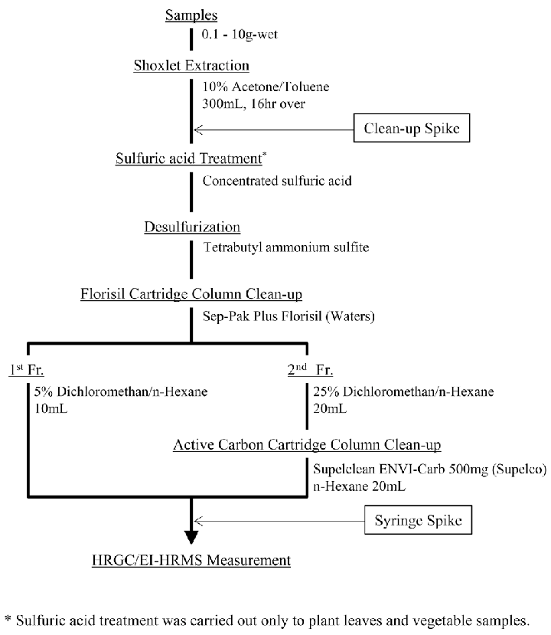
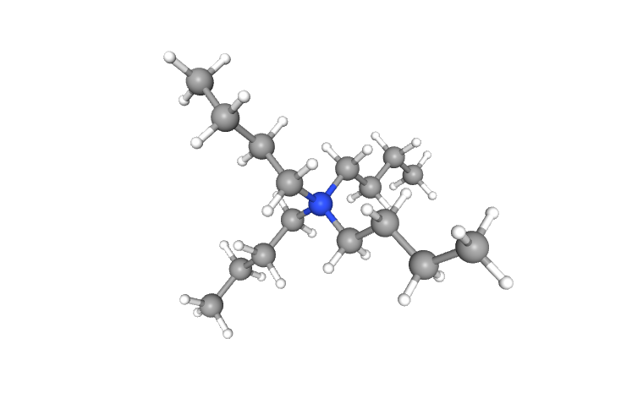
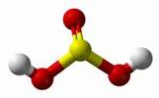
Takanori Saiyama et al, Environmental Chemistry 2016
Notes:
硫酸処理
過剰の硫酸を取り除く トリブチルアンモニウム＋sulfurous acid
Sulfuric acid treatment
Desulfurization
To remove excess sulfuric acid
Tetrabuthylammonium sulfite(Tetrabutylammonium+sulfurous acid)
High resolution GC – High resolution MS with EI mode

Slide 9
MS Chromatogram
Environmental Levels of a Chlorinated Flame Retardant, Dechlorane Plus in Japan
Takanori Sakiyama et al
Notes:
Dechlorane Plus (DP) is a chlorinated flame retardant developed as an alternative for Mirex (Dechlorane) in the1960s, and was detected by Hoh et al. in the environment for the first time in 2006. Thereafter DP as an emerging substance began to be investigated around the world, but the data was not available in Japan until 2011. We investigated contamination levels of DP in the various environmental media in Japan using a high-resolution gas chromatograph/ mass spectrometer (HRGC/HRMS). The DP concentrations detected in Japan were 0.24-230 ng/g-dry in sediments, 1.7 ng/g-dry in soil, 74-270 ng/g-dry in outdoor dust (deposits adhering to windows and road sediments), 2.9-42 ng/g-dry in indoor dust, 0.082-1.2 ng/g-dry in plant leaves, and 5.5-8.0 pg/g-wet in vegetables. These results of our investigation indicated that various environmental matrices had been contaminated with DP, which was detected in high concentrations in deposits adhering to the outside of windows in Japan. In this study, it was found that DP concentrations of sediments in Japan were higher than in foreign countries, but levels in other media were comparable to other countries. DP concentrations in outdoor dust were higher than indoor dust, and it is suggested that DP mostly exists in outdoor environments in Japan. Mirex was present at low levels in most of the samples. Mirex was not used as a pesticide in Japan; therefore it may have been used as a flame retardant, Dechlorane. In outdoor samples (dust, soil and sediments), the ratio of an anti isomer of DP (fanti) was slightly higher than in commercial DP. Furthermore, fanti in indoor dust, plant leaves, and vegetables were lower than in outdoor samples, and were varied significantly

Slide 10
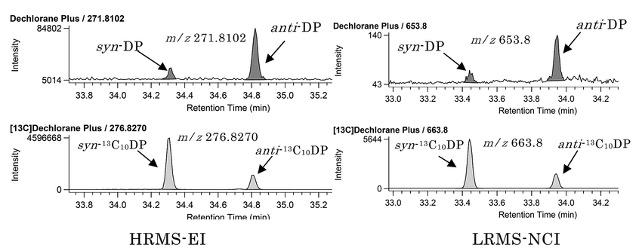
Takanori Saiyama et al, Environmental Chemistry 2016
Notes:
MS分解能の違いによる差はあまり見られなかった。
There were not many differences due to differences in MS resolution.

Slide 11
Concentration Level of Sample
Environmental Levels of a Chlorinated Flame Retardant, Dechlorane Plus in Japan
Takanori Sakiyama et al
Notes:
Dechlorane Plus (DP) is a chlorinated flame retardant developed as an alternative for Mirex (Dechlorane) in the1960s, and was detected by Hoh et al. in the environment for the first time in 2006. Thereafter DP as an emerging substance began to be investigated around the world, but the data was not available in Japan until 2011. We investigated contamination levels of DP in the various environmental media in Japan using a high-resolution gas chromatograph/ mass spectrometer (HRGC/HRMS). The DP concentrations detected in Japan were 0.24-230 ng/g-dry in sediments, 1.7 ng/g-dry in soil, 74-270 ng/g-dry in outdoor dust (deposits adhering to windows and road sediments), 2.9-42 ng/g-dry in indoor dust, 0.082-1.2 ng/g-dry in plant leaves, and 5.5-8.0 pg/g-wet in vegetables. These results of our investigation indicated that various environmental matrices had been contaminated with DP, which was detected in high concentrations in deposits adhering to the outside of windows in Japan. In this study, it was found that DP concentrations of sediments in Japan were higher than in foreign countries, but levels in other media were comparable to other countries. DP concentrations in outdoor dust were higher than indoor dust, and it is suggested that DP mostly exists in outdoor environments in Japan. Mirex was present at low levels in most of the samples. Mirex was not used as a pesticide in Japan; therefore it may have been used as a flame retardant, Dechlorane. In outdoor samples (dust, soil and sediments), the ratio of an anti isomer of DP (fanti) was slightly higher than in commercial DP. Furthermore, fanti in indoor dust, plant leaves, and vegetables were lower than in outdoor samples, and were varied significantly

Slide 12
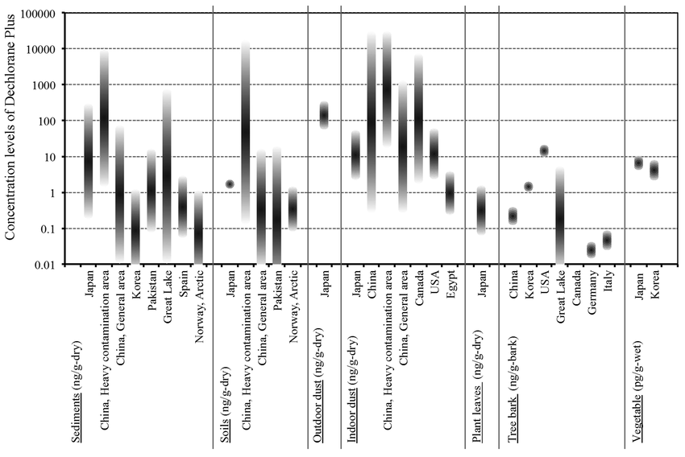
Takanori Saiyama et al, Environmental Chemistry 2016
Notes:
野菜以外は、ng/g-dryで表記しています。野菜はpg/g-wetです。
All items other than vegetables are expressed in ng/g-dry.
The vegetables on the right side are pg/g-wet.
底質、土壌、屋内ダスト、植物の葉、野菜いずれも、これまでに報告された結果と同レベルです。
Results for sediment, soil, indoor dust, plant leaves, and vegetables are all at the same level
as previously reported results.

Slide 13
Ratio of the anti-DP to total-DP (f _{anti} )
Environmental Levels of a Chlorinated Flame Retardant, Dechlorane Plus in Japan
Takanori Sakiyama et al
Notes:
Dechlorane Plus (DP) is a chlorinated flame retardant developed as an alternative for Mirex (Dechlorane) in the1960s, and was detected by Hoh et al. in the environment for the first time in 2006. Thereafter DP as an emerging substance began to be investigated around the world, but the data was not available in Japan until 2011. We investigated contamination levels of DP in the various environmental media in Japan using a high-resolution gas chromatograph/ mass spectrometer (HRGC/HRMS). The DP concentrations detected in Japan were 0.24-230 ng/g-dry in sediments, 1.7 ng/g-dry in soil, 74-270 ng/g-dry in outdoor dust (deposits adhering to windows and road sediments), 2.9-42 ng/g-dry in indoor dust, 0.082-1.2 ng/g-dry in plant leaves, and 5.5-8.0 pg/g-wet in vegetables. These results of our investigation indicated that various environmental matrices had been contaminated with DP, which was detected in high concentrations in deposits adhering to the outside of windows in Japan. In this study, it was found that DP concentrations of sediments in Japan were higher than in foreign countries, but levels in other media were comparable to other countries. DP concentrations in outdoor dust were higher than indoor dust, and it is suggested that DP mostly exists in outdoor environments in Japan. Mirex was present at low levels in most of the samples. Mirex was not used as a pesticide in Japan; therefore it may have been used as a flame retardant, Dechlorane. In outdoor samples (dust, soil and sediments), the ratio of an anti isomer of DP (fanti) was slightly higher than in commercial DP. Furthermore, fanti in indoor dust, plant leaves, and vegetables were lower than in outdoor samples, and were varied significantly

Slide 14
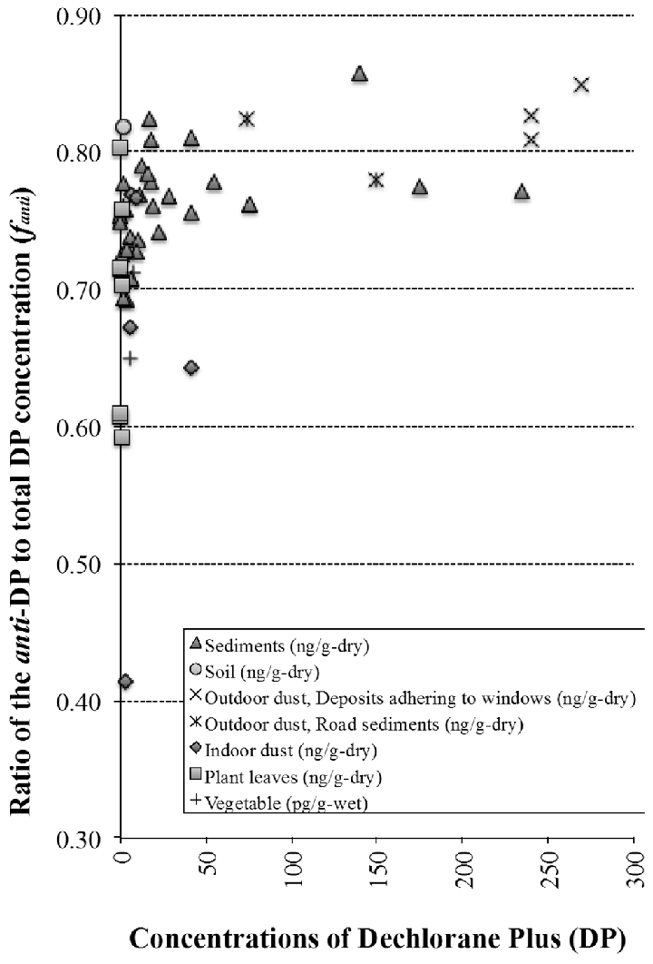
Takanori Saiyama et al, Environmental Chemistry 2016
Notes:
Depend on sediment, soil, outdoor dust,
the ratio of an anti isomer of DP (fanti) was slightly higher than in commercial DP.
Furthermore, fanti in indoor dust, plant leaves, and vegetables were lower than in outdoor samples, and were varied significantly

Slide 15
Dechlorane Plus and Related Compounds in Ambient Air
from Saitama, Japan
Kotaro Minomo et al, (2016)
Notes:
We examined the possibility of analysis of Dechlorane Plus (DP) and related compounds in ambient air by using High Volume Air Sampler (HVAS) installing quartz fiber filter (QFF) and polyurethane foam (PUF), which is usually used for ambient-air-dioxin analysis. Results of recovery test showed that the QFF and PUF can trap most of targets including anti-DP, syn-DP, Dechlorane 601, Dechlorane 602 (Dec-602), Dechlorane 603 (Dec-603), Dechlorane 604, Dechlorane 604 Component B, Chlordene Plus (CP), Dibromoaldrin, Dibromochlordene, and Hexachloro(phenyl)norbornene.
In addition, we analyzed 24 stock extracts of ambient air samples collected by using the HVAS in Kazo, Saitama in fiscal year 2013. Two DP isomers (anti and syn) were detected in all 24 samples. Concentrations of ΣDP (anti-DP+syn-DP) ranged from 1.2 to 6.7 pg/m³ (average: 3.9±1.3 pg/m³). No seasonal variation of ΣDP concentrations was found. f_{anti} (anti-DP/ΣDP) values were substantially constant at the value of technical DP composition, suggesting the DP in the air samples was originated from DP products in the neighborhood. As for the DP related compounds, only Dec-602, Dec-603 and CP were detected in the range of ND (not detected) ~0.09, ND~0.05 and ND~0.13 pg/m³, respectively. To the best of our knowledge, this is the first study to report Dec-602, Dec-603 and CP in the environment in Japan.

Slide 16
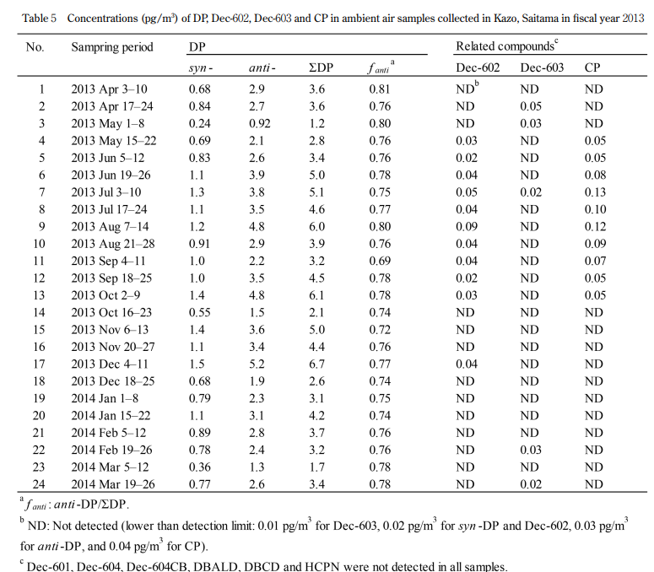
ΣDP (anti-DP+syn-DP) ranged
from 1.2 to 6.7 pg/m³
(average: 3.9±1.3 pg/m³).
No seasonal variation of ΣDP level
f_{anti} (anti-DP/ΣDP) values were
substantially constant
Almost technical DP composition,
suggesting the DP in the air samples
was originated from DP products
in the neighborhood.
Kotaro Minomo et al (2016)
Notes:
We examined the possibility of analysis of Dechlorane Plus (DP) and related compounds in ambient air by using High Volume Air Sampler (HVAS) installing quartz fiber filter (QFF) and polyurethane foam (PUF), which is usually used for ambient-air-dioxin analysis. Results of recovery test showed that the QFF and PUF can trap most of targets including anti-DP, syn-DP, Dechlorane 601, Dechlorane 602 (Dec-602), Dechlorane 603 (Dec-603), Dechlorane 604, Dechlorane 604 Component B, Chlordene Plus (CP), Dibromoaldrin, Dibromochlordene, and Hexachloro(phenyl)norbornene.
In addition, we analyzed 24 stock extracts of ambient air samples collected by using the HVAS in Kazo, Saitama in fiscal year 2013. Two DP isomers (anti and syn) were detected in all 24 samples. Concentrations of ΣDP (anti-DP+syn-DP) ranged from 1.2 to 6.7 pg/m³ (average: 3.9±1.3 pg/m³). No seasonal variation of ΣDP concentrations was found. f_{anti} (anti-DP/ΣDP) values were substantially constant at the value of technical DP composition, suggesting the DP in the air samples was originated from DP products in the neighborhood. As for the DP related compounds, only Dec-602, Dec-603 and CP were detected in the range of ND (not detected) ~0.09, ND~0.05 and ND~0.13 pg/m³, respectively. To the best of our knowledge, this is the first study to report Dec-602, Dec-603 and CP in the environment in Japan.

Slide 17
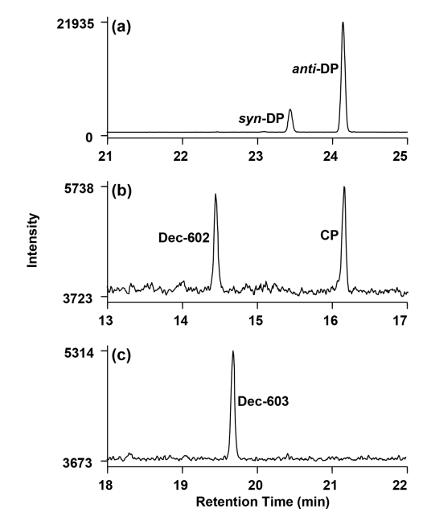
ΣDP (anti-DP+syn-DP) ranged from
1.2 to 6.7 pg/m³
(average: 3.9±1.3 pg/m³).
Mass chromatogram of anti- and syn-DP, Dec-602, Dec603 and CP in ambient air samples
Sample No.17 (2013 Dec 4-11);
Sample No.9 (2013 Aug 7-14);
Sample No.2 (2013 Apr 17-24).
Kotaro Minomo et al (2016)
Notes:
We examined the possibility of analysis of Dechlorane Plus (DP) and related compounds in ambient air by using High Volume Air Sampler (HVAS) installing quartz fiber filter (QFF) and polyurethane foam (PUF), which is usually used for ambient-air-dioxin analysis.
Results of recovery test showed that the QFF and PUF can trap most of targets including anti-DP, syn-DP, Dechlorane 601, Dechlorane 602 (Dec-602), Dechlorane 603 (Dec-603), Dechlorane 604, Dechlorane 604 Component B, Chlordene Plus (CP), Dibromoaldrin, Dibromochlordene, and Hexachloro(phenyl)norbornene.
In addition, we analyzed 24 stock extracts of ambient air samples collected by using the HVAS in Kazo, Saitama in fiscal year 2013. Two DP isomers (anti and syn) were detected in all 24 samples. Concentrations of ΣDP (anti-DP+syn-DP) ranged from 1.2 to 6.7 pg/m³ (average: 3.9±1.3 pg/m³). No seasonal variation of ΣDP concentrations was found. f_{anti} (anti-DP/ΣDP) values were substantially constant at the value of technical DP composition, suggesting the DP in the air samples was originated from DP products in the neighborhood. As for the DP related compounds, only Dec-602, Dec-603 and CP were detected in the range of ND (not detected) ~0.09, ND~0.05 and ND~0.13 pg/m³, respectively. To the best of our knowledge, this is the first study to report Dec-602, Dec-603 and CP in the environment in Japan.

Slide 18
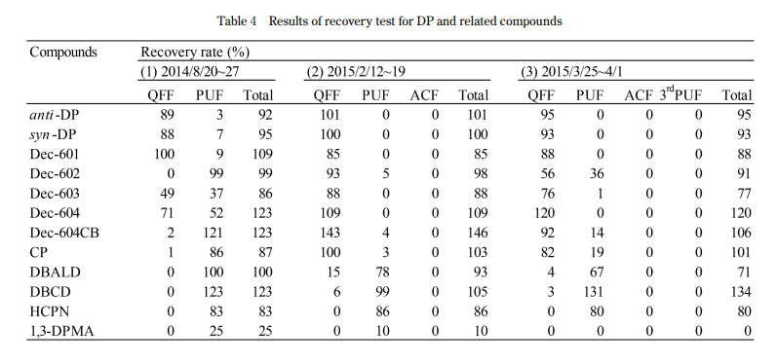
Recovery for DP and related compounds (Particle/Gas phase)
Kotaro Minomo et al (2016)

Slide 19
Dechlorane Plus in Sediment
Notes:
Several types of chemicals are added to resins for enhancement of their physicochemical properties. Among added chemicals, halogenated flame retardants (FRs) including tetrabromobisphenol A (TBBPA) were major additives. Recently, Dechlorane Plus (DP), that was used in commercial applications, has been paid attention as not only FRs but also environmental pollutants, though few information of DP are available. Consequently, we prepared resin samples [acrylonitrilebutadiene-styrene (ABS) and polycarbonate (PC) resins] containing DP at 500 mg/kg as plastic disks, and evaluated the change in concentration of DP on the disks exposed by accelerated weathering tests which were performed in accordance with the JIS K7350-2. As a result of the weathering tests assumed to be similar to the sunlight exposure of approximately half a year, the concentration of DP in ABS resin decreased approximately 10 % despite the fact that the concentration of DP in PC resin did not change. On the other hand, the concentration of TBBPA added to the disks as a reference changed and decreased approximately 30 to 40 % in both resins. For element analyses, there were no significant differences in chlorine concentration based on DP and bromine concentration based on TBBPA between original and weathered resins. Therefore, it seemed that DP, TBBPA, and occurred degradation products did stay in the disks in spite of performing the weathering tests. From the results in this study, a possibility of release to the environment on DP and TBBPA in resins may be not considerable, while it is necessary to perform additional studies in order to evaluate the possibilities of elution to the hydrosphere of fine particles of the resin and of release to the atmospheric environment by incineration processes. Key words: Dechlorane Plus, tetrabromobisphenol A, acrylonitrile-butadiene-styrene, polycarbonate, weathering test

Slide 20
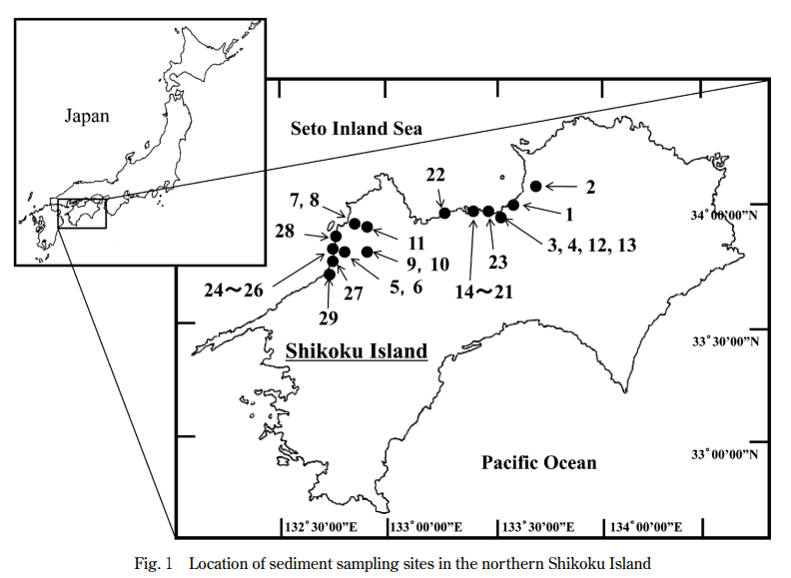
Dechlorane Plus and Dechlorane (Mirex) in Surface Sediment of the Northern Shikoku Island, Japan
Masahide Kawano et al (2016)
Notes:
Dechlorane Plus (DP), a chlorinated flame retardant, was determined in the sediment samples collected in twentynine sampling sites in the northern Shikoku Island along the coast of the Seto Inland Sea, from 2012 to 2013. Dechlorane (Mirex) and PCBs were also measured in this study comparing with the concentrations of DP in the same samples. Concentrations of DP detected in the sediment samples were significantly higher than those of Mirex. On the other hand, statistically slight difference was found between the concentrations of DP and PCBs, indicating significant environmental load and residue of DP in coastal sediments of this region. Principal component analysis based on the analytical results indicated that the chemical manufacture facility, E-waste recycling facility and the waste dumping site would be potential contamination sources of DP. To our knowledge, this is the first paper on DP accumulation in coastal sediments, which showed PCB residues at comparable concentrations, in the northern Shikoku Island

Slide 21
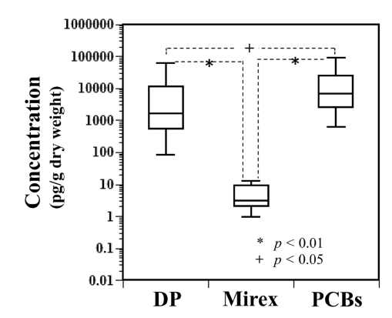
Dechlorane Plus and Dechlorane (Mirex) in Surface Sediment of the Northern Shikoku Island, Japan
10ng/g-dry
1ng/g-dry
0.01ng/g-dry
Masahide Kawano et al (2016)

Slide 22
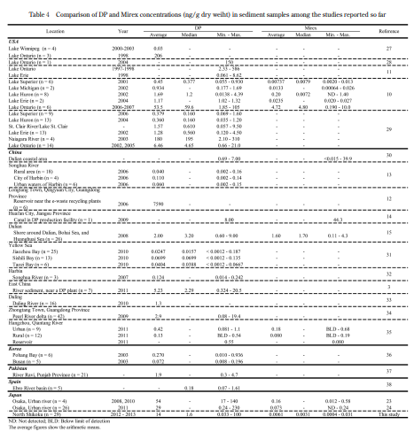
Masahide Kawano et al (2016)

Slide 23
in the sediment
northern Shikoku sediments： 0.033-100ng/g-dry
Osaka urban rivers ： 0.24-230ng/g-dry
Masahide Kawano et al (2016)
Notes:
四国北部海域底質で0.033-100ng/g-dry、大阪都市河川と同程度のレベル
0.033-100ng/g-dry in the sediment of northern Shikoku sediments,
the similar level as in Osaka urban rivers.

Slide 24
Dechlorane Plus in Particulate Matter
Notes:
Several types of chemicals are added to resins for enhancement of their physicochemical properties. Among added chemicals, halogenated flame retardants (FRs) including tetrabromobisphenol A (TBBPA) were major additives. Recently, Dechlorane Plus (DP), that was used in commercial applications, has been paid attention as not only FRs but also environmental pollutants, though few information of DP are available. Consequently, we prepared resin samples [acrylonitrilebutadiene-styrene (ABS) and polycarbonate (PC) resins] containing DP at 500 mg/kg as plastic disks, and evaluated the change in concentration of DP on the disks exposed by accelerated weathering tests which were performed in accordance with the JIS K7350-2. As a result of the weathering tests assumed to be similar to the sunlight exposure of approximately half a year, the concentration of DP in ABS resin decreased approximately 10 % despite the fact that the concentration of DP in PC resin did not change. On the other hand, the concentration of TBBPA added to the disks as a reference changed and decreased approximately 30 to 40 % in both resins. For element analyses, there were no significant differences in chlorine concentration based on DP and bromine concentration based on TBBPA between original and weathered resins. Therefore, it seemed that DP, TBBPA, and occurred degradation products did stay in the disks in spite of performing the weathering tests. From the results in this study, a possibility of release to the environment on DP and TBBPA in resins may be not considerable, while it is necessary to perform additional studies in order to evaluate the possibilities of elution to the hydrosphere of fine particles of the resin and of release to the atmospheric environment by incineration processes. Key words: Dechlorane Plus, tetrabromobisphenol A, acrylonitrile-butadiene-styrene, polycarbonate, weathering test

Slide 25
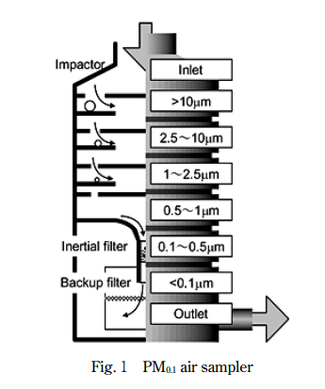
Size Distribution of Dechloranes in Particulate Matter
The particle size distributions of dechloranes were determined. For collecting PM, an Andersen air sampler equipped with five-stage quartz fiber filters and a PM_{0.1} air sampler equipped with six-stage Teflon and inertial SUS fiber filters were used.
Particulate matter (PM) was collected in 2014 - 2015
Andersen air sampler
PM_{0.1} air sampler
Kensaku KAKIMOTO et al (2016)
Notes:
The particle size distributions of dechloranes were determined. For collecting PM, an Andersen air sampler equipped with five-stage quartz fiber filters and a PM_{0.1} air sampler equipped with six-stage Teflon and inertial SUS fiber filters were used. Particulate matter (PM) was collected in April 2014 by Andersen air sampler and October 2014 and January 2015 by PM_{0.1} air sampler. The samples were analyzed for Dechlorane Plus (DP), Dechlorane602, Dechlorane603, and Dechlorane604 Component A using gas chromatography high-resolution mass spectrometry. The almost all nanoparticles smaller than 100 nm are reported to reach and deposit in lung periphery, so it is important to reveal the concentration of these dechloranes in nanoparticles. In our study, only DP was detected in PM. DP was detected from all the filter samples. In this study, the particle size distribution of DP was revealed for the first time and the approximately 70 ％ of DP exist in ＜2.5 µm fractions and 10 ％ of DP exist in ＜0.1 µm fractions of PM samples.

Slide 26
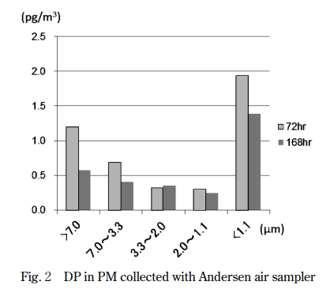
Size Distribution of Dechloranes in Particulate Matter
Kensaku KAKIMOTO et al (2016)
Notes:
The particle size distributions of dechloranes were determined. For collecting PM, an Andersen air sampler equipped with five-stage quartz fiber filters and a PM_{0.1} air sampler equipped with six-stage Teflon and inertial SUS fiber filters were used. Particulate matter (PM) was collected in April 2014 by Andersen air sampler and October 2014 and January 2015 by PM_{0.1} air sampler. The samples were analyzed for Dechlorane Plus (DP), Dechlorane602, Dechlorane603, and Dechlorane604 Component A using gas chromatography high-resolution mass spectrometry. The almost all nanoparticles smaller than 100 nm are reported to reach and deposit in lung periphery, so it is important to reveal the concentration of these dechloranes in nanoparticles. In our study, only DP was detected in PM. DP was detected from all the filter samples. In this study, the particle size distribution of DP was revealed for the first time and the approximately 70 ％ of DP exist in ＜2.5 µm fractions and 10 ％ of DP exist in ＜0.1 µm fractions of PM samples.

Slide 27
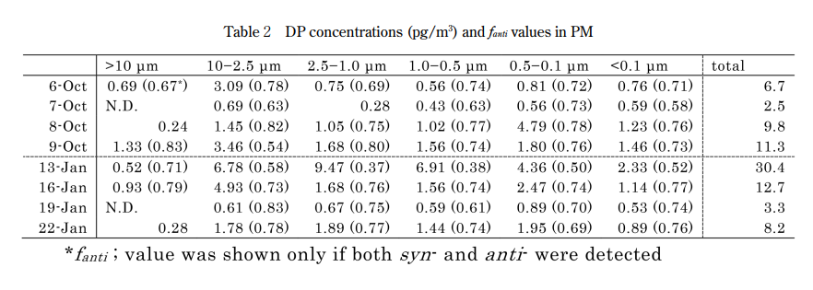
Size Distribution of Dechloranes in Particulate Matter
Kensaku KAKIMOTO et al (2016)
Notes:
The particle size distributions of dechloranes were determined. For collecting PM, an Andersen air sampler equipped with five-stage quartz fiber filters and a PM_{0.1} air sampler equipped with six-stage Teflon and inertial SUS fiber filters were used. Particulate matter (PM) was collected in April 2014 by Andersen air sampler and October 2014 and January 2015 by PM_{0.1} air sampler. The samples were analyzed for Dechlorane Plus (DP), Dechlorane602, Dechlorane603, and Dechlorane604 Component A using gas chromatography high-resolution mass spectrometry. The almost all nanoparticles smaller than 100 nm are reported to reach and deposit in lung periphery, so it is important to reveal the concentration of these dechloranes in nanoparticles. In our study, only DP was detected in PM. DP was detected from all the filter samples. In this study, the particle size distribution of DP was revealed for the first time and the approximately 70 ％ of DP exist in ＜2.5 µm fractions and 10 ％ of DP exist in ＜0.1 µm fractions of PM samples.

Slide 28
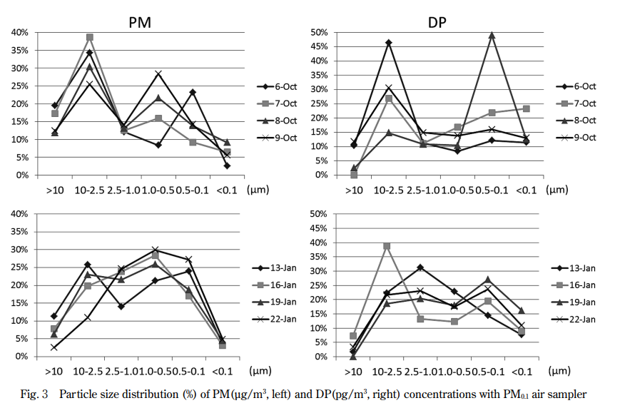
Kensaku KAKIMOTO et al (2016)
Notes:
The particle size distributions of dechloranes were determined. For collecting PM, an Andersen air sampler equipped with five-stage quartz fiber filters and a PM_{0.1} air sampler equipped with six-stage Teflon and inertial SUS fiber filters were used. Particulate matter (PM) was collected in April 2014 by Andersen air sampler and October 2014 and January 2015 by PM_{0.1} air sampler. The samples were analyzed for Dechlorane Plus (DP), Dechlorane602, Dechlorane603, and Dechlorane604 Component A using gas chromatography high-resolution mass spectrometry. The almost all nanoparticles smaller than 100 nm are reported to reach and deposit in lung periphery, so it is important to reveal the concentration of these dechloranes in nanoparticles. In our study, only DP was detected in PM. DP was detected from all the filter samples. In this study, the particle size distribution of DP was revealed for the first time and the approximately 70 ％ of DP exist in ＜2.5 µm fractions and 10 ％ of DP exist in ＜0.1 µm fractions of PM samples.

Slide 29
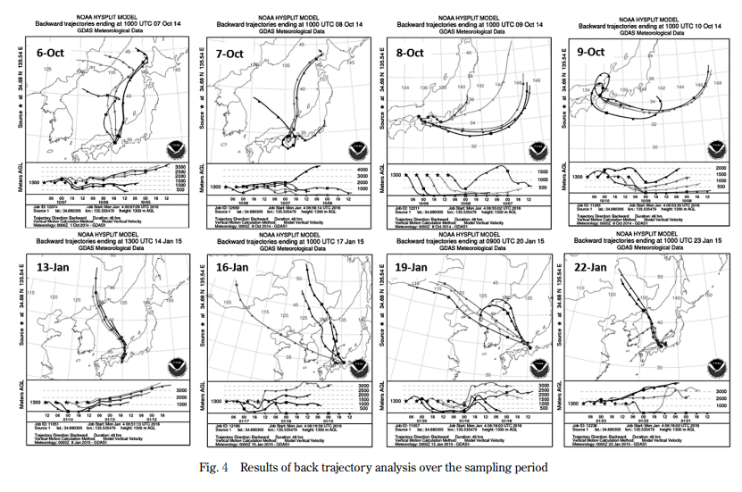
Results of back trajectory analysis over the sampling period
Kensaku KAKIMOTO et al (2016)
Notes:
大気粉塵（PM）中デクロラン類の粒径毎濃度分布を明らかにし た。分析対象としたデクロラン類のうちデクロラン・プラス（DP） のみが検出された。10月に採取した PM に比べ 1 月に採取した試 料では特に，2.5 ～ 1.0 µm，1.0 ～ 0.5 µm，0.5 ～ 0.1 µm の，大気 中で長距離移動性を有する粒子において PM 濃度分布の上昇がみ られ，DP 濃度分布も2.5 ～ 1.0 µm において上昇がみられた。＜0.1 µm の画分には他の画分に比較し高い濃度ではないものの DP が存 在していることが明らかとなった。PM0.1大気サンプラーにて採取 した PM 中の DP は平均で68％が2.5 µm 以下の画分に存在し，13％ が0.1 µm 以下の画分に存在することが明らかとなった

Slide 30
Analytical Methods of Dechlorane Plus in Ambient Air for HRMS-EI and LRMS-NCI
Dechlorane Plus (DP) is a chlorinated flame retardant that has been manufactured for the past 47 years. It is designated as a high-volume chemical (HPV) by the US-EPA, and more than 450 tons are produced annually.
Overseas, cases have been reported in which it has been detected in various environmental media such as lake bottom sediment, fish and shellfish, and the atmosphere.
In Japan, surveys of sediment, soil, indoor dust, and outdoor deposits around urban areas have revealed that outdoor deposits have relatively high concentrations of 74 to 270 ng/g-dry.
However, there are still many unknowns regarding its concentration and behavior in the environment. This time, we investigated the GC/MS measurement method with the aim of measuring DP in the ambient air. Two types of MS were investigated: a magnetic field type (HRMS: EI mode, resolution 10,000) and a quadrupole type (LRMS: NCI mode).
As a result of the measurements, DP was detected in the ambient air, and as far as we know, this is the first report of its detection in the ambient air in Japan.
Kouichirou Matsumoto et al, Environmental Chemistry 2016
Notes:
Dechlorane Plus (DP) is a chlorine-based flame retardant that has been manufactured for the past 40 years. It is designated as a high-volume chemical (HPV) by the US-EPA, and more than 450 tons are produced annually. Overseas, cases have been reported in which it has been detected in various environmental media such as lake bottom sediment, fish and shellfish, and the atmosphere. In Japan, surveys of sediment, soil, indoor dust, and outdoor deposits around urban areas have revealed that outdoor deposits have relatively high concentrations of 74 to 270 ng/g-dry. However, there are still many unknowns regarding its concentration and behavior in the environment. This time, we investigated the GC/MS measurement method with the aim of measuring DP in the ambient air. Two types of MS were investigated: a magnetic field type (HRMS: EI mode, resolution 10,000, hereinafter referred to as HRMS-EI) and a quadrupole type (LRMS: NCI mode, hereinafter referred to as LRMS-NCI). As a result of the measurements, DP was detected in the ambient air, and as far as we know, this is the first report of its detection in the ambient air in Japan.
Dechlorane Plus（DP）は過去40年間にわたり製造されてきた塩素系難燃剤である。US-EPAでは高生産量化学物質（HPV）に指定されており、年間450 t以上が製造されている。海外では湖沼底質、魚類や貝類、大気等様々な環境媒体から検出されている事例が報告されている。国内では都市域周辺の底質、土壌、屋内のダストおよび屋外沈着物を調査した結果、屋外沈着物は74～270 ng/g-dryといった比較的濃度であることがわかってきている。しかしながら、環境中の濃度や挙動については未だ不明な点が多い。
今回、我々は環境大気中のDPを測定することを目的として、GC/MSの測定方法について検討を行った。MSは磁場型（HRMS：EIモード、分解能10,000、以下HRMS-EI）及び四重極型（LRMS：NCIモード、以下LRMS-NCI）の2機種で検討した。測定の結果、環境大気からDPが検出され、知る限り環境大気では国内初検出の報告である。

Slide 31
物理化学的性状
Chemical Name Dechlorane Plus
CAS Number 13560-89-9
Mol Formula C₁₈H₁₂Cl₁₂
Mol Weight 653.73
Melt Pt >325℃
Water Solubility 7.51e⁻¹⁰ mg/L (25℃)
Log P (octanol-water) 11.27
Vapor Pressure 7.06e⁻¹⁰ mm Hg (25℃)
Henry's Law Constant 7.44e⁻⁶ atm-m³/mole (25℃)
syn-DP
anti-DP
Kouichirou Matsumoto et al, Environmental Chemistry 2016

Slide 32
Samples and methods
sampling
Collection method PS-Air , 3L/min , 24 hours
Surrogate Dechlorane Plus- ¹³ C ₁₀ ( syn , anti )
Collection location Rooftop of Japan Environmental Hygiene Center
Collection date : April 18-19 , 19-20 , 23-24 , 24-25 , 2012 _ _ _ _ _ _ _ _
* Double measurements will be conducted throughout the day.
CLeanup
Elution method 10% dichloromethane / hexane 8 mL
Syringe spike Mirex- ¹³ C ₁₀ , final volume 100 μL
measurement
GC/MS Agilent 6890 / AutoSpec Ultima NT (EI mode, Re > 10,000)
Agilent 7890 / 5975C (NCI mode, CH ₄ )
Kouichirou Matsumoto et al, Environmental Chemistry 2016

Slide 33
GC/MS measurement conditions
GC/MS | 6890 / AutoSpec (HRMS-EI) | 7890 / 5975 (LRMS-NCI)
Column | DB-17HT (30 m, 0.25 mm, 0.32 μm )
Oven Temp. | 100℃(1min)→20℃/min→160℃(0min)→3℃/min→220℃(0min)→10℃/min→330℃(3min)
Injector Temp. | 280℃
Injection Port Type | Splitless
Injection Vol. | 1 μL
Interface Temp. | 320℃
Source Temp. | 280℃ | 150℃
Ionization Mode | EI | NCI (RG : Methane)
Monitor Ion (DP) | m/z 271.8102, 273.8072 | m/z 651.8, 653.8
Monitor Ion (DP-¹³C₁₀) | m/z 276.8270, 278.8240 | m/z 663.8, 665.8
Monitor Ion (Mirex-¹³C₁₀) | m/z 276.8270, 278.8240 | m/z 413.8, 411.8
Kouichirou Matsumoto et al, Environmental Chemistry 2016

Slide 34
Chromatogram of standard solution
HRMS-EI
syn -DP
anti -DP
LRMS-NCI
syn -DP
anti -DP
Kouichirou Matsumoto et al, Environmental Chemistry 2016

Slide 35
Mass spectrum ( HRMS-EI )
272
274
272
274
syn -DP
anti -DP
279
277
syn - _{DP} - ^{13C10}
277
279
anti - DP- ¹³ C ₁₀
Kouichirou Matsumoto et al, Environmental Chemistry 2016
Notes:
Fragmentation

Slide 36
Mass spectrum ( LRMS-NCI )
syn -DP
651.8
653.8
anti -DP
651.8
653.8
syn - _{DP} - ^{13C10}
663.8
665.8
anti - DP- ¹³ C ₁₀
663.8
665.8
Kouichirou Matsumoto et al, Environmental Chemistry 2016

Slide 37
calibration curve
As/Ass : Area ratio of standard material and surrogate
Qs/Qss : Concentration ratio of standard substance and surrogate
Surrogate concentration: 5 pg/μL
HRMS-EI for anti - DP had R ² =0.9928 , which was poorer linearity than others;
A highly linear calibration curve was obtained.
There is an extremely strong correlation between the area ratio (As/Ass) of HRMS-EI and LRMS-NCI
( Test using Fisher 's r z transformation, significance level 5% )
syn -DP, anti -DP: 0.1-10 pg/ μL ( r=1.000, P<0.0001 )
syn -DP: 10-50 pg/ μL ( r=1.000, P<0.0001 )
anti -DP: 10-50 pg/ μL ( r=0.997, P<0.0001 )
There is no difference between the calibration curves of HRMS-EI and LRMS-NCI
Kouichirou Matsumoto et al, Environmental Chemistry 2016

Slide 38
Equipment detection lower limit value ( IDL )
 | HRMS-EI ( syn -DP) | LRMS-NCI ( syn -DP) | HRMS-EI ( anti -DP) | LRMS-NCI ( anti -DP)
Injection solution concentration (pg/μL) | 0.10 | 0.10 | 0.10 | 0.10
Injection volume (μL) | 1.0 | 1.0 | 1.0 | 1.0
Result 1 (pg/μL) | 0.0984 | 0.107 | 0.105 | 0.102
Result 2 (pg/μL) | 0.0980 | 0.103 | 0.101 | 0.108
Result 3 (pg/μL) | 0.108 | 0.101 | 0.101 | 0.106
Result 4 (pg/μL) | 0.102 | 0.104 | 0.105 | 0.104
Result 5 (pg/μL) | 0.0948 | 0.100 | 0.098 | 0.102
Result 6 (pg/μL) | 0.101 | 0.105 | 0.101 | 0.108
Result 7 (pg/μL) | 0.102 | 0.102 | 0.093 | 0.104
Average value (pg/μL) | 0.1005 | 0.1032 | 0.1006 | 0.1049
Standard deviation (pg/μL) | 0.004034 | 0.002297 | 0.004176 | 0.002701
IDL conversion value (pg/m ³ ) | 0.37 | 0.21 | 0.39 | 0.25
IQL conversion value (pg/m ³ ) | 0.96 | 0.55 | 0.99 | 0.64
CV (%) | 4.0 | 2.2 | 4.2 | 2.6
The sample volume and final liquid volume are
4.2 m3 ^{and} 100 μL respectively
t- test (significance level 5% ) for each measurement value of HRMS-EI and LRMS-NCI
syn -DP : No significant difference ( P=0.14 )
anti -DP : Significant difference ( P=0.042 )
LRMS-NCI has higher sensitivity for IDL
IDL = t(n-1,0.05)×σ _{n-1} ×2
IQL = σ _{n-1} ×10
Kouichirou Matsumoto et al, Environmental Chemistry 2016

Slide 39
Chromatogram when calculating
HRMS-EI
syn -DP
(S/N = 11)
anti -DP
(S/N = 14)
S/N ratio of LRMS-NCI is relative to
syn -
anti -
High sensitivity
LRMS-NCI
syn -DP
(S/N = 52)
anti -DP
(S/N = 60)
Kouichirou Matsumoto et al, Environmental Chemistry 2016

Slide 40
Sampling conditions
 | 18-19, April, 2012 | 19-20, April, 2012 | 23-24, April, 2012 | 24-25, April, 2012
Pump | SP208-10L (GL Science) | SP208-10L (GL Science) | SP208-10L (GL Science) | SP208-10L (GL Science)
Flow Rate | 3 L/min | 3 L/min | 3 L/min | 3 L/min
Sampling Time | 24h | 24h | 24h | 24h
Air Temp. | 18.4℃ | 17.7℃ | 19.0℃ | 20.8℃
Humidity | 60.0% | 59.7% | 82.6% | 73.5%
Atmospheric Press. | 1019.2 hPa | 1022.5 hPa | 1008.7 hPa | 1011.2 hPa
Sampling Vol. (A) | 4268.6 L | 4271.9 L | 4271.7 L | 4270.2 L
Sampling Vol. (B) | 4269.0 L | 4268.5 L | 4268.9 L | 4269.3 L
Weather | Fine / Cloudy | Fine / Cloudy | Rainy / Fine | Slight Rain / Fine
Kouichirou Matsumoto et al, Environmental Chemistry 2016

Slide 41
Measurement of ambient air (sample chromatogram)
HRMS-EI
anti -DP
(S/N = 42)
syn -DP
(S/N = 7.5)
The S/N ratio of HRMS-EI was almost the same as that of
2.8 times more sensitive
LRMS-NCI
anti -DP
(S/N = 15)
syn -DP
(S/N = 6.2)
LRMS-NCI, depending on the sample,
Cleanup may be required
Kouichirou Matsumoto et al, Environmental Chemistry 2016

Slide 42
DP concentration in the ambient air
Duplicate measurements exclude samples on days 23-24, HRMS -EI: syn -DP : 2.0 to 7.7 % , anti -DP : 0.88 to 8.1% , Total DP : 2.6 to 6.7% , LRMS-NCI : syn - Good results were obtained, with deviations of DP
the 23rd to 24th and the differences in the measured values are thought to be due to the rainy weather.
Kouichirou Matsumoto et al, Environmental Chemistry 2016

Slide 43
Comparison of concentration and composition
There is an extremely strong correlation between the measured values ( Sample A, Sample B, Mean ) obtained by the two measurement methods.
( Test using Fisher 's r z transformation, significance level 5% )
syn -DP: r=0.994 ~ 0.999, P=0.0002 ~ 0.0036
anti -DP: r=0.999 ~ 1.000, P<0.0001
syn + anti : r=0.999, P<0.0001
There is no difference in the measured value depending on the measurement method.
f _{anti} = concentration of anti -isomer divided by total of syn + anti concentrations for each sample.
The average f _{anti} was 0.70 to 0.83 . This ratio was similar to that of Commercial DP ( 0.75 to 0.80 ) * , suggesting contamination originating from the preparation.
* Hoh E. et al., Environ. Sci. Technol. 40 , 1184-1189, 2006.
Kouichirou Matsumoto et al, Environmental Chemistry 2016

Slide 44
Surrogate recovery rate
Mirex - ^{13C10} was used for the syringe spike because the same m / z _{as} DP-13C10 could ^{be} used . However, the retention time is more than 9 minutes apart from the DP retention time , and it may be affected by the matrix eluting at the same time during each detection time, so depending on the sample, it may be necessary to clean up or change the syringe spike. There may be cases where it is necessary to do so.
Additionally, Mirex- ¹³ C10 cannot be used when collecting and analyzing POPs _{at the same time.}
Kouichirou Matsumoto et al, Environmental Chemistry 2016

Slide 45
Comparison with literature reported values of atmospheric DP
Location | Media | Concentration | Reference
Lake Erie | Air | 34 ± 24 pg/m3 ⁽ mean ± one standard error) | Hoh E. et al., Environ. Sci. Technol. 40 , 1184-1189, 2006.
Great Lakes | Air | Urban : 7.2 and 2.4 pg/m³ (two sites) Rural : 20, 0.8 and 0.8 pg/m³ (three sites) | Venier M. et al., Environ. Sci. Technol. 42, 4745-4751, 2008
China | Air | < 0.8 – 66 pg/m³ f_{syn} = 0.32 (Urban Air) | Ren N. et al., Environ. Sci. Technol. 42, 6476-6480, 2008.
East China | Air | Urban : 6.9 pg/m³ (mean) Rural : 3.5 pg/m³ (mean) | Qiu X. et al., Chemosphere. 80, 1207–1212, 2010
DP Manufacturer, China | Air | 7737–26734 pg/m³ | Wang B. et al., Chemosphere. 80, 1285–1290, 2010
European Arctic | Air | 0.05 - 4.2 pg /m³ f_{syn} = 0.37 – 0.67 | Möller A et al., Environ Sci Technol. 44, 8977–8982, 2010
Kawasaki, Japan | Air | HRMS-EI : 2.0 – 24 pg /m³ (Mean 7.4 pg /m³ ) LRMS-NCI: 2.2 – 24 pg/m3 ⁽ Mean 7.4 pg/ ^{m3} ) | This study
The DP concentrations detected in this study were at the same level as urban air concentrations reported in the literature.
Kouichirou Matsumoto et al, Environmental Chemistry 2016

Slide 46
Comparison with POPs concentration
pg/ ^{m3}
pg/ ^{m3}
warm season are quoted from the 2010 monitoring survey (Ministry of the Environment) . (Results for Dorin, Mirex, and Toxaphene are as of 2009 )
DP is higher than the brominated flame retardants PBDEs and HBBs , the concentration was not particularly high compared to the concentration of chlorinated POPs for which monitoring surveys are being conducted . Further investigation is desired, as data showed that the concentration was higher during rainy weather.
Kouichirou Matsumoto et al, Environmental Chemistry 2016

Slide 47
conclusion
The linearity of the calibration curves created using the two measurement methods, HRMS-EI and LRMS-NCI, was good, and there was no statistically significant difference between the two measurement methods .
the IDL sample conversion value was lower for LRMS-NCI , and the S/N ratio was approximately 5 times more sensitive for syn -DP and approximately 4 times more sensitive for anti -DP .
On the other hand, for air samples, the S/N ratios of the two measurement methods were almost the same for anti -DP , but for syn -DP , HRMS-EI was about 3 times more sensitive, and when using LRMS-NCI , can be expected to improve by cleaning up
As a result of analyzing DP in the ambient air , syn -DP : 0.46 to 7.7 pg/m3 , anti - DP : 1.5 to 16 pg/ ^{m3} , Total DP : 2.0 to 24 pg/ ^{m3} detected
Duplicate measurements exclude samples taken in rainy weather, HRMS-EI has syn -DP : 2.0 to 7.7% , anti -DP : 0.88 to 8.1% , Total DP : 2.6 to 6.7% , and LRMS-NCI has syn -DP : Good results were obtained with deviations of 0.47 to 15% , anti -DP : 0.17 to 6.3% , and Total DP : 0.57 to 8.9% .
There was a correlation between the double measurement values and average values obtained by the two measurement methods, and there was no difference between the measurement values by the two measurement methods.
Regarding the isomer composition, f _{anti} = 0.70 to 0.83 , which was similar to Commercial DP ( 0.75 to 0.80 ), suggesting contamination from the preparation.
Mirex- ^{13C10} as the syringe spike , the calculated surrogate recovery rate was in the range of 90 to 120% , indicating good recovery .
The DP concentrations detected in this study were at the same level as urban air concentrations reported in the literature.
Kouichirou Matsumoto et al, Environmental Chemistry 2016

Slide 48
Seasonal variation of atmospheric DP

Slide 49
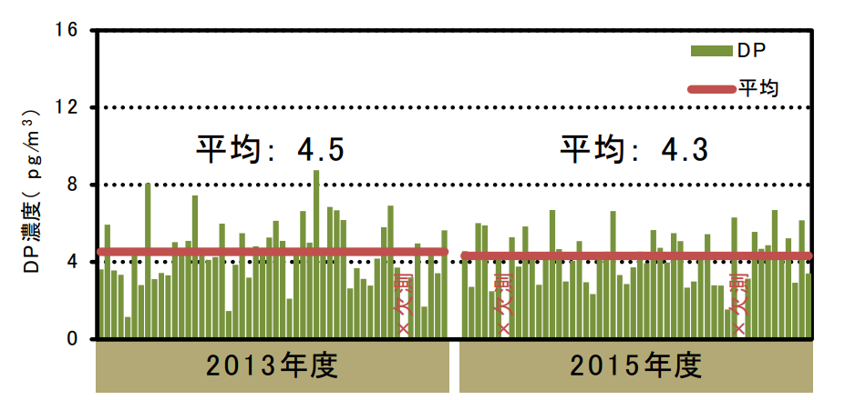
Dechlorane Plus and Related Compounds in Ambient Air
from Saitama, Japan
Seasonal variation of atmospheric DP in Saitama Japan
Kotaro Minomo et al

Slide 50
Pre-Feasibility Study
on Environmental Pollution
of Dechlorane Plus in Resins
by Accelerated Weathering Tests
Nobuyasu HANARI et al (2016)
Notes:
Several types of chemicals are added to resins for enhancement of their physicochemical properties. Among added chemicals, halogenated flame retardants (FRs) including tetrabromobisphenol A (TBBPA) were major additives. Recently, Dechlorane Plus (DP), that was used in commercial applications, has been paid attention as not only FRs but also environmental pollutants, though few information of DP are available. Consequently, we prepared resin samples [acrylonitrilebutadiene-styrene (ABS) and polycarbonate (PC) resins] containing DP at 500 mg/kg as plastic disks, and evaluated the change in concentration of DP on the disks exposed by accelerated weathering tests which were performed in accordance with the JIS K7350-2. As a result of the weathering tests assumed to be similar to the sunlight exposure of approximately half a year, the concentration of DP in ABS resin decreased approximately 10 % despite the fact that the concentration of DP in PC resin did not change. On the other hand, the concentration of TBBPA added to the disks as a reference changed and decreased approximately 30 to 40 % in both resins. For element analyses, there were no significant differences in chlorine concentration based on DP and bromine concentration based on TBBPA between original and weathered resins. Therefore, it seemed that DP, TBBPA, and occurred degradation products did stay in the disks in spite of performing the weathering tests. From the results in this study, a possibility of release to the environment on DP and TBBPA in resins may be not considerable, while it is necessary to perform additional studies in order to evaluate the possibilities of elution to the hydrosphere of fine particles of the resin and of release to the atmospheric environment by incineration processes. Key words: Dechlorane Plus, tetrabromobisphenol A, acrylonitrile-butadiene-styrene, polycarbonate, weathering test

Slide 51
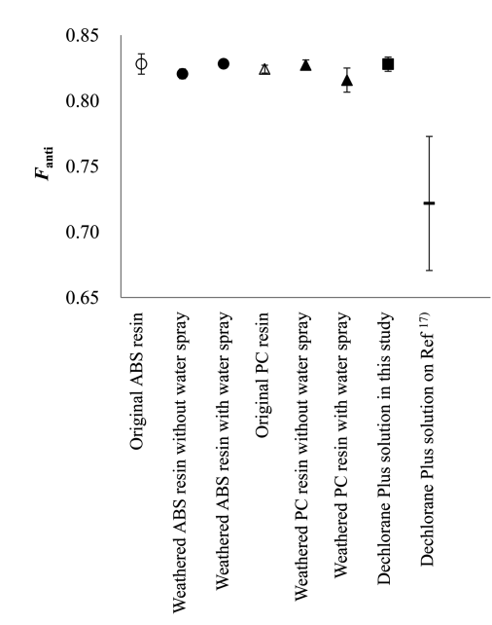
polycarbonate
(PC) resin
Weathering Test
resin samples
acrylonitrilebutadiene-styrene
(ABS) resin
Nobuyasu HANARI et al (2016)
Notes:
Several types of chemicals are added to resins for enhancement of their physicochemical properties. Among added chemicals, halogenated flame retardants (FRs) including tetrabromobisphenol A (TBBPA) were major additives. Recently, Dechlorane Plus (DP), that was used in commercial applications, has been paid attention as not only FRs but also environmental pollutants, though few information of DP are available. Consequently, we prepared resin samples [acrylonitrilebutadiene-styrene (ABS) and polycarbonate (PC) resins] containing DP at 500 mg/kg as plastic disks, and evaluated the change in concentration of DP on the disks exposed by accelerated weathering tests which were performed in accordance with the JIS K7350-2. As a result of the weathering tests assumed to be similar to the sunlight exposure of approximately half a year, the concentration of DP in ABS resin decreased approximately 10 % despite the fact that the concentration of DP in PC resin did not change. On the other hand, the concentration of TBBPA added to the disks as a reference changed and decreased approximately 30 to 40 % in both resins. For element analyses, there were no significant differences in chlorine concentration based on DP and bromine concentration based on TBBPA between original and weathered resins. Therefore, it seemed that DP, TBBPA, and occurred degradation products did stay in the disks in spite of performing the weathering tests. From the results in this study, a possibility of release to the environment on DP and TBBPA in resins may be not considerable, while it is necessary to perform additional studies in order to evaluate the possibilities of elution to the hydrosphere of fine particles of the resin and of release to the atmospheric environment by incineration processes. Key words: Dechlorane Plus, tetrabromobisphenol A, acrylonitrile-butadiene-styrene, polycarbonate, weathering test

Slide 52
Thank you for your attention

Slide 53
And more……

Slide 54
Flame retardants and organochlorine pollutants in bald eagle plasma from the Great Lakes region
in bald eagles plasma (ng/g-wet).
Syn-DP 0.01 0.01 0.23 0.01 0.05 0.07 0.06 ± 0.03 0.03
Anti-DP 0.01 0.01 0.45 0.01 0.11 0.15 0.12 ± 0.07 0.06
Total DP 0.02 0.02 0.68 0.02 0.16 0.22 0.19 ± 0.10 0.09
Syn-DP : Anti-DP ≒ １：２ in bald eagles plasma
Marta Venier et al
Notes:
We report measurements of polybrominated diphenyl ethers and of emerging flame retardants in the
plasma of nestling bald eagles sampled from early May to late June of 2005. Concentrations of total PBDEs
ranged from 0.35 ng g1 ww to 29.3 ng g1 ww (average = 5.7 ± 1.9 ng g1 ww). The most abundant congeners
were BDE-47, BDE-99, and BDE-100. The fully brominated congener, BDE-209, was detected in
approximately one third of the samples at an average concentration of 1.2 ± 0.72 ng g1 ww. Several
emerging flame retardants, such as pentabromoethylbenzene (PBEB), hexabromocyclododecanes
(HBCDs), and Dechlorane Plus (DP), were detected in these samples. Polychlorinated biphenyls (PCBs)
and organochlorine pesticides were also detected at levels close to those previously published. A statistically
significant relationship was found between total PBDE concentrations and total PCB and p,p0-DDE
concentrations, suggesting that these compounds share a common source, which is most likely the
eagle’s food.

Slide 55
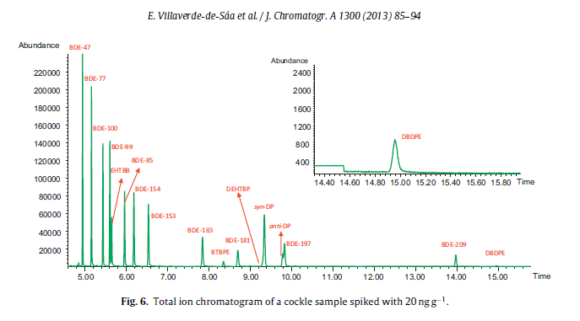
Matrix solid-phase dispersion combined with GC/MS for the determinationof fifteen halogenated flame retardants in mollusks
Eugenia Villaverde-de-Sáa et al
Notes:
This study presents the development and validation of a new analytical method for the simultaneousdetermination of fifteen analytes classified as halogenated flame retardants (HFRs) – nine brominateddiphenyl ethers (BDEs) and six novel HFRs – in different kinds of mollusks using matrix solid-phasedispersion (MSPD) followed by gas chromatography coupled to negative chemical ionization-mass spec-trometry (GC–NCI-MS). The proposed method is the first one developed for such a broad range of HFRs inaquatic biota, featuring several advantages, including low solvent and sample intake, simplicity of opera-tion, reduced cost and integration of extraction and clean-up into a single step. Under optimal conditions,0.5 g of freeze-dried sample, 0.5 g of a primary-secondary amine (PSA) as solid support, a sorbent combi-nation of 1.75 g of florisil (deactivated with 5% Milli-Q water), 1.75 g of acidified silica (10% (w/w) H2SO4)and 0.5 g of silica, and 10 mL dichloromethane as elution solvent were used. Standard addition over theextract was required however for the correct quantification due to matrix effects in the GC system, par-ticularly for novel HFRs, that could not be compensated with the internal standards. The method affordedLODs in the range of 0.003–0.07 ng g−1dry weight (0.0006–0.014 ng g−1on a wet weight basis, assumingan 80% sample water content), except for decabromodiphenyl ethane (DBDPE) (0.6 ng g−1dry weight,0.12 ng g−1wet weight). The accuracy of the method was evaluated with three different types of spikedmollusk species using surrogate standards and standard addition over the extract for quantification andthe recoveries were in the 70–120% range, except for bis(2-ethylhexyl)-3,4,5,6-tetrabromo-phthalate(DEHTBP) in clam (Ruditapes philippinarum) samples (46% recovery). Moreover, the method was success-fully validated with standard reference materials (SRMs) of salmon and mussel tissues for BDEs. Finally,the method was applied to the determination of HFRs in different kind of freeze-dried mollusks: mussel(Mytilus galloprovincialis), cockle (Cerastoderma edule) and clam (R. philippinarum). Raft cultured musselsshowed the highest concentrations of HFRs (up to 0.8 ng g−1wet weight of BDE-209).

Slide 56
Determination of emerging halogenated flame retardants and polybrominated diphenyl ethers in serum by GC/MS
Concentrations of HFRs in human serum from Norway (ng/g-lipid)
syn-DP 0.84 0.39 0.11 0.17 0.18 0.28 0.13 0.60 6.0 0.15
anti-DP 2.5 1.1 0.80 1.0 0.52 0.87 0.84 1.5 13 0.72
Syn-DP : Anti-DP ≒ 1：2 ～1:7 in bald eagles plasma
Enrique Cequier et al
Notes:
Emerging flame retardants are used in a great variety of household goods and thus have the potential topollute our indoor environment. Health concerns regarding exposure to these flame retardants demandnew methods to survey their occurrence in humans. This work describes development and optimizationof an analytical method comprising solid phase extraction and gas chromatography coupled to mass spec-trometry for the determination of besides 15 polybrominated diphenyl ethers, 7 emerging halogenatedflame retardants in human serum (1,2-bis[2,4,6-tribromophenoxy] ethane, decabromodiphenyl ethane,hexabromobenzene, Dechlorane Plus®, hexachlorocyclopentenyl-dibromocyclooctane, dechlorane 602and 603). The method was thoroughly validated at three spiking levels obtaining averaged recoveries>80% with a RSD of 5% (n = 12). Accuracies ranged from 88 to 125% except for DBDPE, which averaged66% with overall RSD of 11% (n = 12). Method limits of detection (MLD) ranged from 0.3 to 5.4 pg/mLserum, except for decabromodiphenyl ether and decabromodiphenyl ethane for which MLDs were 14and 20 pg/mL serum, respectively. In human serum samples from Norway, we were able to detect andquantify hexabromobenzene, 1,2-bis[2,4,6-tribromophenoxy] ethane, Dechlorane Plus®, Dechlorane 602and 603.

Slide 57
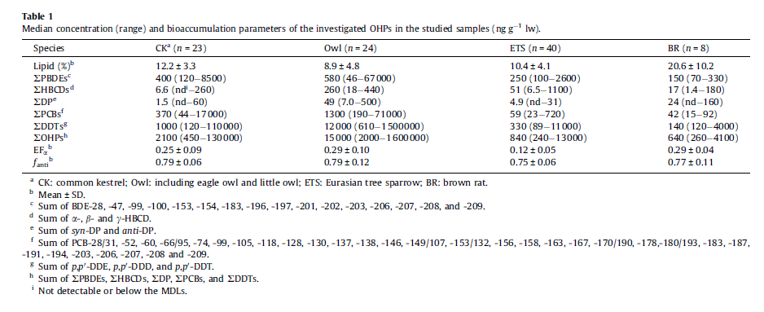
Occurrence and biomagnification of organohalogen pollutants in two terrestrial predatory food chains
f _{anti-DP} = 0,75-0.79 in two terrestrial predatory food chains
Lehuan Yu et al
Notes:
Organohalogen pollutants (OHPs), including dichlorodiphenyl trichloroethane and its metabolites (DDTs), polychlorinated biphenyls (PCBs), polybrominated diphenyl ethers (PBDEs), hexabromocyclododecanes (HBCDs), and dechlorane plus (DP), were determined in three raptor species, namely, the common
kestrel (Falco tinnunculus), eagle owl (Bubo bubo), and little owl (Athene noctua), as well as in their
primary prey items: Eurasian tree sparrow (Passer montanus) and brown rat (Rattus norvegicus). DDTs
were the predominant pollutants in avian species followed by PBDEs and PCBs, then minimally contribution
of HBCDs and DP. Inter-species differences in the PBDE congener profiles were observed between the
owls and the common kestrels, with relatively high contributions of lower brominated congeners in the
owls but highly brominated congeners in the kestrels. This result may partly be attributed to a possible
greater in vivo biotransformation of highly brominated BDE congeners in owls than in kestrels. a-HBCD
was the predominant diastereoisomer with a preferential enrichment of ()-enantiomer in all the samples.
No stereoselective bioaccumulation was found for DP isomers in the investigated species. Biomagnification
factor (BMF) values were generally higher in the ratowl food chain than in the
sparrowkestrel food chain. Despite this food chain-specific biomagnification, the relationships between
the log BMF and log KOW of PCBs and PBDEs followed a similar function in the two food chains, except for
BDE-47, -99, and -100 in the sparrowkestrel feeding relationship.
2013

Slide 58
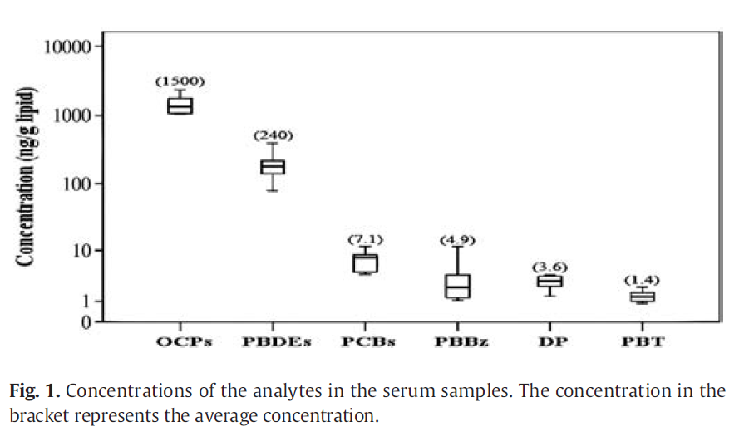
Concentrations and relationships between classes of persistent
halogenated organic compounds in pooled human serum samples and air from Laizhou Bay, China
Ying Wang et al
Notes:
Persistent halogenated organic compounds, including polychlorinated biphenyls (PCBs), organochlorine pesticides
(OCPs), polybrominated diphenyl ethers (PBDEs), dechlorane plus (DP), pentabromobenzene (PBBz),
and pentabromotoluene (PBT), were analyzed in pooled human serum samples from different age groups and
air samples fromthe south coast of Laizhou Bay, Shandong Province, China. TheΣ25OCP andΣ8PBDE congeners
were found at higher concentrations than the other compounds,with mean concentrations of 1500 and 240 ng/g
lipid in serum and 330 and 140 000 pg/m3 in the air, respectively. PBBz and PBT were detected in every
serum and air sample, with mean concentrations of 4.9 and 1.4 ng/g lipid in serum and 100 and 250 pg/m3 in
air, respectively. In serum, the mean concentrations of Σ14PCBs and ΣDP were 7.1 and 3.6 ng/g lipid,
respectively, and in air, the mean concentrations ofΣ12dioxin-like (DL-) PCBs andΣDP were 1.7 and 1.4 pg/m3,
respectively. Different relationships were observed between the concentrations of different compounds in
serumand the volunteers' ages, and the concentration distributions with age were closely related to the historic
production and usage volumes of each chemical in China. The ubiquity of PCBs, OCPs, PBDEs, DP, PBBz, and PBT in
serum and air is potentially concerning, and effective measures should be taken to control the concentrations of
these chemicals in the environment and humans. Significant correlations were found between the chemical
concentrations in serumand air, suggesting that inhalationmay be an important exposure route for the residents
of Laizhou Bay.

Slide 59
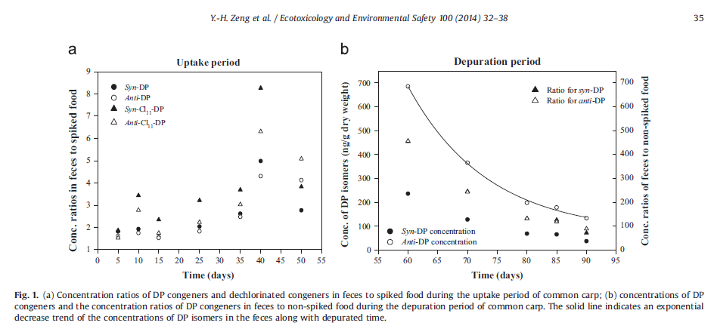
Gastrointestinal absorption, dynamic tissue-specific accumulation, and isomer composition of dechlorane plus and related analogs in common carp by dietary exposure
Yan-Hong Zeng et al
Notes:
Dechlorane plus(DP)isahigh-productivevolumesubstancewhichhadbeenidentified asubiquitous pollutant andhasbeenwidelydetectedinbiota.Inthepresentstudy,commoncarp(Cyprinus carpio) was exposedtoknownamountsofcommercialDP-25underlaboratoryconditions.Thegastrointestinal absorption andtissue-specific bioaccumulationofDPanditsdechlorinatedanalogsincommoncarp wereinvestigated.Thehigherabsorptionefficiencies butlowerassimilationefficiencies of anti-isomers indicated stereoselectivemetabolismof anti-isomers in fish. Linearuptakecurveswereseeninserum and muscle,butthedepurationcurvesforallthefourtissues(muscle,serum,liverandgonad)didnot follow the first-order kinetics.Theliverexhibitedahighaffinity for anti-isomers duringtheexperiment. Other tissues,suchasserum,muscle,andgonad,showedaselectiveaccumulationof syn-DP intheearly stages oftheexperiment,particularlytheserum.However,thedeviationof fanti between differenttissues disappeared atlatestagesoftheexperiment,andthe fanti valuesinalltissueswereclosetothatin commercial mixtures.OurresultssuggestthatthebioaccumulationofDPisacomplexandmulti- factorial process.

Slide 60
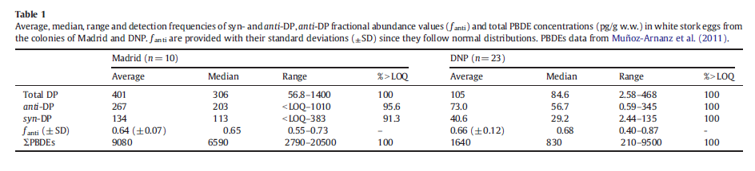
Dechlorane plus and possible degradation products in white stork eggs from Spain
Juan Muñoz-Arnanz et al
Notes:
Table 1
Average, median, range and detection frequencies of syn- and anti-DP, anti-DP fractional abundance values (ƒanti) and total PBDE concentrations (pg/g w.w.) in white stork eggs from
the colonies of Madrid and DNP. ƒanti are provided with their standard deviations (±SD) since they follow normal distributions. PBDEs data from Muñoz-Arnanz et al. (2011).
The occurrence of the emerging chlorinated flame retardant Dechlorane Plus (DP) and three of its possible degradation products was investigated in white stork eggs from two colonies in Spain. The average DP concentrations were 401 pg/g wet weight (w.w.) for the urban/industrial colony and 105 pg/g w.w. for the rural colony. One possible degradation product, anti-[DP-1Cl], was found in approximately 10% of the samples. No significant stereoisomer enrichments were detected in any colony based on the average anti-DP fractional abundances found which agrees with previous studies in herring gulls. The relationship between DP and PBDE contents in both colonies was explored leading to different scenarios, i.e. no correlation was found in the urban colony but theywere statistically correlated in the rural colony. To the best of our knowledge, this is the first study to report DP in a species from a terrestrial food web, and also to report a DP degradation product in biota.

Slide 61
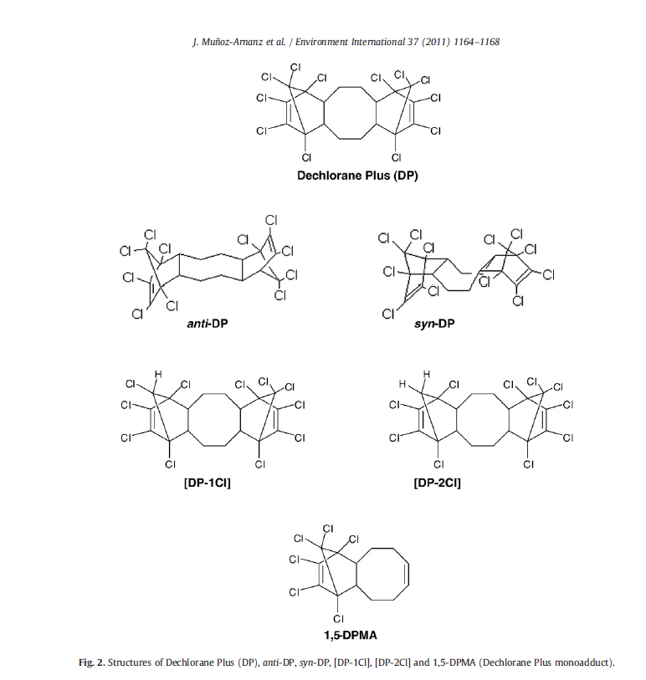
Juan Muñoz-Arnanz et al
Notes:
Table 1
Average, median, range and detection frequencies of syn- and anti-DP, anti-DP fractional abundance values (ƒanti) and total PBDE concentrations (pg/g w.w.) in white stork eggs from
the colonies of Madrid and DNP. ƒanti are provided with their standard deviations (±SD) since they follow normal distributions. PBDEs data from Muñoz-Arnanz et al. (2011).
The occurrence of the emerging chlorinated flame retardant Dechlorane Plus (DP) and three of its possible degradation products was investigated in white stork eggs from two colonies in Spain. The average DP concentrations were 401 pg/g wet weight (w.w.) for the urban/industrial colony and 105 pg/g w.w. for the rural colony. One possible degradation product, anti-[DP-1Cl], was found in approximately 10% of the samples. No significant stereoisomer enrichments were detected in any colony based on the average anti-DP fractional abundances found which agrees with previous studies in herring gulls. The relationship between DP and PBDE contents in both colonies was explored leading to different scenarios, i.e. no correlation was found in the urban colony but theywere statistically correlated in the rural colony. To the best of our knowledge, this is the first study to report DP in a species from a terrestrial food web, and also to report a DP degradation product in biota.

Slide 62
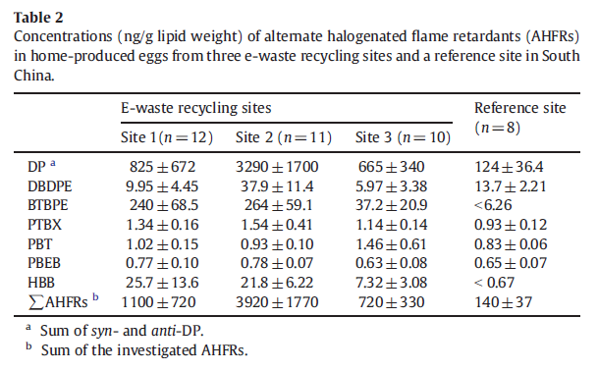
Halogenated flame retardants in home-produced eggs from an electronic waste recycling region in South China: Levels, composition profiles, and human dietary exposure assessment
Xiao-Bo Zheng et al
Notes:
Three regulated halogenated flame retardants (HFRs), i.e., polybrominated diphenyl ethers (PBDEs), polybrominated biphenyls (PBBs) and hexabromocyclododecanes (HBCDs), and several alternative HFRs (AHFRs) including Dechlorane Plus (DP), decabromodiphenyl ethane (DBDPE), and 1,2-bis(2,4,6-tribromophenoxy) ethane (BTBPE), were investigated in the home-produced eggs from three recycling sites and a reference site in an electronic waste (e-waste) recycling region, South China. Mean levels of HFRs in eggs from the recycling sites ranged 2640–14100, 700–1620, 44–350, and 720–3920 ng/g lipid weight forΣPBDEs,ΣPBBs,ΣHBCDs, andΣAHFRs, respectively, which were one to two orders of magnitude higher than those examined in the reference site. PBDEs were the predominant HFR in those eggs, with contributions >50% to the total HFRs; followed by PBBs and the AHFRs (contributing 14–22% in average). The α-HBCD was the predominant diastereoisomers of HBCDs, with preferential enrichment of the (−)-enantiomer
in most of the eggs; but no significant stereoselective enrichment of the DP isomers was observed in these eggs. The average estimated daily intakes (EDIs) of PBDEs, PBBs, HBCDs, and the AHFRs via eggs from the recycling sites ranged 4200–20000, 1120–2440, 80–490, and 970–4530 ng/day, respectively, which were one to two orders of magnitude higher than those reported from other parts of the world. The potential adverse effects of these HFRs to human health in the e-waste sites should be further investigated. This is the first report on the isomer compositions of DP and the chiral signatures of HBCDs in hen eggs

Slide 63
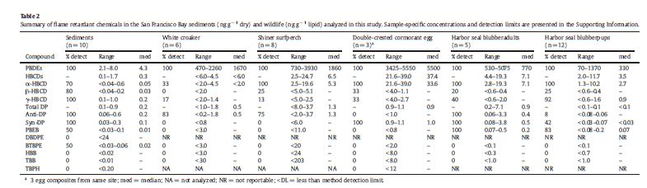
Brominated and chlorinated flame retardants
in San Francisco Bay sediments and wildlife
Susan L. Klosterhaus et al
Notes:
Restrictions on the use of polybrominated diphenyl ethers (PBDEs) have resulted in the use of alternative
flame retardants in consumer products to comply with flammability standards. In contrast to PBDEs, information
on the occurrence and fate of these alternative compounds in the environment is limited, particularly in
the United States. In this study, a survey of flame retardants in San Francisco Bay was conducted to evaluate
whether PBDE replacement chemicals and other current use flame retardants were accumulating in the Bay
food web. In addition to PBDEs, brominated and chlorinated flame retardants (hexabromocyclododecane
(HBCD) and Dechlorane Plus (DP)) were detected in Bay sediments and wildlife. Median concentrations of
PBDEs, HBCD, and DP, respectively, were 4.3, 0.3, and 0.2 ng g−1 dry weight (dw) in sediments; 1670,
b6.0, and 0.5 ng g−1 lipid weight (lw) in white croaker (Genyonemus lineatus); 1860, 6.5, and 1.3 ng g−1
lw in shiner surfperch (Cymatogaster aggregata); 5500, 37.4, and 0.9 ng g−1 lw in eggs of double-crested cormorant
(Phalacrocorax auritus); 770, 7.1, and 0.9 ng g−1 lw in harbor seal (Phoca vitulina) adults; and 330,
3.5, and b0.1 ng g−1 lw in harbor seal (P. vitulina) pups. Two additional flame retardants, pentabromoethylbenzene
(PBEB) and 1,2-bis(2,4,6 tribromophenoxy)ethane (BTBPE)were detected in sediments butwith less frequency and
at lower concentrations (median concentrations of 0.01 and 0.02 ng g−1 dw, respectively) compared to the other
flame retardants. PBEB was also detected in each of the adult harbor seals and in 83% of the pups (median concentrations
0.2 and 0.07 ng g−1 lw, respectively). The flame retardants hexabromobenzene (HBB), decabromodiphenyl
ethane (DBDPE), bis(2-ethylhexyl) tetrabromophthalate (TBPH), and 2-ethylhexyl 2,3,4,5-tetrabromobenzoate
(TBB),were not detected in sediments and BTBPE, HBB and TBBwere not detected inwildlife samples. Elevated concentrations
of some flame retardantswere likely associated with urbanization and Bay hydrodynamics. Compared to
other locations, concentrations of PBDEs in Bay wildlife were comparable or higher, while concentrations of the alternatives
were generally lower. This study is the first to determine concentrations of PBDE replacement products
and other flame retardants in San Francisco Bay, providing some of the first data on the food web occurrence of
these flame retardants in a North American urbanized estuary

Slide 64
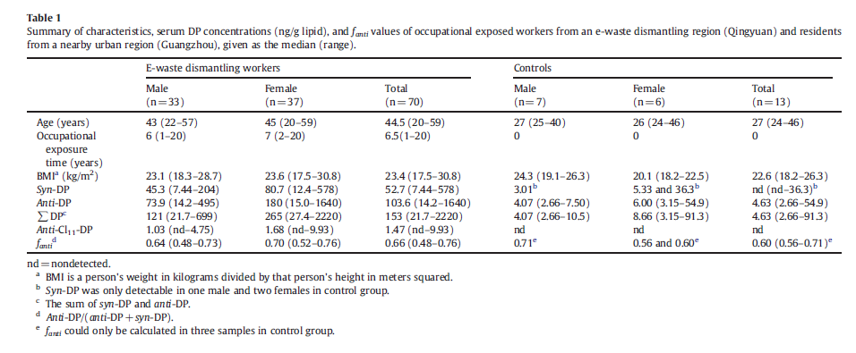
Dechlorane Plus in serum from e-waste recycling workers: Influence of gender and potential isomer-specific metabolism
Susan L. Klosterhaus et al
Notes:
Dechlorane Plus (DP) and its dechlorinated product, anti-Cl11-DP, were measured in serum of 70 occupationally
exposed workers in an e-waste recycling region and 13 residents of an urban area in South China. The DP levels
were significantly higher in the workers (22–2200 ng/g with median of 150 ng/g lipid) than in the urban residents
(2.7–91 ng/gwith median of 4.6 ng/g lipid). The DP concentrations in females were found to be associated
with their age but such relationwas not found formales. Significant differences in DP levels and DP isomer composition
were found between genders. The females had remarkably higher DP levels and fanti values (fraction of
anti-DP to total DPs) in serum than the males. Anti-Cl11-DP was significantly correlated with anti-DP for both
genders but with different slope of regression line. The ratios of anti-Cl11-DP to anti-DP (mean of 0.017) in
males were significantly higher than those (mean of 0.010) in females. Combining with the lower fanti values
in males, it is likely that males have higher metabolic potential for DPs than females which resulted in the
lower DP loading in serum. However, the different patterns of selective uptake and/or excretion of different compounds
between genders cannot be eliminated as a possible reason for the observed gender differences. This
study is the first to report on the gender difference in DP accumulation in human, and its mechanism is worth
further investigation.

Slide 65
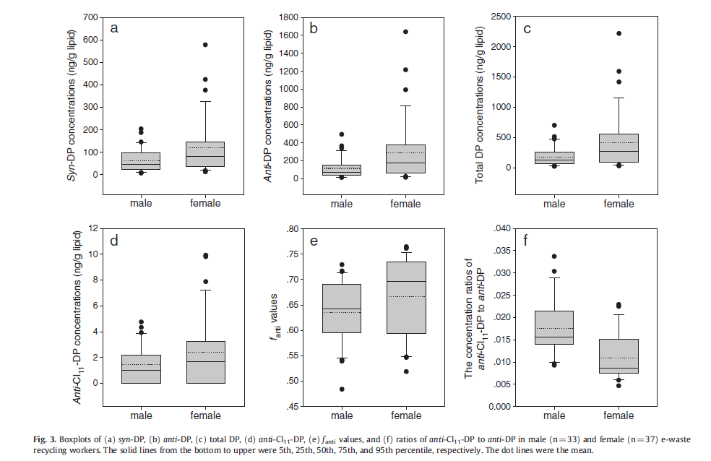
Susan L. Klosterhaus et al
Notes:
Dechlorane Plus (DP) and its dechlorinated product, anti-Cl11-DP, were measured in serum of 70 occupationally
exposed workers in an e-waste recycling region and 13 residents of an urban area in South China. The DP levels
were significantly higher in the workers (22–2200 ng/g with median of 150 ng/g lipid) than in the urban residents
(2.7–91 ng/gwith median of 4.6 ng/g lipid). The DP concentrations in females were found to be associated
with their age but such relationwas not found formales. Significant differences in DP levels and DP isomer composition
were found between genders. The females had remarkably higher DP levels and fanti values (fraction of
anti-DP to total DPs) in serum than the males. Anti-Cl11-DP was significantly correlated with anti-DP for both
genders but with different slope of regression line. The ratios of anti-Cl11-DP to anti-DP (mean of 0.017) in
males were significantly higher than those (mean of 0.010) in females. Combining with the lower fanti values
in males, it is likely that males have higher metabolic potential for DPs than females which resulted in the
lower DP loading in serum. However, the different patterns of selective uptake and/or excretion of different compounds
between genders cannot be eliminated as a possible reason for the observed gender differences. This
study is the first to report on the gender difference in DP accumulation in human, and its mechanism is worth
further investigation.

Slide 66
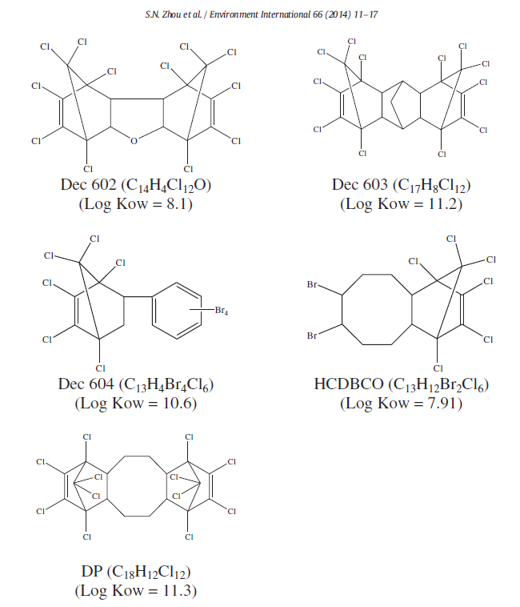
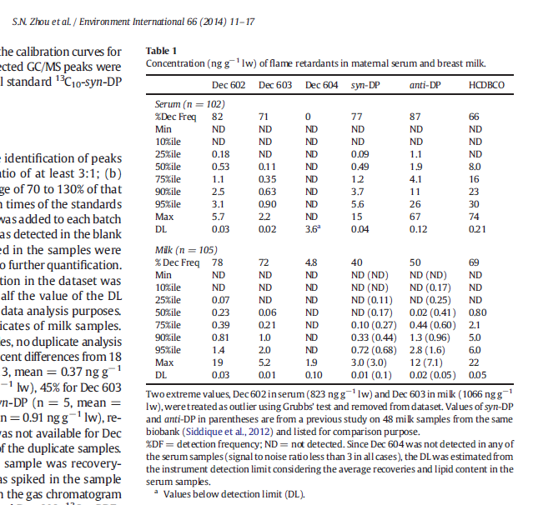
Hexachloronorbornene-based flame retardants in humans: Levels in
maternal serum and milk
Simon Ningsun Zhou et al
Notes:
Five hexachloronorbornene-based flame retardants, Dechlorane Plus (DP), Dechlorane 602 (Dec 602),
Dechlorane 603 (Dec 603), Dechlorane 604 (Dec 604) and hexachlorocyclopentadienyl-dibromocyclooctane
(HCDBCO), were measured in human milk and maternal serum. Dec 602, Dec 603 and HCDBCO were detected
in both samplematriceswith detection frequencies over 60%. Dec 604 was not detected in serumand only detected
in 4.8% of milk samples. DPwas present in over 77–87% of serum and 40–50% ofmilk samples. DP levels found
in this study were lower than those reported in two Chinese studies. The ratio of the two DP isomers found in
human samples (fanti-DP = 0.8) remained similar to the ratio reported in the DP technical mixture. Levels of
Dec 602 and Dec 603 in serum were correlated. Levels of Dec 602 and HCBDCO were also correlated in serum
samples as well as in milk samples. These biomonitoring results have provided baseline information about the
presence of these flame retardants in nursing women in Canada, which can be used for estimating human exposure
to these chemicals.

Slide 67
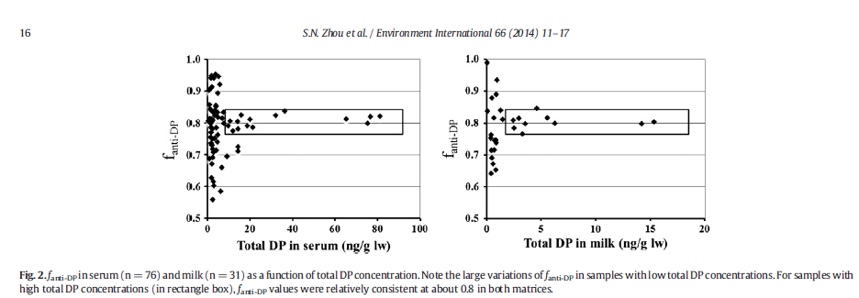
Hexachloronorbornene-based flame retardants in humans: Levels in
maternal serum and milk
Simon Ningsun Zhou et al
Notes:
Five hexachloronorbornene-based flame retardants, Dechlorane Plus (DP), Dechlorane 602 (Dec 602),
Dechlorane 603 (Dec 603), Dechlorane 604 (Dec 604) and hexachlorocyclopentadienyl-dibromocyclooctane
(HCDBCO), were measured in human milk and maternal serum. Dec 602, Dec 603 and HCDBCO were detected
in both samplematriceswith detection frequencies over 60%. Dec 604 was not detected in serumand only detected
in 4.8% of milk samples. DPwas present in over 77–87% of serum and 40–50% ofmilk samples. DP levels found
in this study were lower than those reported in two Chinese studies. The ratio of the two DP isomers found in
human samples (fanti-DP = 0.8) remained similar to the ratio reported in the DP technical mixture. Levels of
Dec 602 and Dec 603 in serum were correlated. Levels of Dec 602 and HCBDCO were also correlated in serum
samples as well as in milk samples. These biomonitoring results have provided baseline information about the
presence of these flame retardants in nursing women in Canada, which can be used for estimating human exposure
to these chemicals.

Slide 68
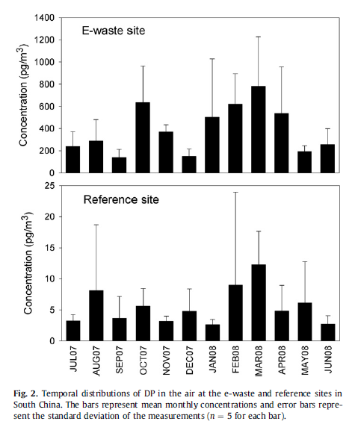
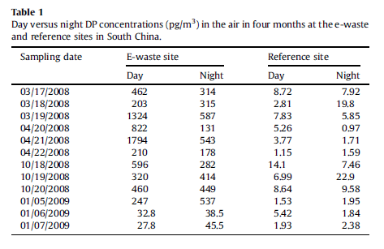
Dechlorane Plus (DP) in air and plants at an electronic
waste (e-waste) site in South China
She-Jun Chen et al
Notes:
Air and foliage samples (Eucalyptus spp. and Pinus massoniana Lamb.) were collected from e-waste and
reference sites in South China and analyzed for Dechlorane Plus (DP) and two dechlorinated DPs. DP
concentrations in the air were 13.1e1794 pg/m3 for the e-waste site and 0.47e35.7 pg/m3 for the
reference site, suggesting the recycling of e-waste is an important source of DP to the environment. Plant
DP, with concentrations of 0.45e51.9 ng/g dry weight at the e-waste site and 0.09e2.46 ng/g at the
reference site, exhibited temporal patterns similar to the air DP except for pine needle at the reference
site. The air-plant exchange of DP could be described with the two-compartment model. Anti-Cl11 DP was
measured in most air and plant samples from the e-waste site. The ratios of anti-Cl11 DP to anti-DP in the
air and plants may indicate the preferential uptake of dechlorinated DP by plant compared with DP.

Slide 69
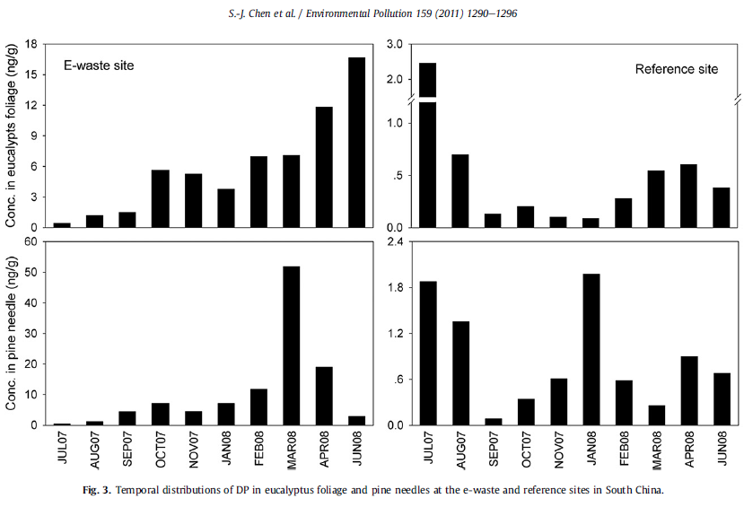
Dechlorane Plus (DP) in air and plants at an electronic
waste (e-waste) site in South China
She-Jun Chen et al
Notes:
Air and foliage samples (Eucalyptus spp. and Pinus massoniana Lamb.) were collected from e-waste and
reference sites in South China and analyzed for Dechlorane Plus (DP) and two dechlorinated DPs. DP
concentrations in the air were 13.1e1794 pg/m3 for the e-waste site and 0.47e35.7 pg/m3 for the
reference site, suggesting the recycling of e-waste is an important source of DP to the environment. Plant
DP, with concentrations of 0.45e51.9 ng/g dry weight at the e-waste site and 0.09e2.46 ng/g at the
reference site, exhibited temporal patterns similar to the air DP except for pine needle at the reference
site. The air-plant exchange of DP could be described with the two-compartment model. Anti-Cl11 DP was
measured in most air and plant samples from the e-waste site. The ratios of anti-Cl11 DP to anti-DP in the
air and plants may indicate the preferential uptake of dechlorinated DP by plant compared with DP.

Slide 70
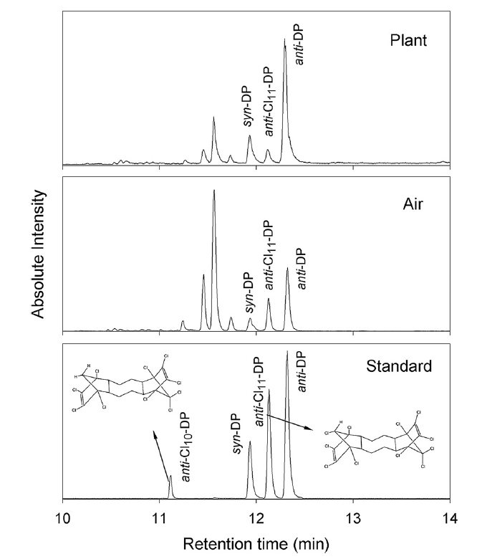
She-Jun Chen et al
Notes:
Air and foliage samples (Eucalyptus spp. and Pinus massoniana Lamb.) were collected from e-waste and
reference sites in South China and analyzed for Dechlorane Plus (DP) and two dechlorinated DPs. DP
concentrations in the air were 13.1e1794 pg/m3 for the e-waste site and 0.47e35.7 pg/m3 for the
reference site, suggesting the recycling of e-waste is an important source of DP to the environment. Plant
DP, with concentrations of 0.45e51.9 ng/g dry weight at the e-waste site and 0.09e2.46 ng/g at the
reference site, exhibited temporal patterns similar to the air DP except for pine needle at the reference
site. The air-plant exchange of DP could be described with the two-compartment model. Anti-Cl11 DP was
measured in most air and plant samples from the e-waste site. The ratios of anti-Cl11 DP to anti-DP in the
air and plants may indicate the preferential uptake of dechlorinated DP by plant compared with DP.

Slide 71
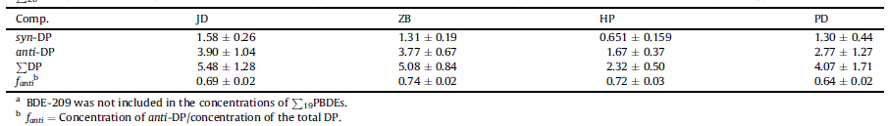
Particle-bound Dechlorane Plus and polybrominated diphenyl ethers
in ambient air around Shanghai, China
Zhiqiang Yu et al
Notes:
In present study, atmospheric particles from Shanghai, the biggest city and the most important industrial
base in China, were analyzed for polybrominated diphenyl ethers (PBDEs) and Dechlorane Plus (DP).
Concentrations of
P
20PBDEs and DP both exhibited the changing trend of industrial area > urban areas.
Jiading District had the highest levels of particulate PBDEs and DP with values of 744 152 pg/m3 and
5.48 1.28 pg/m3, respectively. Compared with similar data in other areas of the world, PBDEs in
Shanghai were at medium pollution level, while DP was at lower level, which reflected their different
production and use in Shanghai. The results from multiple linear regression analysis suggested that deca-
BDE mixture was the most important contributor of particulate PBDEs in Shanghai. The fractions of anti-
DP showed no significant differences to those of the technical mixtures (p > 0.05), which suggested that
no obviously stereoselective process occurred in ambient air around Shanghai.

Slide 72
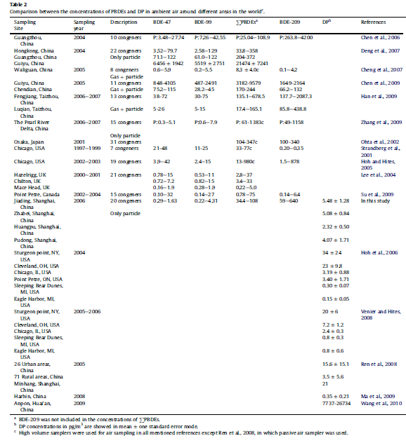
Zhiqiang Yu et al
Notes:
In present study, atmospheric particles from Shanghai, the biggest city and the most important industrial
base in China, were analyzed for polybrominated diphenyl ethers (PBDEs) and Dechlorane Plus (DP).
Concentrations of
P
20PBDEs and DP both exhibited the changing trend of industrial area > urban areas.
Jiading District had the highest levels of particulate PBDEs and DP with values of 744 152 pg/m3 and
5.48 1.28 pg/m3, respectively. Compared with similar data in other areas of the world, PBDEs in
Shanghai were at medium pollution level, while DP was at lower level, which reflected their different
production and use in Shanghai. The results from multiple linear regression analysis suggested that deca-
BDE mixture was the most important contributor of particulate PBDEs in Shanghai. The fractions of anti-
DP showed no significant differences to those of the technical mixtures (p > 0.05), which suggested that
no obviously stereoselective process occurred in ambient air around Shanghai.

Slide 73
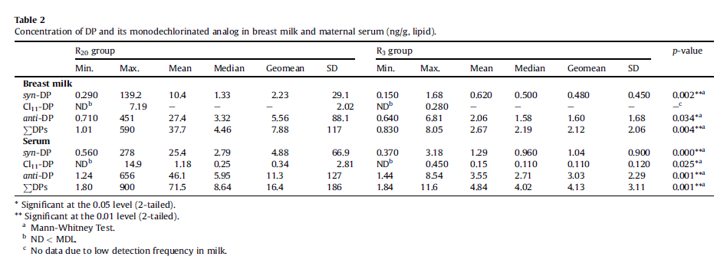
Dechlorane Plus and its dechlorinated analogs from an e-waste recycling center in
maternal serum and breast milk of women in Wenling, China
Yu-Jie Ben et al
Notes:
We measured Dechlorane Plus (DP) and its dechlorinated analogs in the blood and milk from women
living in e-waste recycling sites in Wenling of Taizhou region, China (n . 49). Both syn-DP and anti-DP
were detected in all samples. Another compound, Cl11-DP, was detected in 45% and 84% of milk and
serum samples, respectively. DP levels in blood and milk from residents living in the local environment
>20 yrs (R20 group) were significantly higher than those living in Taizhou <3 yrs (R3 group) (p < 0.05).
The milk/serum partition coefficient from the same women was approximately 0.43 and 0.47 for syn-DP
and anti-DP, respectively. A similar value in milk compared with anti-DP/PDPs (fanti) in serum suggested
that stereoselective DP bio-accumulation did not occur during the DP transport from blood to milk. This
result indicate that DP can bio-accumulate in blood and milk with the low milk/serum partition coefficient
and similar blood and milk stereoselective bio-accumulation profiles

Slide 74
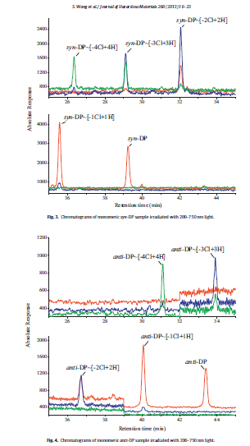
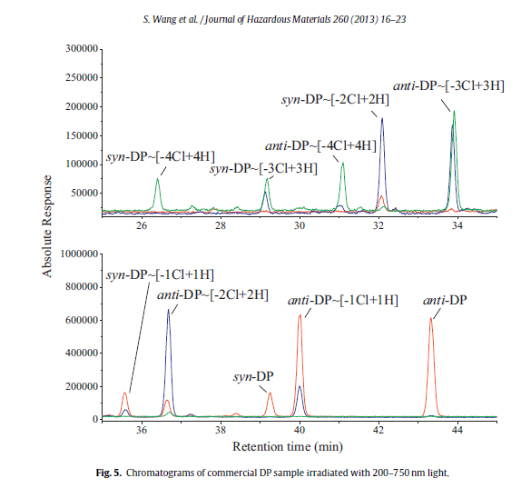
Photodegradation of Dechlorane Plus in n-nonane under the irradiation of xenon lamp
Siwen Wang et al
Notes:
Photodegradation has been regarded as the main mechanism for the removal of many halogenated
organic pollutants in the environment. The photodegradation of Dechlorane Plus (DP), an emerging contaminant
taken worldwide concerns in recent years, was investigated under the irradiation of a xenon
lamp. Rapid photodegradation was found under the irradiation of 200–750 nm light, while the degradation
became much slower when the range of light wavelength changed to 280–750 nm. DP degradation
followed the pseudo first-order kinetics. The quantum yields of 200–280 nm (UV-C) were about 2–3
orders of magnitude higher than 280–320 nm, and no yields can be detected in 320–750 nm range, in an
agreement with the changing photodegradation rates with wavelength. The photodegradation products
were identified as lower chlorinated DPs, implicating a mechanism of reductive dechlorination. No photoisomerization
or solvent adducts were observed, and the difference of photodegradation rate between
syn- and anti-DP isomers was negligible.

Slide 75
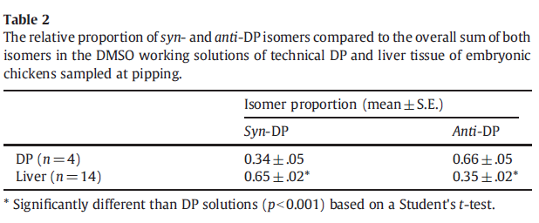
The effects of Dechlorane Plus on toxicity and mRNA expression in chicken embryos:
A comparison of in vitro and in ovo approaches
Doug Crump et al
Notes:
Dechlorane Plus (DP) is an additive chlorinated flame retardant comprising two major isomers, syn- and anti-
DP, that is used in a variety of commercial/industrial products. It has been detected in biotic and abiotic
matrices including the eggs of herring gulls collected from the Laurentian Great Lakes. However, data on
potential toxicological and molecular responses to exposure are lacking, especially for avian species. A
combined in vitro/in ovo approach was used to determine concentration-dependent effects of DP in chicken
embryonic hepatocytes (CEH) and chicken embryos following injection of DP into the air cell of eggs prior to
incubation. Overt toxicity (i.e. cytotoxicity and pipping success) and mRNA expression levels of transcripts
previously determined to be responsive to a brominated flame retardant were assessed in CEH and hepatic
tissue. DP was not cytotoxic up to a maximum concentration of 3 μMin CEH, and no effects on pipping success
were observed up to the highest nominal dose group of 500 ng/g egg. A significant shift in isomeric content of
syn- and anti-DP was detected between stock solutions of the commercial mixture and hepatic tissue; the
proportion of the syn-DP isomer increased from 0.34 to 0.65 with a concomitant decrease of anti-DP from 0.66
to 0.35. None of the mRNA transcripts changed as a result of in vitro or in ovo exposure to DP indicating that,
although there was concordance between the two approaches, DP may evoke its toxicity through other modes
of action. At current environmental exposure levels, no adverse effects of DP on embryonic viability or
pathways associated with the genes assessed are predicted..

Slide 76
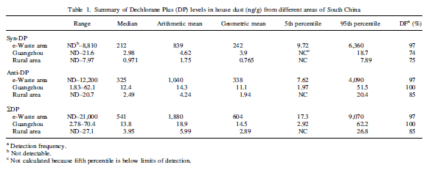
DECHLORANE PLUS IN HOUSE DUST FROM E-WASTE RECYCLING AND URBAN
AREAS IN SOUTH CHINA: SOURCES, DEGRADATION, AND HUMAN EXPOSURE
JING WANG et al
Notes:
Abstract—Dechlorane Plus (DP) was measured in house dust from e-waste recycling and from urban and rural areas of South China,
with geometric mean concentrations of 604, 14.5, and 2.89 ng/g, respectively. Dechlorane Plus in house dust in the e-waste area
originated from e-waste recycling activities, whereas household appliances served as a major source of DP in urban house dust. The
isomer ratios ( fanti) of DP in most dust samples from the e-waste area were significantly lower than those in the urban and rural dust
samples and the commercial mixture. Several [1CltH] and [2Clt2H] dechloro-DPs were identified in house dust from the e-waste
area, and an a-Cl11 DP was qualified with concentrations of<55.1 ng/g. Photolytic degradation experiments were conducted by exposing
anti-DP, syn-DP, and commercial DP solutions to ultraviolet (UV) light. The slight difference in isomeric half-life derived by
photodegradation, as well as the lower fanti values in the e-waste combusted residue, suggest a significant influence of isomer-specific
thermal degradation of DP during e-waste burning on isomer composition in house dust in the e-waste area. The average estimated daily
intakes (EDIs) of DP via house dust ranged from 0.06 to 30.2 ng/d for adults and 0.14 to 121 ng/d for toddlers in the studied area. The
average EDIs of a-Cl11 DP for adults and toddlers in the e-waste area were 0.07 and 0.18 ng/d, respectively. Environ. Toxicol. Chem.
2011;30:1965–1972. # 2011 SETAC

Slide 77
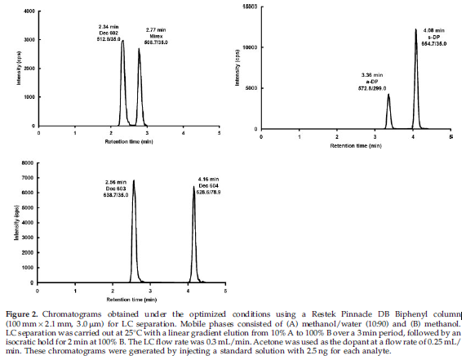
Liquid chromatography/atmospheric pressure photoionization
tandem mass spectrometry for analysis of Dechloranes
LC separation
Simon Ningsun Zhou et al
Notes:
Liquid chromatography/atmospheric pressure photoionization tandem mass spectrometry (LC/APPI-MS/MS) was
investigated as an instrumental method for the analysis of the halogenated norbornene flame retardants, Mirex,
Dechloranes 602, 603, 604, and Dechlorane Plus (DP). The LC separation was optimized by screening a variety of
stationary and mobile phases, resulting in a short LC separation time of 5 min. Different atmospheric pressure
ionization approaches were examined including electrospray ionization, atmospheric pressure chemical ionization,
and APPI, each with and without post-column addition. APPI without post-column addition was chosen for
providing the best ionization response. The optimized LC/APPI-MS/MS approach resulted in instrument detection
limits ranging between 25 and 50 pg. Good linearity was also achieved (up to 25.0 ng/mL; R >0.999). The method was
applied to extracts of environmental samples including surface water, fish and sediments for screening purposes, and
the results agreed well with those obtained by gas chromatography/mass spectrometry. Copyright 2011 John Wiley
& Sons, Ltd.

Slide 78
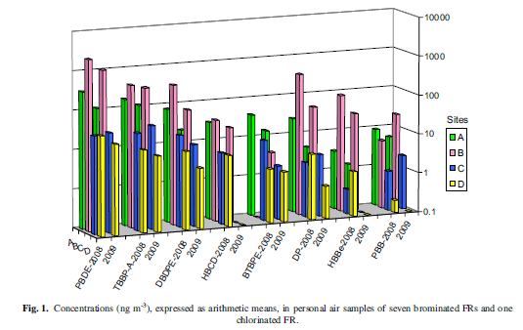
Exposure to Flame Retardants in Electronics Recycling Sites
CHRISTINA ROSENBERG et al
Notes:
Waste electrical and electronic equipment (WEEE) contains various hazardous substances
such as flame retardants (FRs). Inhalation exposures to many FRs simultaneously among
WEEE recycling site workers have been little studied previously. The breathing zone airborne
concentrations of five brominated FR compounds tetrabromobisphenol-A (TBBP-A), decabromodiphenylethane
(DBDPE), hexabromocyclododecane, 1,2-bis(2,4,6-tribromophenoxy)-
ethane, hexabromobenzene, and one chlorinated FR (Dechlorane Plus) were measured at
four electronics recycling sites in two consecutive years. In addition, concentrations of polybrominated
diphenyl ethers (PBDEs) and polybrominated biphenyls were measured. The
three most abundant FRs in personal air samples were PBDEs (comprising mostly of deca-
BDE), TBBP-A, and DBDPE, with mean concentrations ranging from 21 to 2320 ng m23, from
8.7 to 430 ng m23, and from 3.5 to 360 ng m23, respectively. At two of the sites, the emission
control actions (such as improvements in ventilation and its maintenance and changes in cleaning
habits) proved successful, the mean levels of FRs in personal samples being 10–68 and 14–
79% of those from the previous year or alternatively below the limit of quantification. At the
two remaining sites, the reductions in FR exposures were less consistent. The concentrations
reported may pose a health hazard to the workers, although evaluation of the association between
FR exposure and adverse health effects is hampered by lacking occupational exposure
limits. Therefore, the exposures should be minimized by adequate control measures and maintaining
good occupational hygiene practice.

Slide 79
Exposure to Flame Retardants in Electronics Recycling SitesAtmospheric deposition of persistent organic pollutants and chemicals of emerging concern at two sites in northern Sweden
Mean standard deviation of monthly deposition fluxes of quantified compounds calculated from total fluxes over the entire sampling period and adjusted for the size of the sampler
(ng /m²/month)
Abisko 22±21
Krycklan 1.1±0.52
Pallas 0.52–0.76
Rao 3.3–10
Aspvreten 4.6–12
Lake Superior 2.9
Seth Newton et al
Notes:
Bimonthly bulk atmospheric deposition samples (precipitation + dry particle) were taken for one year at an
arctic (Abisko, 68200 N, 19030 E) and a sub-arctic (Krycklan 64140 N, 19460 E) location in northern Sweden
using Amberlite IRA-743 as an absorbent for hydrophobic pollutants. The samples were analyzed by gas
chromatography-high resolution mass spectrometry (GC-HRMS) for polychlorinated biphenyls (PCBs),
legacy organochlorine pesticides (OCPs . hexachlorocyclohexanes and chlordane-related compounds),
polybrominated diphenyl ethers (PBDEs) and emerging chemicals. Higher deposition rates of most
compounds were observed at the more northern site despite its receiving less precipitation and being
more remote. HCHs and PCBs made up the bulk of the total deposition at both sites. Five emerging
chemicals were detected: the current-use pesticides trifluralin and chlorothalonil; and non-BDE flame
retardants 1,2-dibromo-4-(1,2-dibromoethyl)cyclohexane (TBECH), 1,2-bis(2,4,6-tribromophenoxy)
ethane (BTBPE), and Dechlorane Plus (DP). A decrease in the fraction of the anti isomer of DP was
observed at the arctic site, indicating isomer-selective degradation or isomerization during long range
transport. Air parcel back trajectories revealed a greater influence from air originating over the ocean at
the more northern site. The differences in these air sources were reflected in higher PHCH to PPCB
ratios compared to the more southern site, as HCHs are related to volatilization from the ocean and
Abisko is located <100 km from the Norwegian coast, while PCBs are emitted from continental sources.

Slide 80
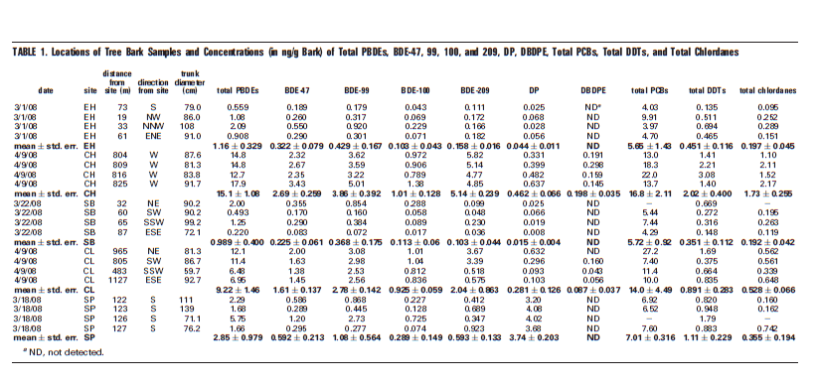
Evaluation of Tree Bark as a Passive Atmospheric Sampler for Flame Retardants, PCBs, and Organochlorine Pesticides
AMINA SALAMOVA et al
Notes:
To investigate the relationship between the levels of persistent
organic pollutants in tree bark (a passive sampler) and
those in air and precipitation, tree bark and air and precipitation
samples were collected during the same time period at the
five U.S. Integrated Atmospheric Deposition Network (IADN)
sites located in Great Lakes basin. The concentrations of
polybrominated diphenyl ethers, Dechlorane Plus, decabromodiphenyl
ethane, polychlorinated biphenyls, DDTs, and
chlordanes were measured in these samples. Overall, the
pollutant concentrations in tree bark are significantly related
to the concentrations of these compounds in the air and
precipitation collected where the tree was growing. Generally,
the highest tree bark and air pollutant concentrations were
observed at urban sites, and the lowest concentrations were
observed at remote sites. The overall correlation between bark
and atmospheric and precipitation concentrations for all the
compounds measured in this study was highly significant (P <
0.0001) over 3-4 orders of magnitude. In addition, bark-air
partition coefficients, measured for all the chemical categories
in this study, were about 106, which was in good agreement
with previously estimated bark-air partition coefficients
for corresponding pollutant groups.

Slide 81

Brominated and Chlorinated Flame Retardants in Tree Bark from
Around the Globe
Amina Salamova et al
Notes:
ABSTRACT: Brominated and chlorinated flame retardants were measured in about 40 samples of
tree bark from 12 locations around the globe. The analytes were polybrominated diphenyl ethers
(PBDE), Dechlorane Plus (DP), decabromodiphenylethane (DBDPE), hexabromocyclododecane
(HBCD), hexabromobenzene (HBB), pentabromoethylbenzene (PBEB), pentabromobenzene
(PBBz), and tetrabromo-p-xylene (pTBX). The highest concentrations of these compounds were
detected at an urban site in Downsview, Ontario, Canada. Total PBDE and DP concentrations
ranged from 2.1 to 190 ng/g lipid weight and from 0.89 to 48 ng/g lipid weight, respectively.
Relatively high levels of DP (46 ± 4 ng/g lipid weight) were found at a remote site at Bukit
Kototabang in Indonesia. The concentrations of total PBDE, DP, PBEB, and HBCD in the tree bark
samples were significantly associated with human population in the nearby areas (r2 = 0.21−0.56;
P < 0.05). In addition, the concentrations of total PBDE and DP were significantly associated (r2 =
0.40−0.64; P < 0.05). with the corresponding atmospheric concentrations of these compounds over
a concentration range of 2−3 orders of magnitude.

Slide 82
After the PBDE Phase-Out: A Broad Suite of Flame Retardants in
Repeat House Dust Samples from California
ng/g dust
LOQ >LOQ min med max >LOQ min med max
% %
Robin E. Dodson et al
Notes:
ABSTRACT: Higher house dust levels of PBDE flame retardants (FRs) have been reported in California than other parts of the world, due to the state’s furniture flammability standard. However, changing levels of these
and other FRs have not been evaluated following the 2004 U.S. phase-out of PentaBDE and OctaBDE. We analyzed dust collected in 16 California homes in 2006 and again in 2011 for 62 FRs and organohalogens, which represents the broadest investigation of FRs in homes. Fifty-five compounds were detected in at least one sample; 41 in at least 50% of samples. Concentrations of chlorinated OPFRs, including two (TCEP and
TDCIPP) listed as carcinogens under California’s Proposition 65, were found up to 0.01% in dust, higher than previously reported in the U.S. In 75% of the homes, we detected TDBPP, or brominated “Tris,” which was banned in children’s sleepwear because of carcinogenicity. To our knowledge, this is the first report on TDBPP in house dust. Concentrations of Firemaster 550 components (EH-TBB, BEHTEBP, and TPHP) were higher in 2011 than 2006, consistent with its use as a PentaBDE replacement. Results highlight the evolving nature of FR exposures and suggest that manufacturers continue to use hazardous chemicals and replace chemicals of concern with chemicals with uncharacterized toxicity.

Slide 83

Assessment on the Occupational Exposure of Manufacturing
Workers to Dechlorane Plus through Blood and Hair Analysis
Haidong Zhang et al
Notes:
ABSTRACT: Dechlorane Plus (DP), as a widely used flame retardant in different electrical and textile applications, has recently attracted great concern around the world. The present study investigated the DP levels and distribution in human samples from a DP manufacturing plant and a nearby area in east China. The DP concentrations ranged from 89.8 to 2958 ng/g lipid weight in whole blood and 4.08 to 2159 ng/g dry weight in hair. For the workers engaged in DP manufacturing process, their DP levels were significantly higher
than those in most of the other two control groups from the nearby area. The values of anti-DP fractional abundance ( fanti ratio) were commonly lower in the human samples from both the manufacturing plant and nearby area compared with those in the commercial products, and excretion as well as biotransformation are possible reasons for stereoselective accumulation of the syn-DP isomer in humans. Furthermore, a significantly positive relationship (p < 0.05) was obtained between (i) the concentrations (and fanti) in the paired blood and hair samples, indicating a similar distribution pattern of the two DP isomers in the paired samples; (ii) the DP levels in human body and the exposure time (p < 0.05), which suggests that further assessment could be needed to investigate potential long-term risks to the occupational population.

Slide 84

Polybrominated Diphenyl Ethers and Alternative Flame Retardants in Air and Precipitation Samples from the Northern Lake Victoria Region, East Africa
(ng/m²/sample)
Kenneth Arinaitwe et al ( ng/m²/sample)
Notes:
ABSTRACT: High volume air and precipitation samples were collected close to the shore of Lake Victoria at Entebbe, Uganda, between October 2008 and July 2010 inclusive. Polybrominated diphenyl ethers (PBDEs) and alternative flame retardants (AFRs) were analyzed by GC−MS. BDEs 47, 99, and 209 were the predominant PBDEs with mean concentrations (in air) of 9.84, 4.38, 8.27 pg m−3 and mean fluxes in precipitation of 3.40, 6.23, and 7.82 ng m−2 sample−1, respectively. 1,2-bis(2,4,6-tribromophenoxy)ethane (BTBPE), and hexabromocyclododecane (HBCDD), anti- and syn-Dechlorane plus were detected at levels comparable with
those of PBDEs. Both PBDEs and AFRs in air generally increased from 2008 to 2010. Elevated PBDE concentrations in air were associated with slow moving low altitude air masses from the region immediately adjacent to the lake, while low concentrations were mostly associated with fast moving westerly and southwesterly air masses. Analysis of the octa and nona-BDE profiles suggested photolysis and pyrolytic debromination of BDE-209 in the air samples. The highly halogenated and most abundant PBDEs and AFRs in air also predominated in precipitation samples. This is the first study to report flame retardants in high volume air samples and precipitation in Equatorial Africa.

Slide 85


Placental transfer of Dechlorane Plus in mother–infant pairs
in an e-waste recycling area (Wenling, China)
Jie Yu Ben et al ( ng/g-lipid)
Notes:
It has been reported that breastfeeding can expose newborns to Dechlorane Plus (DP), but transplacental transfer of DP has not been documented. We measured DP and its dechlorinated analogs in matched maternal blood–placenta–cord blood samples from 72 residents of the e-waste recycling area of Wenling, China. DP was detected in cord sera, indicating the occurrence of prenatal DP exposure and the transfer of DP across the placenta. The concentration ratio in the cord serum and maternal serum, was estimated to be 0.45 for syn-DP and 0.35 for anti-DP respectively, indicating the placenta partially limited DP transfer with a greater extent for anti-DP. The DP concentrations in the maternal serum, placenta, and cord serum strongly correlated, indicating that DP could transfer between the tissues. The DP concentrations in the matched samples could be predicted from each other. The anti-DP/total DP concentration ratios in the placentas and cord sera were significantly different from those in the maternal sera, suggesting that DP stereoselectively bioaccumulates in human tissues. When the congener concentrations of polybrominated diphenyl ethers (PBDEs) were used as control variables, DP and total triiodothyronine concentrations associated in the sera from mothers who had lived in Wenling for over 20 years.

Slide 86


Identification and Determination of Hexachlorocyclopentadienyl-
Dibromocyclooctane (HCDBCO) in Residential Indoor Air and Dust: A
Previously Unreported Halogenated Flame Retardant in the Environment
JIPING ZHU et al
Notes:
Hexachlorocyclopentadienyl-dibromocyclooctane (HCDBCO, CAS 51936-55-1) has been detected in residential indoor air and indoor dust in Ottawa, Canada. The positive identification of the chemical wasbased on the interpretation of the mass spectra of the chemical obtained under both electron impact and negative chemical ionization operation modes, as well as through the synthesis of this chemical. This is the first report on the
presence of HCDBCO in the environment. Although the levels of HCDBCO in indoor dust, with a geometric mean of 2.7 ng g-1 and a median of 2.0 ng g-1 respectively, are generally low compared to those of polybrominated diphenyl ethers (PBDEs) and dechlorane plus, another recently detected flame
retardant, high levels of HCDBCO were detected in several dust samples with a maximum level of 93,000 ng g-1 which is 16 times higher than the maximum level of the structurally related dechlorane plus. On the other hand, levels of HCDBCO in indoor air, with a geometric mean of 70 pg m-3 and a median of 92 pg m-3, were higher than those of the major PBDE congeners. The maximum level of HCDBCO found in indoor air was 3000 pg m-3. Structurally, HCDBCO belongs to a group of norbornane based halogenated flame retardants. The
presence of HCDBCO in the indoor environment may raise awareness of the potential release of this and related flame retardants into the environment during the production and usage of products that contain them, and the potential implications of human exposure to these chemicals as people spend the majority of their time indoors in modern society.

Slide 87

Flame retardants are the suspected source of a new compound in the environment
Ed Sverko et al
Notes:
Ed Sverko didn’t set out to find a new compound bioaccumulating in fish when he and a group of Canadian colleagues began looking at a Lake Ontario sediment core sample to collect data on how the concentrations
of the widely used Dechlorane Plus (DP) flame retardant 3changed over time. But the project, which resulted
in a new ES&T research article (Environ. Sci.Technol. 2009, DOI 10.1021/es9025535) “developed on its own,” as Sverko puts it. In the process, Sverko’s group learned a great deal about how the retardant is produced, as
well as identifying a compound that may confound its analysis.

Slide 88


Flame Retardants in the Serum of Pet Dogs and in Their Food
Figure 1. (Left) Total PBDEs concentrations in ng/g ww in serum from dogs (this study), cats,13 eagles,7 women in Indiana,16 and adults.6 (Right)
Total PBDE concentrations in dog food (this study), cat food,13 and three types of human food.20 The bars represent one standard error.
Marta Venier et al
Notes:
ABSTRACT: A previous study from our laboratory showed that pet cats had much higher
serum levels of flame retardants compared to humans, despite sharing the same household
environment. Dogs, on the other hand, are expected to have lower serum levels of flame
retardants because they are metabolically better equipped to degrade these compounds.
Thus, we hypothesized that dogs might be more similar to humans in their response to
these environmental stressors and be better indicators of human exposures to these
contaminants. Serum samples and their food were collected from 18 dogs and analyzed for
PBDEs and other emerging flame retardants. The concentrations of PBDEs in dog serum
and dog food averaged 1.8 ( 0.4 ng/g wet weight (ww) and 1.1 ( 0.2 ng/g ww,
respectively. While the dog serum samples were dominated by the tetra to hepta BDE
congeners, BDE-209 was the most abundant congener in the dog food. This difference in
congener pattern was analyzed in terms of half-lives. Assuming food as the main exposure
source, the average half-life in dog serum was 450 ( 170 days for the less brominated
congeners and 2.3 ( 0.5 days for BDE-209. Dust was also considered as an additional
exposure source, giving unreasonable residence times. In addition to PBDEs, other flame
retardants, including Dechlorane Plus, decabromodiphenylethane, and hexabromocyclododecane,
were identified in these samples.

Slide 89

Concentrations and Trends of Halogenated Flame Retardants in the Pooled Serum of Residents of Laizhou Bay, China
SONGJIE HE et al
Notes:
Abstract: The south coast of Laizhou Bay, in northeastern China, is a production area for halogenated flame retardants (HFR). In 2007, the authors measured serum concentrations of polybrominated diphenyl ethers (PBDEs) in Laizhou Bay residents. To assess the PBDE concentration trend, and determine the concentrations of the emerging flame retardants Dechlorane Plus (DP) and bis(2-ethylhexyl)-3,4,5,6-tetrabromophthalate (TBPH), the authors measured the concentrations of 8 PBDE congeners, 2 DP isomers, and TBPH in 10 composite samples, which were pooled from the serum collected from 305 Laizhou Bay residents in October 2011. The average concentration of the total PBDE (P8PBDE) concentration in all serum pools was 240 ng/g lipid weight, and the highest serum pool concentration (in the 30- to 39-yr-old male group) was 780 ng/g lipid weight. Brominated diphenyl ether-209 was the dominant congener, accounting for 87% ofP8PBDE. Compared with a previous study,P8PBDE serum concentrations in the present study showed no change in order of magnitude, but the relative contribution of BDE-209 to P8PBDE was higher. The average concentration of PDP in all serum pools was 3.6 ng/g lipid weight, ranging from 1.4 ng/g lipid weight (in the 50- to 59-yr-old male group) to 11 ng/g lipid weight (in the 20- to 29-yr-old male group). The concentration of DP was lower than in other reported studies. The study also detected TBPH in the 30- to 39-yr-old female group, suggesting that TBPH, as an emerging HFR, requires further monitoring. Environ Toxicol Chem 2013;32:1242–1247.

Slide 90


Dechlorane plus monoadducts in a lake ontario (canada) food web and
biotransformation by lake trout (salvelinus namaycush) liver microsomes
GREGG T. TOMY et al
Notes:
Abstract: Compounds related to the high-production-volume flame retardant Dechlorane Plus (DP) were measured in a Lake Ontario food web located downstream of a DP manufacturing plant. These compounds, 1,3- and 1,5-DP-monoadducts (DPMA), are positional isomers and are thought to arise from the incomplete reaction of DP or impurities in the DP starting material during its manufacture. The 1,3-DPMA isomer was measured (0.12–199 ng g1 lipid wt) in all trophic levels, whereas 1,5-DPMA was measured only sporadically in the food web and was not detectable in the apex predator, lake trout (Salvelinus namaycush). Concentrations of DPMA isomers when detected in Lake Ontario biota were greater than that of total DP for all trophic levels. The prevalence of 1,3-DPMA in the food web, and especially in lake trout, may be due to obstruction of the existing carbon double bond to enzyme attack, rendering it less readily metabolized. To examine this hypothesis, biotransformation kinetic experiments using in vitro lake trout liver microsomal exposures were performed. Zero-order depletion rate constants for 1,3- and 1,5-DPMA were 92.2 and 134.6 pmole h1, respectively, with corresponding half-lives of 2.03 0.14 h (1,3-DPMA) and 1.39 0.09 h (1,5-DPMA). Furthermore, the 1,5-isomer was depleted to a greater extent than 1,3-DPMA. Specific biotransformation products were not identified. These data support the hypothesis that 1,5-DPMA is more readily metabolized than 1,3-DPMA by lake trout. The present study also shows that the concentrations of these isomers, which the authors speculate might be unintended impurities or byproducts in some technical DP formulations, exceed that of the intended product in biota. Environ Toxicol Chem 2013;32:1376–1381. # 2013 SETAC

Slide 91

Identification and determination of the dichlorination products
of Dechlorane 602 in Great Lakes fish and Arctic beluga whales
by gas chromatography–high resolution mass spectrometry
Li Shen et al
Notes:
Abstract During the course of our studies of in-use chlorinated flame retardants, such as Dechlorane Plus® and Dechloranes 602 and 604, blubber of beluga whales from the Canadian Arctic and lake trout and whitefish from the North American Great Lakes were found to contain two novel dechlorination products of Dechlorane 602 (Dec602). The structures of these compounds were characterized by experiments performed using both gas chromatography–high resolution mass spectrometry and Fourier transform mass spectrometry with a prepared technical mixture of monohydro and dihydroDec602 derivatives. TheseDec602 derivatives are analogous to the well-known monohydro and dihydro photochemical degradation products of Mirex. The ratio of the two monohydroDec602 diastereomers varied between Lake Ontario fish and those from the upper lakes, but only one isomer was found in Arctic beluga, indicating that one isomer is either more stable or more bioaccumulative. Dechlorane Plus®, Dec603, and Dec 604 were not detected in Arctic beluga, but Dec602 and its monohydroDec602 derivative were measured in approximately equal concentrations, ranging from 25 to 300 pg/g lipid. In Great Lakes fish, concentrations of the monohydroDec602 derivatives were also close
to those of Dec602, ranging from 2 to 67 ng/g lipid and were greatest in Lake Ontario. This study reports on the first measurements of dechlorane-related compounds inArctic biota and the first detection of monohydroDec602 degradation products and their accumulation in biota.

Slide 92


Li Shen et al
Notes:
Abstract During the course of our studies of in-use chlorinated flame retardants, such as Dechlorane Plus® and Dechloranes 602 and 604, blubber of beluga whales from the Canadian Arctic and lake trout and whitefish from the North American Great Lakes were found to contain two novel dechlorination products of Dechlorane 602 (Dec602). The structures of these compounds were characterized by experiments performed using both gas chromatography–high resolution mass spectrometry and Fourier transform mass spectrometry with a prepared technical mixture of monohydro and dihydroDec602 derivatives. TheseDec602 derivatives are analogous to the well-known monohydro and dihydro photochemical degradation products of Mirex. The ratio of the two monohydroDec602 diastereomers varied between Lake Ontario fish and those from the upper lakes, but only one isomer was found in Arctic beluga, indicating that one isomer is either more stable or more bioaccumulative. Dechlorane Plus®, Dec603, and Dec 604 were not detected in Arctic beluga, but Dec602 and its monohydroDec602 derivative were measured in approximately equal concentrations, ranging from 25 to 300 pg/g lipid. In Great Lakes fish, concentrations of the monohydroDec602 derivatives were also close
to those of Dec602, ranging from 2 to 67 ng/g lipid and were greatest in Lake Ontario. This study reports on the first measurements of dechlorane-related compounds inArctic biota and the first detection of monohydroDec602 degradation products and their accumulation in biota.

Slide 93


Li Shen et al
Notes:
Abstract During the course of our studies of in-use chlorinated flame retardants, such as Dechlorane Plus® and Dechloranes 602 and 604, blubber of beluga whales from the Canadian Arctic and lake trout and whitefish from the North American Great Lakes were found to contain two novel dechlorination products of Dechlorane 602 (Dec602). The structures of these compounds were characterized by experiments performed using both gas chromatography–high resolution mass spectrometry and Fourier transform mass spectrometry with a prepared technical mixture of monohydro and dihydroDec602 derivatives. TheseDec602 derivatives are analogous to the well-known monohydro and dihydro photochemical degradation products of Mirex. The ratio of the two monohydroDec602 diastereomers varied between Lake Ontario fish and those from the upper lakes, but only one isomer was found in Arctic beluga, indicating that one isomer is either more stable or more bioaccumulative. Dechlorane Plus®, Dec603, and Dec 604 were not detected in Arctic beluga, but Dec602 and its monohydroDec602 derivative were measured in approximately equal concentrations, ranging from 25 to 300 pg/g lipid. In Great Lakes fish, concentrations of the monohydroDec602 derivatives were also close
to those of Dec602, ranging from 2 to 67 ng/g lipid and were greatest in Lake Ontario. This study reports on the first measurements of dechlorane-related compounds inArctic biota and the first detection of monohydroDec602 degradation products and their accumulation in biota.

Slide 94

The use of mass defect plots for the identification of (novel)
halogenated contaminants in the environment
Karl J. Jobst et al
Notes:
Abstract Mass defect is the difference between the nominal and exact mass of a chemical element or compound. An intrinsic property of polyhalogenated molecules is a uniquely negative mass defect, which readily distinguishes halogenated from non-halogenated compounds in a complex mass spectrum and can be visualized by constructing a mass defect plot. This study demonstrates the utility of the mass defect plot as a powerful tool to screen gas-chromatography (ultra)high-resolution mass spectrometry data for potentially
toxic and bioaccumulative halogenated compounds in a Lake Ontario lake trout, an apex species in the Great Lakes environment. Our results indicate that the sample is contaminated with polychlorinated biphenyls, terphenyls, diphenylethers, as well as other chlorinated pesticides and flame retardants that are regulated and routinely analyzed by traditional target analyses. However, the mass defect plot also displays peaks which could be traced to the presence of as yet undiscovered contaminants. These include chlorinated polycyclic aromatic hydrocarbons as well as mixed halogenated analogues of the flame retardant Dechlorane 604. The
identity of the latter class of compounds is supported by experiments with genuine standards.

Slide 95

Karl J. Jobst et al
Notes:
Abstract Mass defect is the difference between the nominal and exact mass of a chemical element or compound. An intrinsic property of polyhalogenated molecules is a uniquely negative mass defect, which readily distinguishes halogenated from non-halogenated compounds in a complex mass spectrum and can be visualized by constructing a mass defect plot. This study demonstrates the utility of the mass defect plot as a powerful tool to screen gas-chromatography (ultra)high-resolution mass spectrometry data for potentially
toxic and bioaccumulative halogenated compounds in a Lake Ontario lake trout, an apex species in the Great Lakes environment. Our results indicate that the sample is contaminated with polychlorinated biphenyls, terphenyls, diphenylethers, as well as other chlorinated pesticides and flame retardants that are regulated and routinely analyzed by traditional target analyses. However, the mass defect plot also displays peaks which could be traced to the presence of as yet undiscovered contaminants. These include chlorinated polycyclic aromatic hydrocarbons as well as mixed halogenated analogues of the flame retardant Dechlorane 604. The
identity of the latter class of compounds is supported by experiments with genuine standards.

