Slide 1
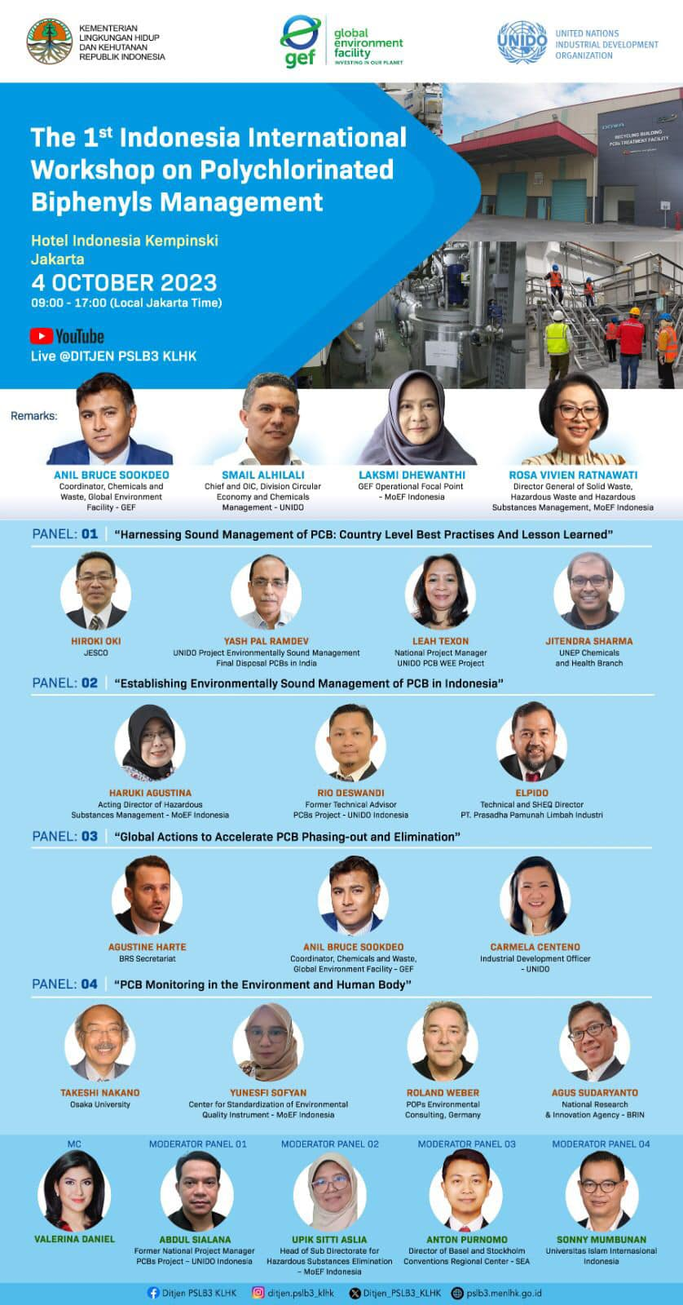

Slide 2


PCB Monitoring in the Environment
and Human Body
Takeshi Nakano
Research Center for Environmental Preservation, Osaka Univ.
Biosignal Research Ceenter, Kobe Univ.

Slide 3
“Kanemi Yusho”
“Kanemi Yusho” was mainly caused by PCDFs transformed from heated PCB during the deodorization process of rice bran oil in the Kanemi Warehouse, Kitakyushu, Japan (1968) .
Approximately 15 thousand people suffered from various illnesses, especially in the skin, liver, kidney among others. “Kanemi Yusho” is considered to be the greatest food disaster in Japan.
The sale of “Kanemi rice bran oil” was terminated within a half year after the incidence of “Kanemi Yusho” .
Shibuya et al, Epigenetic Inheritance Symposium 2023
Impact for Biology and Society , 23－25 Aug, ETH Zurich, Switzerland
Notes:
“Kanemi Yusho” was mainly caused by PCDFs transformed from heated PCB during the deodorization process of rice bran oil in the Kanemi Warehouse, Kitakyushu, Japan (1968) .
Approximately 15 thousand people suffered from various illnesses, especially in the skin, liver, kidney among others. “Kanemi Yusho” is considered to be the greatest food disaster in Japan.
The sale of “Kanemi rice bran oil” was terminated within a half year after the incidence of “Kanemi Yusho” .
In the second and third generations after “Kanemi Yusho”, symptons similar to those in the first generation also appeared with high incidences.
“Research and Clinical Center for Yusho and Dioxin” started generational analysis based on the interview to patients (From 2021).
It is very important to solve the generational problems of “Kanemi Yusho” occurring through TEI to treat and estimate the impact on future generations.
「カネミ油症」は、北九州市のカネミ倉庫で米ぬか油の脱臭工程中に加熱されたPCBから変化したPCDFが主な原因であった（1968年）。
約15,000人が、特に皮膚、肝臓、腎臓などの様々な病気に苦しんだ。「カネミ油症」は日本最大の食品災害と言われている。
カネミ米ぬか油」は「カネミ油庄」発生後、半年で販売中止となった。
「カネミ油症」発生後の第2世代、第3世代でも、第1世代と同様の症状が高い頻度で出現した。
「油症・ダイオキシン研究臨床センター」では、患者への聞き取り調査をもとに世代分析を開始した（2021年～）。
TEIを通じて発生した「カネミ油症」の世代間問題を解決し、治療や将来世代への影響を推定することは非常に重要である。
将来へ向けての新たなメッセージ
新たな視点
Transgenerational Epigenetic Inheritance
Epigenetic Inheritance: Concepts, Mechanisms and Perspectives

Slide 4
“Kanemi Yusho”
In the second and third generations after “Kanemi Yusho”, symptons similar to those in the first generation also appeared with high incidences.
“Research and Clinical Center for Yusho and Dioxin” started generational analysis based on the interview to patients (From 2021).
It is very important to solve the generational problems of “Kanemi Yusho” occurring through TEI（Transgenerational epigenetic inheritance) to treat and estimate the impact on future generations.
Shibuya et al, Epigenetic Inheritance Symposium 2023
Impact for Biology and Society , 23－25 Aug, ETH Zurich, Switzerland
Notes:
“Kanemi Yusho” was mainly caused by PCDFs transformed from heated PCB during the deodorization process of rice bran oil in the Kanemi Warehouse, Kitakyushu, Japan (1968) .
Approximately 15 thousand people suffered from various illnesses, especially in the skin, liver, kidney among others. “Kanemi Yusho” is considered to be the greatest food disaster in Japan.
The sale of “Kanemi rice bran oil” was terminated within a half year after the incidence of “Kanemi Yusho” .
In the second and third generations after “Kanemi Yusho”, symptons similar to those in the first generation also appeared with high incidences.
“Research and Clinical Center for Yusho and Dioxin” started generational analysis based on the interview to patients (From 2021).
It is very important to solve the generational problems of “Kanemi Yusho” occurring through TEI to treat and estimate the impact on future generations.
「カネミ油症」は、北九州市のカネミ倉庫で米ぬか油の脱臭工程中に加熱されたPCBから変化したPCDFが主な原因であった（1968年）。
約15,000人が、特に皮膚、肝臓、腎臓などの様々な病気に苦しんだ。「カネミ油症」は日本最大の食品災害と言われている。
カネミ米ぬか油」は「カネミ油庄」発生後、半年で販売中止となった。
「カネミ油症」発生後の第2世代、第3世代でも、第1世代と同様の症状が高い頻度で出現した。
「油症・ダイオキシン研究臨床センター」では、患者への聞き取り調査をもとに世代分析を開始した（2021年～）。
TEIを通じて発生した「カネミ油症」の世代間問題を解決し、治療や将来世代への影響を推定することは非常に重要である。
将来へ向けての新たなメッセージ
新たな視点
Transgenerational Epigenetic Inheritance
Epigenetic Inheritance: Concepts, Mechanisms and Perspectives

Slide 5
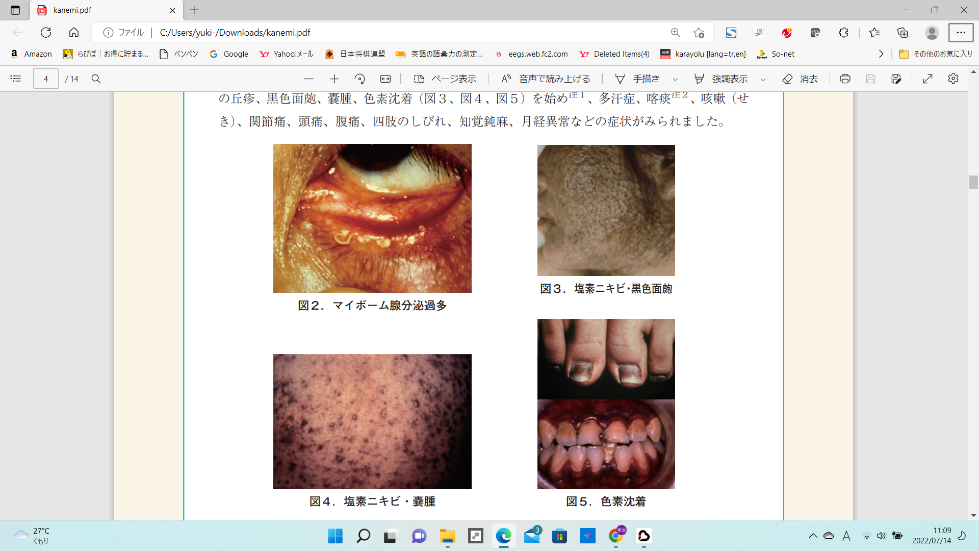
Symptoms of “Kanemi Yusho” (F0 generation)
Chlorine acne, black comedones
Meibomian gland hypersecretion
Chlorine acne, cyst
Pigmentation
(Guidance for Kanemi Yusho ― Symptoms and treatment ;
Research and Clinical Center for Yusho and Dioxin (2020)

Slide 6
Time trend of PCB level in ambient air (log scale) (1974-2000)

Slide 7
PCB level of ambient air（ng/m³）
Prohibition of manufacture
and use (1972)
Time trend of PCB level in air
Notes:
PCB levels in air samples in Japan. In 1974, the atmospheric PCB level, which was 100 ng/m3, dropped to 10 ng/m3 a few years after the prophibition of PCB use, and to the level of 1 ng/m3 10 years later, recently, it had dropped to less than 0.1 ng/m3. It was 1/1000 of the 1970’ highest period.

Slide 8
Time trend of PCB level in ambient air (2002-2017) MOE Japan

Slide 9
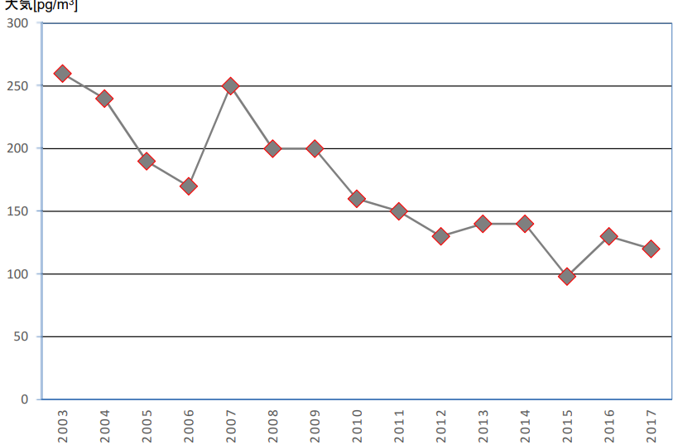
0.1ng/m3
Trend of PCB level in air (2003-2017) MOEJ
Notes:
PCB concentration in the environment in the recent 15 years (2002-2017) has been decreasing.

Slide 10
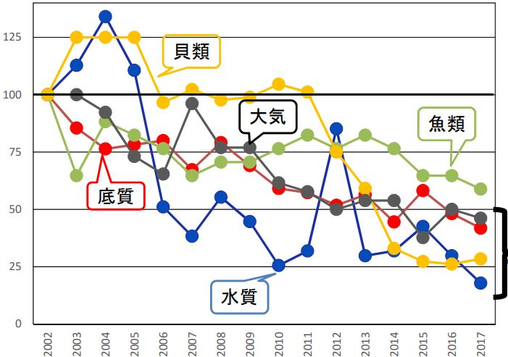
shellfish
Air
fish
sediment
water
Time trend of PCB level (2002-2017) MOEJ
Notes:
In particular, the decreasing trend of water, sediment, shellfish and air is statistically significant, and it has decreased by less than half in about 15 years.

Slide 11
Time trend of PCB level in breast milk (1973-2000)

Slide 12
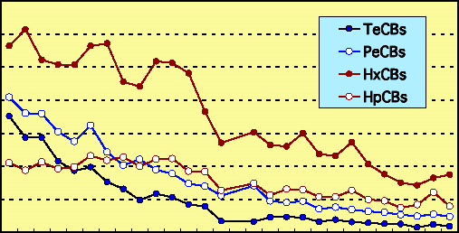
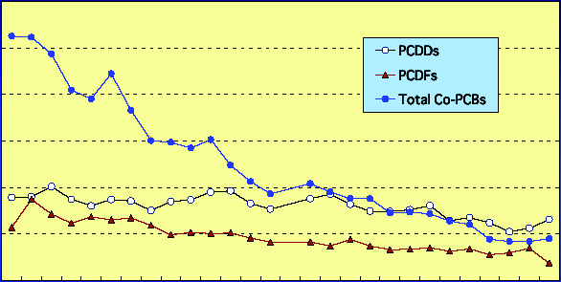
Time trend of breast milk levels
µg / g-fat
0.3
0.2
0.1
0
µg g-fat
PCB
60
40
20
0
60
40
20
0
pg TEQ/g-fat
pg TEQ/g-fat
Dioxins
Year (1973-2000)
Year (1973-2000)
Konishi et al. (2003)
Konishi et al (2003) Organohalogen compds
Notes:
Regarding PCB concentration levels in breast milk from 1973 to 2000, A clear decreasing trend was observed, reflecting decreasing concentration levels in the environment.

Slide 13
PCB congener profile in environmental and human samples
Notes:
Regarding PCB congener composition in environmental samples and human samples, environmental samples such as water, sediment, and air are similar in composition to PCB products itself.
Only 2,4,5-chlorine substituted congener is less metabolized in human samples. It is the major congener in human samples.

Slide 14
PCB Congeners Separation mono 3 3 di 12 10 tri 24 23 tetra 42 39 penta 46 38 hexa 42 40 hepta 24 23 octa 12 12 nona 3 3 deca 1 1 Total 209 192
The Number of PCB congeners and
Notes:
Important points in PCB analysis.
Isomer analysis
What's important is,
To organize the isomers of unintentionally formed PCBs
It was unintentionally formed for various chemicals, including pigments.

Slide 15
TrCB
PCB product
¹³C- TrCB
Internal standard
Congener soescific Analysis of TrCB (HT8-PCB)

Slide 16
PeCB
PCB product
P5CB
800000
Intensity
400000
0
20
22
24
26
28
30
32
34
36
38
Retention Time (min)
Calculated Retention Time
#104
#103
#100
#102
#121
#101
#113
#112
#119
#117
#125
#116
#111
#120
#110
#124
#109
#107
#123
#106
#118
#114
#122
#105
#127
#96
#94
#93
#98
#95
#88
#91
#92
#84
#89
#90
#99
#83
#86
#97
#87
#85
#82
#126
#108
#115
¹³C- PeCB
13C-P5CB
Internal Standard
50000
Intensity
0
20
22
24
26
28
30
32
34
36
38
Retention Time (min)
Congener soescific Analysis of PeCB (HT8-PCB)

Slide 17
PCB product
Sediment
Environmental
Sea water
Breast milk
human
Adipose tissue
Distribution of HxCB isomers
in environmental and human samples
Notes:
Distribution of HxCB isomers in environmental and human samples

Slide 18
Environmental
human
Distribution of HpCB isomers
Congener profiles of PCBs(Hepta-) in environmental and human samples

Slide 19
PCB congener profile in human samples (blood)

Slide 20
Levels of the predominant PCB congeners in human blood
(n=24)
Congeners
Mean
±
2S.D.
Existence Ratio*
cumulative
(%)
22.3
34.1
42.4
49.0
54.5
59.6
63.4
67.0
70.3
73.3
75.6
(BZ#)
(ng /g-lipid)
(%)
245-245
#153
28.0
±
28.0
22.3
245-2345
#180
14.9
±
16.6
11.8
245-234
#138
10.4
±
9.2
8.3
245-2356
#187
8.3
±
8.5
6.6
245-34
#118
6.9
±
5.9
5.5
#163,164
6.4
±
6.2
5.1
245-24
#99
4.7
±
4.2
3.8
245-4
#74
4.6
±
2.6
3.6
245-235
#146
4.1
±
3.7
3.3
2345-234
#170
3.8
±
4.1
3.0
2345-34
#156
2.8
±
3.0
2.3
Sum
75.6
*
Mean is compare to total PCBs level
Hirai et al, (2003) Organohalogen compounds

Slide 21
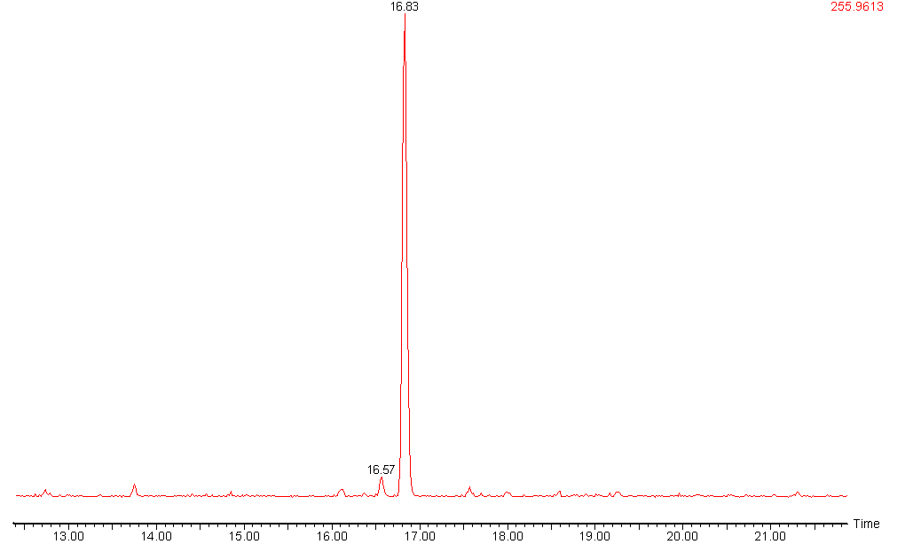
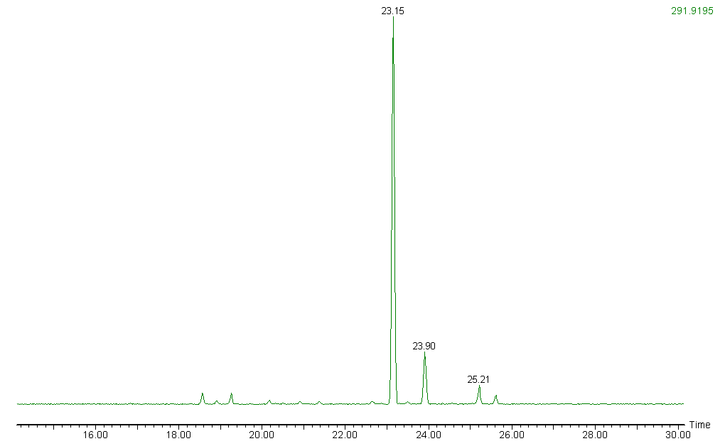
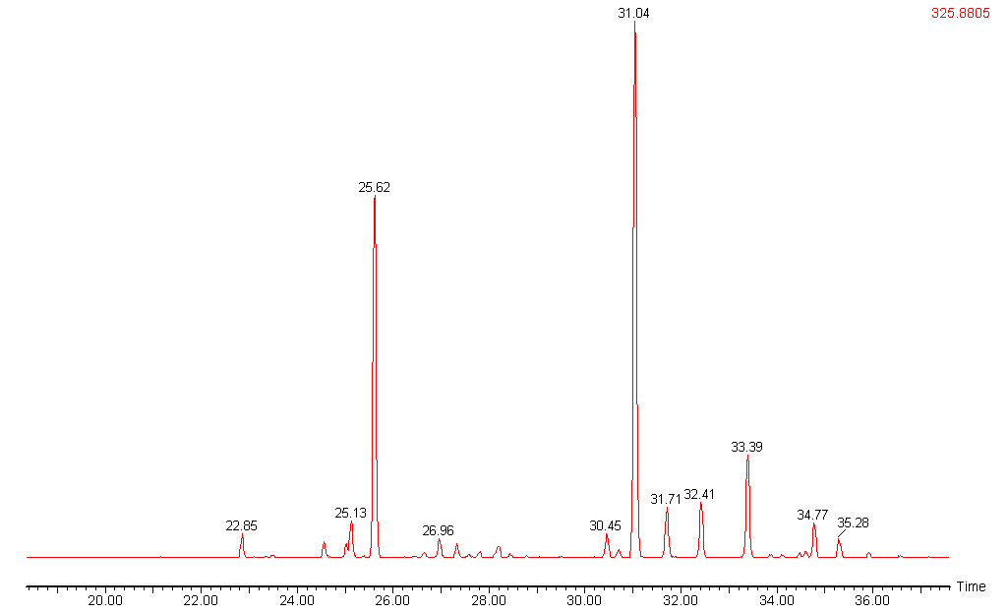
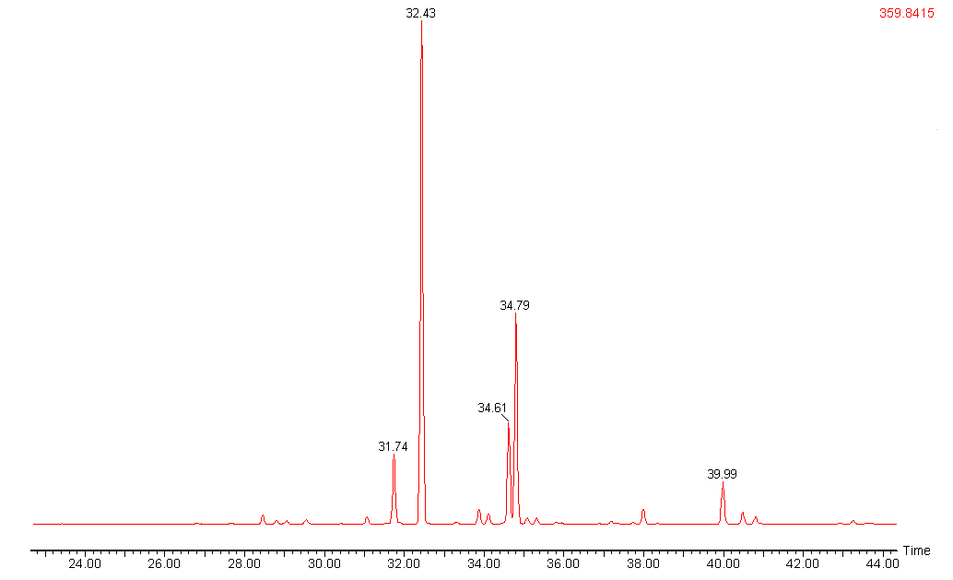
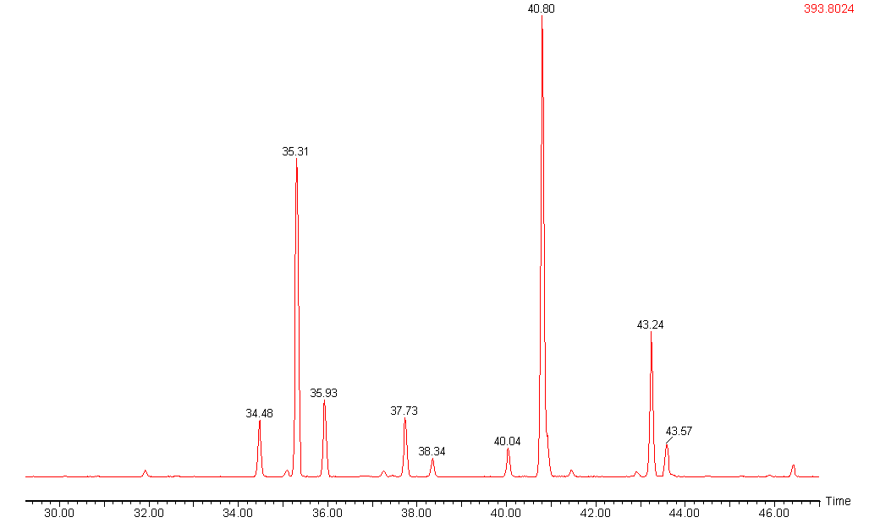
#28
Tri-CBs
＃28
24-4
＃31
Tetra-CBs
#74
245-4
＃74
＃80
Penta-CBs
#99
245-34
#118
＃99
＃118
245-24
Hexa-CBs
＃153
245-234
#153
245-245
＃163/
＃164
#138
＃138
Hepta-CBs
#187
＃180
＃187
245-2345
#180
245-2356
＃170
Chromatogram of PCB in human blood （3~7Cl）
Hirai et al, (2003) Organohalogen compounds

Slide 22
Breast milk/adipose tissue/blood
#153
(2,2',4,4',5,5'-)
#74
(2,4,4',5-)
#138
(2,2',3,4,4',5'-)
#99 (2,2',4,4',5-)
#187
(2,2',3,4',5,5',6-)
#118
(2,3',4,4',5-)
Main PCB congeners in human samples

Slide 23
Air, water, plankton, fish, birds, wildlife, humans Homologue profiles change widely due to differences in metabolic capacity.
Notes:
大気、水質、プランクトン、魚、鳥、野生動物、ヒト
代謝能力の差によって、異性体の組成が大きく異なります。
Important points in PCB analysis.
Isomer analysis
What's important is,
The homologous composition of each source
Estimation of origin by isomer composition
To organize the isomers of unintentionally generated PCBs
It was unintentionally generated for various chemicals, including pigments.
It contains PCB.
iPhoneから送信

Slide 24
Fish
Air
魚
大気
Water
Shellfish
貝類
水質
Sediment
Bird
底質
鳥
Notes:
同族体組成も異なります。
分布が少しずつ高塩素側に移行しています
The homologue composition is also differs.
The distribution is gradually shifting towards the high chlorine side.

Slide 25
Source estimation
KC３００
KC５００
N.C.P.
Insulator
capacitor
Sediment A
Sediment B
KC４００
KC６００
Insulator
Ship paint
capacitor
Notes:
The homologous composition of each source
In Japan mainly 4 types of PCB produced KC300,KC400, KC500, KC600
Look, and compare profile,
Sediment –A was collected from the sampling station near the paper manufacturing company
Sediment-B was collected from near the shipyard

Slide 26
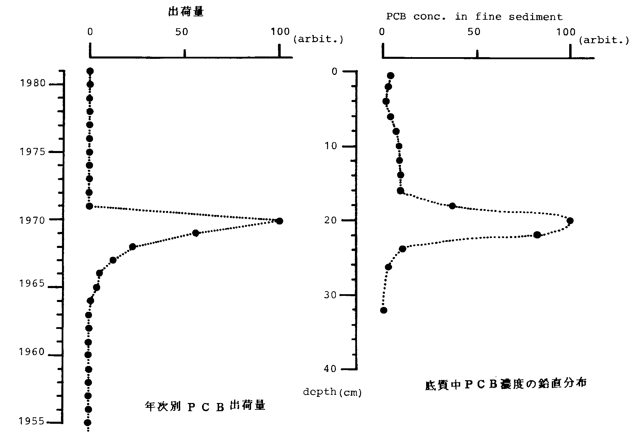
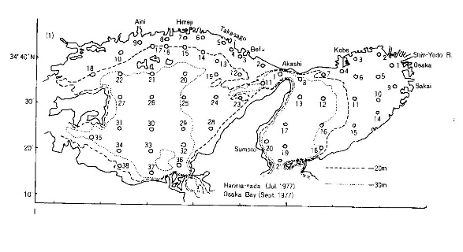
熱安定性
PCBは汚染拡散の重要な指標
化学的
環境中で分解しない。：難分解性
生物学的
使用期間10～20年の環境負荷
異性体 209 ： 情報量が多い
海域底質中PCBの鉛直分布
PCB汚染の時間的・経年変化
海域底質中PCBの水平分布
PCB汚染の空間的移動

Slide 27
PCB congener profile in human samples and environment Why are they so different?

Slide 28
Some isomers are more easily metabolized than others Because the molecular structure of PCB congeners is structurally dependent on the reaction with enzymes and various receptors

Slide 29
Dechlorination, hydroxylation, reactions occur specifically due to differences in molecular structure. The differences are caused by the magnitude of the interaction PCB with the enzyme/recepter.
Notes:
Metabolic degradation shows different dechlorination and hydroxylation activities depending on the type of cytochrom P450 subfamily."

Slide 30
Metabolic degradation shows different dechlorination and hydroxylation activities depending on the type of cytochrom P450 subfamily.
Notes:
Metabolic degradation shows different dechlorination and hydroxylation activities depending on the type of cytochrom P450 subfamily."

Slide 31
Monitoring OH-PCBs in PCB transport worker’s urine as a non-invasive exposure assessment tool Haga Y., Nakano T. et al (2017 ESPR)
Notes:
Monitoring of hydroxylated PCBs in urine is recommended for evaluating PCB exposure to confirm the safety of PCB workers.

Slide 32
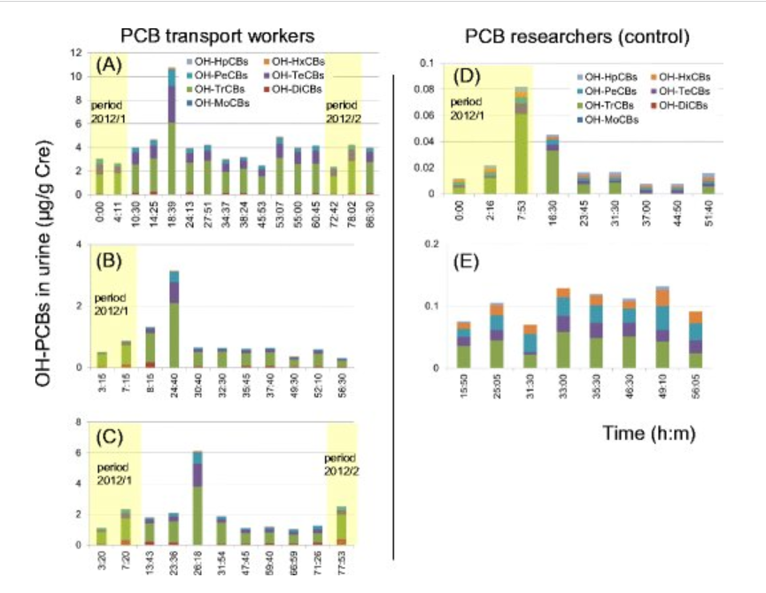

Slide 33
Thank you for your attention

Slide 34
Unintentional formation of PCB
Notes:
The interaction with RYR, which is responsible for Ca channeling in the hippocampus of the brain, causes a large difference between the r- and s-PCB
. Enantiomers by chiral recognition separation columnActual measurement of the specific rotatory degreeConfirmation of the specific rotatory degree by quantum chemical calculationAssignment of the absolute configuration of each fractionAssessment of the chiral separation measurement metabolic experiment toxicity of the sampleCorrespondence between the actual measurement and the calculation result

Slide 35
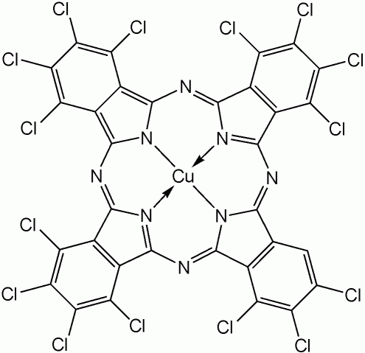
The pigments
15 azo-type
5 phthalocyanine-type pigments.
Type | Concentration levels (ppm=mg/kg) | PCB congener patterns
azo-type | PCBs: 0.16~ 740 ppm PeCBz: N.D.~ 0.018 ppm HCBz: N.D.~ 0.019 ppm DL-PCBs(#77): 0~49 pg-TEQ/g | #11, #35, and #77, or #52, #101, and #153 were found. #11 or #52 was dominant
phthalocyanine-type | PCBs: N.D.~ 0.43ppm PeCBz: 0.0057~ 8.5 ppm HCBz: 0.020~ 19 ppm | Nona-Deca chlorinated PCBs(#206, #207, #208, #209) were found. #209 was dominant.
Cl
R
N=N
N=N
R
Cl

Slide 36
Results
PCB congener profiles of
azo pigment
Notes:
- 有機顔料中の副生PCB異性体を分析し,
- pigment from 3,3’-dichlorobenzidine
contain #11, #35, #77
- pigment from 2,2’,5,5’-tetrachlorobenzidine
contain #52, #101, #153
- phthalocyanine-type pigment
#209
顔料製造の過程と密接な関連が推定された。
- 顔料中のPCBは、精製過程で残ったものと推測され、これら、副反応で生成する異性体は、排水や、廃棄物として、環境への負荷が起こる例も報告されており、負荷低減への対策も必要である。

Slide 37
azo-type pigment
PCB congener profiles of azo pigment

Slide 38

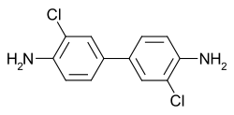
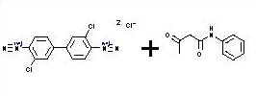
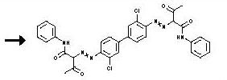
NaNO₂, HCl
3,3’-dichloro benzidine
diazonium
Ｎ－acetoacetyl aniline
diazonium
pigment production
disazo

Slide 39
CB-52(25-25)
NaNO₂, HCl
(CuCl₂)
CB-101(245-25)
2,2’,5,5’- tetrachloro benzidine
Sandmeyer reaction
Ar-N⁺≡N + CuX → Ar-X + Cu⁺ + N₂↑
CB-153(245-245)
Notes:
ザンドマイヤー反応
芳香族ジアゾニウム塩をフッ素を除くハロゲン化銅(I)あるいはシアン化銅(I)、チオシアン化銅(I)の存在下に生成させ、加温分解すると、元のアミノ基の位置が対応するハロゲンあるいはシアノ基・チオシアノ基で置き換えられた置換アリール体が得られる。この反応は1884年に発見した T. Sandmeyer に因んでザンドマイヤー反応と呼ばれる。この反応は一電子移動を含むラジカル的な機構を経て進行し、中間体としてアリール銅化合物を経由すると考えられている。
Ar-N⁺≡N + CuX → Ar-X + Cu⁺ + N₂↑ (X = Cl, Br, CN, SCN) ハロゲンがフッ素の場合はフッ化銅(II)がフッ化銅(I)に比べて安定なため反応が進行しない（フッ化銅(I) は放置すると不均化を起こしてフッ化銅(II)と金属銅となる）。

Slide 40
2,2’,5,5 ’- tetrachloro benzidine
PCB congeners in pigment (disazo)
permanent yellow lemon; PY81;

Slide 41
- Organic Pigment
Pigment-A
Pigment-B
(N.D.)
M1CB
(N.D.)
M1CB
#11(3-3)
D2CB
#11(3-3)
D2CB
#35(34-3)
T3CB
(ﾌﾗｸﾞﾒﾝﾄｲｵﾝ)
T3CB
#77
#52
(34-34)
T4CB
(25-25)
T4CB
#101
(N.D.)
P5CB
(245-25)
P5CB

Slide 42
analysis of pigment(1) : Pigment Orange 13
azo-type pigment
Company B pyrazolone ogange(C.I. PO13)
Total PCBs 17 mg/kg(ppm)
Cl
#11 14mg/kg
Only #11, #35, and #77 were found.
Cl
#11 accounting for over 80% of the total PCBs.
Cl
Cl
#35 2.2mg/kg
Cl
Cl
Cl
Cl
Cl
#77 0.49mg/kg
H₂N
NH₂
Cl
Cl
#77 is a dioxin-like PCB(DL-PCB).
The dioxin concentration calculated using the TEF for this congener was 49pg-TEQ/g
3,3’-dichlorobenzidine

Slide 43
azo-type pigment
CH3
CH3
CH3
CO
Cl
CO
CH3
H3C
HNOC
CH
N=N
N=N
CH
CONH
CH3
Cl
Pigment yellow12
（benzidine yellow）
raw material
Cl
Cl
H₂N
NH₂
Cl
#11
Cl
3,3’-dichlorobenzidine
Cl
Cl
Cl
Cl
Cl
Cl
Cl
#35
#77

Slide 44
analysis of pigment(2) : Pigment Yellow 81
azo-type pigment
Company B benzidine yellow (C.I. PY81)
Total PCBs 740mg/kg(ppm)
Cl
#11 0.53mg/kg
Cl
#52 : >99% of total PCBs.
Cl
Cl
#52 730mg/kg
Cl
Cl
Cl
Cl
Cl
Cl
#101 Tr (major)
H₂N
NH₂
Cl
Cl
Cl
Cl
Cl
Cl
Cl
2,2’,5,5’-tetrachlorobenzidine
Cl
Cl
#153 Tr (major)
Cl
Cl

Slide 45
azo-type pigment
CH3
CH3
CH3
CO
Cl
Cl
CO
CH3
H3C
HNOC
CH
N=N
N=N
CH
CONH
CH3
Cl
Cl
Pigment yellow81
（benzidine yellow）
raw material
Cl
Cl
Cl
Cl
H₂N
NH₂
Cl
Cl
Cl
Cl
#52
2,2’,5,5’-tetrachlorobenzidine
Cl
Cl
Cl
Cl
Cl
Cl
Cl
Cl
Cl
Cl
Cl
#101
#153

Slide 46
Results
PCB congener profiles of phthalocyanine pigment
Notes:
- 有機顔料中の副生PCB異性体を分析し,
- pigment from 3,3’-dichlorobenzidine
contain #11, #35, #77
- pigment from 2,2’,5,5’-tetrachlorobenzidine
contain #52, #101, #153
- phthalocyanine-type pigment
#209
顔料製造の過程と密接な関連が推定された。
- 顔料中のPCBは、精製過程で残ったものと推測され、これら、副反応で生成する異性体は、排水や、廃棄物として、環境への負荷が起こる例も報告されており、負荷低減への対策も必要である。

Slide 47
phthalocyanine-type pigment
pigment green 7
pigment blue 15
PCB congener profiles of phthalocyanine pigment

Slide 48
Example of analysis of pigment(3)
phthalocyanine-type pigment
Company B phthalocyanine green (C.I. PG7)
Total PCBs 0.43mg/kg(ppm)
Cl
Cl
Cl
Cl
Cl
Cl
#209 0.42mg/kg
#209 accounting for over 99% of the total PCBs.
Cl
Cl
Cl
Cl
Cl
Cl
Cl
Cl
Cl
#208 0.0048mg/kg
Cl
Cl
Cl
Cl
Cl
Cl
Cl
Cl
Cl
Cl
Cl
#202,#206,#208 Tr
Cl
Cl
Cl
Cl
Pentachlorobenzene
Hexachlorobenzene

Slide 49
phthalocyanine-type pigment
raw material
By-product
Cl
phthalic anhydride
urea
copper chloride
Cl
Cl
Cl
Cl
PeCBz
pigment blue 15
(phthalocyanine blue)
Cl
Cl
Cl
Cl
chlorination
Cl
Cl
Δ
HCB
pigment green 7
(phthalocyanine green)
pigment green 7
Cl
Cl
Cl
Cl
Cl
Cl
Cl
Cl
Cl
Cl
Cl
Cl
Cl
Cl
Cl
Cl
Cl
Cl
Cl
#209
#208
highly chlorinated PCBs

Slide 50
#52
Pigment yellow81
#101
#153
#35
#77
#11
pyrazolone ogange
#209
phthalocyanine green
KC400
Congener pattern

Slide 51
The differences are also observed in the optical isomers. The r- and s- of chiral PCBs (atropisomer) also show significant differences in toxicity.

Slide 52
This difference in toxicity is observed as a difference in the magnitude of the reaction with enzymes and the interaction with receptors.

Slide 53
The interaction with RYR, which is responsible for Ca channeling in the hippocampus of the brain, causes a large difference between the r- and s-PCB
Notes:
The interaction with RYR, which is responsible for Ca channeling in the hippocampus of the brain, causes a large difference between the r- and s-PCB
. Enantiomers by chiral recognition separation columnActual measurement of the specific rotatory degreeConfirmation of the specific rotatory degree by quantum chemical calculationAssignment of the absolute configuration of each fractionAssessment of the chiral separation measurement metabolic experiment toxicity of the sampleCorrespondence between the actual measurement and the calculation result

Slide 54
Enantiomers by chiral recognition separation column Actual measurement of the specific rotatory degree Confirmation of the specific rotatory degree by quantum chemical calculation
Notes:
The interaction with RYR, which is responsible for Ca channeling in the hippocampus of the brain, causes a large difference between the r- and s-PCB
. Enantiomers by chiral recognition separation columnActual measurement of the specific rotatory degreeConfirmation of the specific rotatory degree by quantum chemical calculationAssignment of the absolute configuration of each fractionAssessment of the chiral separation measurement metabolic experiment toxicity of the sampleCorrespondence between the actual measurement and the calculation result

Slide 55
Assignment of the absolute configuration of each fraction Assessment of the chiral separation Metabolic experiment toxicity Correspondence between actual measurement calculation result
Notes:
The interaction with RYR, which is responsible for Ca channeling in the hippocampus of the brain, causes a large difference between the r- and s-PCB
. Enantiomers by chiral recognition separation columnActual measurement of the specific rotatory degreeConfirmation of the specific rotatory degree by quantum chemical calculationAssignment of the absolute configuration of each fractionAssessment of the chiral separation measurement metabolic experiment toxicity of the sampleCorrespondence between the actual measurement and the calculation result

Slide 56
Chiral PCBs

Slide 57
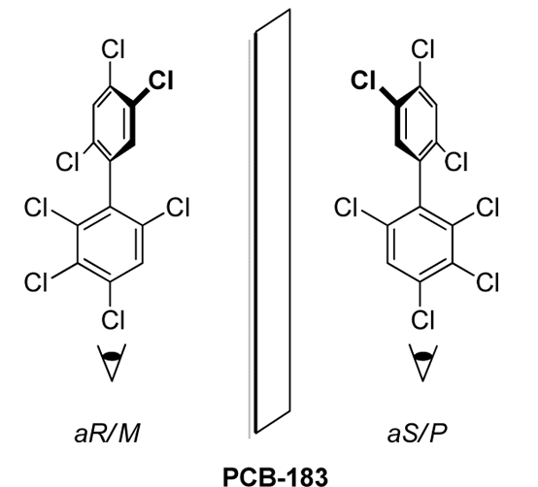
Chiral PCBs
Toda, M., Matsumura, C., Tsurukawa, M., Okuno, T., Nakano, T., Inoue, Y., Mori, T. 2012. Absolute configuration of atropisomeric PCB 183 enantiomerically enriched in human samples. J. Phys. Chem. A., in press.
19 PCB congeners contain 3 or 4 ortho- substituted chlorines and have high energy barriers that prevent rotation of the two rings.
Technically called atropisomers instead of enantiomers.
Selective metabolism in humans, wildlife, soils, sediments.

Slide 58
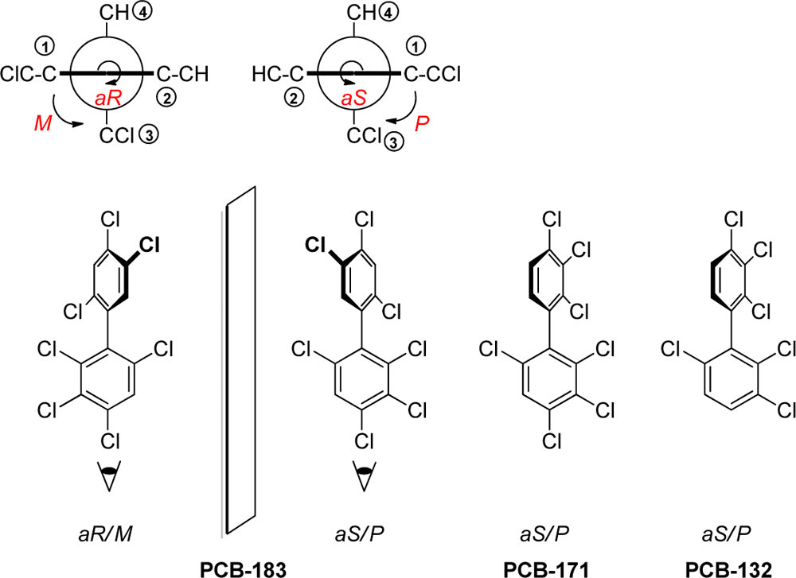
Toda, Matsumura, Tsurukawa, Okuno, Nakano, Inoue, Mori, Journal of Physical Chemistry A. DOI: http://dx.doi.org/10.1021/jp306363n
Notes:
aR,aSとM,Pの命名は、異なる
aR,aS 軸を隔てて手前、奥を1-2-3-4と順位をつけるか？
M,P 軸を隔てて手前、奥を1-3と順位をつけるか？
右回り、左回りは一致しない

Slide 59
38℃
PCB-139 | 1ｍL/min | 40cm
カラム温度 | RT-1 | RT-2
10C | 9.522 | 10.696
15C | 9.065 | 10.079
20C | 8.701 | 9.58
25C | 8.367 | 9.142
30C | 8.023 | 8.699
35C | 7.679 | 8.271
38C | 7.56 | 8.11
40C | 7.401 | 7.924
30℃
25℃
15℃
HPLC column temperature and chiral separation (PCB-139)
Notes:
キラル認識カラムでPCBをHPLCで分離
Separate PCBs by HPLC using a chiral recognition column

Slide 60
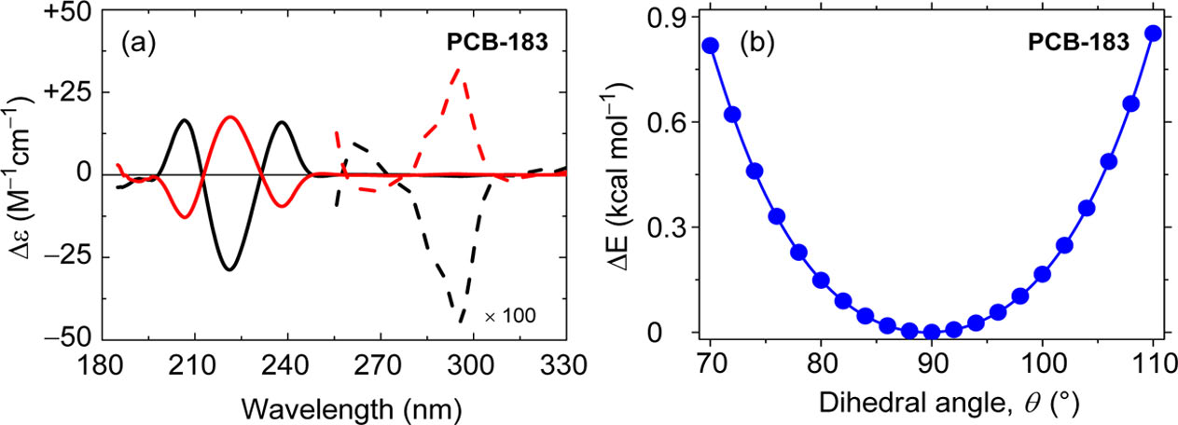
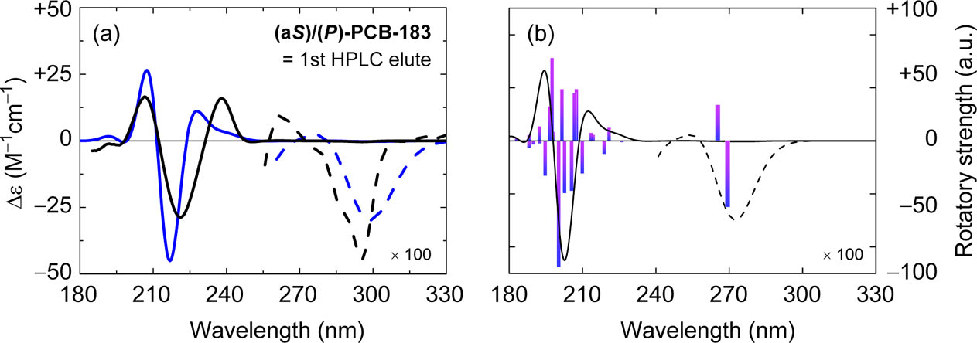
Experimental data and theoretical chemical calculations were integrated and analyzed to enable specific optical rotation measurements of each enantiomer. We confirmed that the experimental and calculated results of the circular dichroism spectrum and specific optical rotation agree well.
Toda, Matsumura, Tsurukawa, Okuno, Nakano, Inoue, Mori, Journal of Physical Chemistry A. DOI: http://dx.doi.org/10.1021/jp306363n
Notes:
短いカラム、低い分離能（R）で分取した各エナンチオマーで、旋光度測定を可能にするために、実験データと理論的な化学計算とを統合させて解析した。円二色性スペクトルと旋光度が、実験と計算の結果がよく一致することを確認した。
Experimental data and theoretical chemical calculations were integrated and analyzed to enable specific optical rotation measurements of each enantiomer separated using a short column and low resolution (R). We confirmed that the experimental and calculated results of the circular dichroism spectrum and optical rotation agree well.

Slide 61
Enantioselective oxidation by cytochrome P450

Slide 62
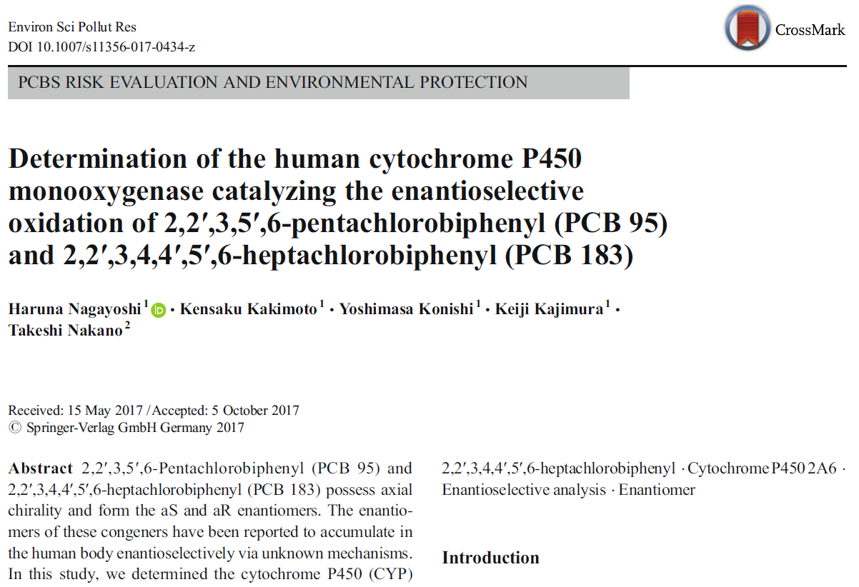

Slide 63
Changes in enantiomer fraction (EF) value of PCB 95 after 3h treatment
Nagayoshi et al, ESPR, (2017)
Notes:
Fig. 2 Changes in enantiomer fraction (EF) value of PCB 95 after a 3-h
treatment with 13 humanCYP isoforms, ratCYP2B1 (40 pmol/mL each),
or S9s (1 mg/mL). EF values were calculated using the following
formula: EF = area of first eluent peak/sum of areas of both
enantiomers. When the EF value was equal to 0.5, both enantiomers
were considered to be present at the same concentration in the solution
(racemate). All experiments were conducted in triplicates. Error bars
indicate standard deviations. Asterisk indicates statistical significance
calculated using the Student’s t test (*indicates p < 0.05 and **indicates
p < 0.01)

Slide 64
Enantioselective toxicity : PCB 95 Ryanodine Receptors (RyRs) Hippocampal Neuronal Networks

Slide 65
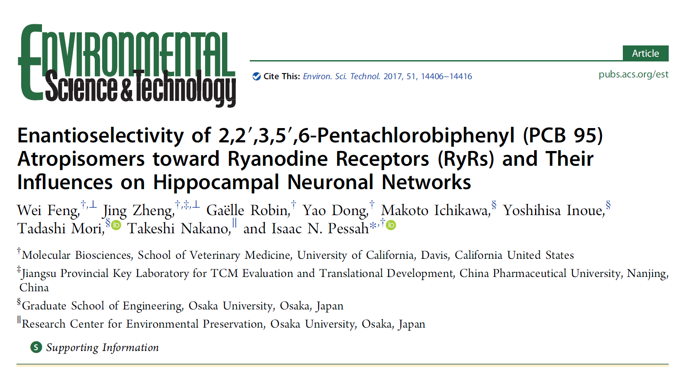

Slide 66
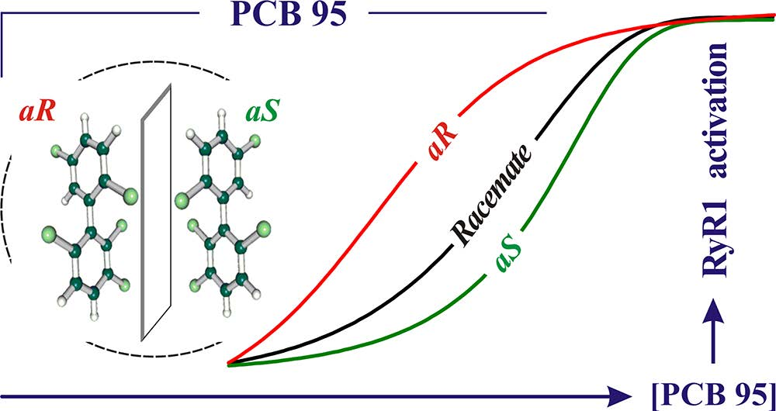
Notes:
The interaction with RYR, which is responsible for Ca channeling in the hippocampus of the brain, shows a large difference between the r- and s-PCB.

Slide 67
Specific rotation of chiral PCB and computational chemistry

Slide 68
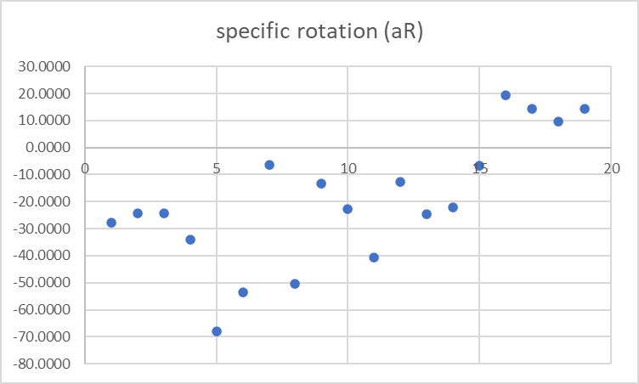
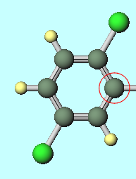
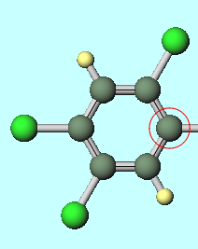
25-
245-
aR-(-), aS-(+)
aR-(+), aS-(-)
 | 236-236 | 2346-2 | 236-2 | 236-24 | 236-23 | 2346-23 | 2345-236 | 234-236 | 235-236 | 236-25 | 236-245 | 2346-245 | 2346-25
 | PCB136 | PCB88 | PCB45 | PCB91 | PCB84 | PCB131 | PCB174 | PCB132 | PCB135 | PCB95 | PCB149 | PCB183 | PCB144
dipole polarizability aR | 222.3550 | 210.3370 | 193.8865 | 211.3800 | 208.6502 | 225.4404 | 240.6577 | 225.0905 | 225.3504 | 210.1290 | 226.6060 | 243.8259 | 226.8724
dipole polarizability aS | 222.3567 | 210.3372 | 193.8781 | 211.3810 | 208.6502 | 225.4106 | 240.6599 | 225.0865 | 225.3492 | 210.1437 | 226.6118 | 243.8059 | 226.8745
rotatory dispersion aR | -0.2599 | -0.2047 | -0.1833 | -0.2882 | -0.5733 | -0.5007 | -0.0653 | -0.4707 | -0.1238 | 0.1641 | 0.1342 | 0.0983 | 0.1325
rotatory dispersion aS | 0.3517 | 0.2358 | 0.2709 | 0.2624 | 0.5720 | 0.5246 | 0.1990 | 0.5617 | 0.2449 | -0.1486 | -0.1292 | -0.0713 | -0.0904
specific rotation aR | -27.8752 | -24.2703 | -24.2990 | -34.1829 | -67.9927 | -53.7062 | -6.3926 | -50.4882 | -13.2776 | 19.4659 | 14.3945 | 9.6224 | 14.2169
specific rotation aS | 37.7314 | 27.9655 | 35.9124 | 31.1223 | 67.8322 | 56.2733 | 19.4868 | 60.2542 | 26.2738 | -17.6193 | -13.8636 | -6.9822 | -9.6920
specific rotation [alpha] in deg*[dm(g/cc)]^(-1)
2346-24 | 2346-234 | 2346-235 | 2346-234 | 2346-2346 | 2345-2346
PCB139 | PCB171 | PCB175 | PCB176 | PCB197 | PCB196
228.3205 | 242.3123 | 242.4190 | 239.2310 | 256.4995 | 258.0849
228.3043 | 242.3119 | 242.3827 | 239.1816 | 256.4589 | 258.0921
-0.2113 | -0.4145 | -0.1289 | -0.2518 | -0.2446 | -0.0739
0.2291 | 0.4471 | 0.1659 | 0.2667 | 0.2047 | 0.1632
-22.6629 | -40.5870 | -12.6243 | -24.6538 | -22.0369 | -6.6565
24.5791 | 43.7838 | 16.2498 | 26.1116 | 18.4366 | 14.6994

Slide 69
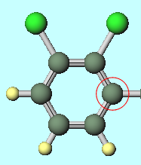
25-
245-
#149
aR-(+)
#183
#95
#144
#174
#171
#88
#135
#175
#196
#136
#197
#91
#45
#139
#132
#176
aR-(-)
#131
#84
specific rotation [alpha] in deg・[dm(g/cc)]⁻¹
23-
Notes:
カーン・インゴルド・プレローグ順位則
P（プラス）右巻きらせん、M（マイナス）左巻きらせん
偏光 polarization 電場・磁場の振動方向が規則的な光
右旋性dextrorotatary
左旋性levorotatory
絶対配置
aR:Rectus右
aS:Sinister左

Slide 70
2,5- / 2,4,5- : aR-(+) 2,3- : aR-(-)
specific rotation
2,3-
2,5-
2,4,5-
<<<<<<<<
#84, #131
#183, #144, #149, #95
aR-(-) aR-(+)
Notes:
2,5-, 2,4,5-
#183
#144
#149
#95
2,3-
#84
#131

Slide 71
Finally. Message for the Future from old reseracher

Slide 72
“Kanemi Yusho”
“Kanemi Yusho” was mainly caused by PCDFs transformed from heated PCB during the deodorization process of rice bran oil in the Kanemi Warehouse, Kitakyushu, Japan (1968) .
Approximately 15 thousand people suffered from various illnesses, especially in the skin, liver, kidney among others. “Kanemi Yusho” is considered to be the greatest food disaster in Japan.
The sale of “Kanemi rice bran oil” was terminated within a half year after the incidence of “Kanemi Yusho” .
Shibuya et al, Epigenetic Inheritance Symposium 2023
Impact for Biology and Society , 23－25 Aug, ETH Zurich, Switzerland
Notes:
“Kanemi Yusho” was mainly caused by PCDFs transformed from heated PCB during the deodorization process of rice bran oil in the Kanemi Warehouse, Kitakyushu, Japan (1968) .
Approximately 15 thousand people suffered from various illnesses, especially in the skin, liver, kidney among others. “Kanemi Yusho” is considered to be the greatest food disaster in Japan.
The sale of “Kanemi rice bran oil” was terminated within a half year after the incidence of “Kanemi Yusho” .
In the second and third generations after “Kanemi Yusho”, symptons similar to those in the first generation also appeared with high incidences.
“Research and Clinical Center for Yusho and Dioxin” started generational analysis based on the interview to patients (From 2021).
It is very important to solve the generational problems of “Kanemi Yusho” occurring through TEI to treat and estimate the impact on future generations.
「カネミ油症」は、北九州市のカネミ倉庫で米ぬか油の脱臭工程中に加熱されたPCBから変化したPCDFが主な原因であった（1968年）。
約15,000人が、特に皮膚、肝臓、腎臓などの様々な病気に苦しんだ。「カネミ油症」は日本最大の食品災害と言われている。
カネミ米ぬか油」は「カネミ油庄」発生後、半年で販売中止となった。
「カネミ油症」発生後の第2世代、第3世代でも、第1世代と同様の症状が高い頻度で出現した。
「油症・ダイオキシン研究臨床センター」では、患者への聞き取り調査をもとに世代分析を開始した（2021年～）。
TEIを通じて発生した「カネミ油症」の世代間問題を解決し、治療や将来世代への影響を推定することは非常に重要である。
将来へ向けての新たなメッセージ
新たな視点
Transgenerational Epigenetic Inheritance
Epigenetic Inheritance: Concepts, Mechanisms and Perspectives

Slide 73
“Kanemi Yusho”
In the second and third generations after “Kanemi Yusho”, symptons similar to those in the first generation also appeared with high incidences.
“Research and Clinical Center for Yusho and Dioxin” started generational analysis based on the interview to patients (From 2021).
It is very important to solve the generational problems of “Kanemi Yusho” occurring through TEI（Transgenerational epigenetic inheritance) to treat and estimate the impact on future generations.
Shibuya et al, Epigenetic Inheritance Symposium 2023
Impact for Biology and Society , 23－25 Aug, ETH Zurich, Switzerland
Notes:
“Kanemi Yusho” was mainly caused by PCDFs transformed from heated PCB during the deodorization process of rice bran oil in the Kanemi Warehouse, Kitakyushu, Japan (1968) .
Approximately 15 thousand people suffered from various illnesses, especially in the skin, liver, kidney among others. “Kanemi Yusho” is considered to be the greatest food disaster in Japan.
The sale of “Kanemi rice bran oil” was terminated within a half year after the incidence of “Kanemi Yusho” .
In the second and third generations after “Kanemi Yusho”, symptons similar to those in the first generation also appeared with high incidences.
“Research and Clinical Center for Yusho and Dioxin” started generational analysis based on the interview to patients (From 2021).
It is very important to solve the generational problems of “Kanemi Yusho” occurring through TEI to treat and estimate the impact on future generations.
「カネミ油症」は、北九州市のカネミ倉庫で米ぬか油の脱臭工程中に加熱されたPCBから変化したPCDFが主な原因であった（1968年）。
約15,000人が、特に皮膚、肝臓、腎臓などの様々な病気に苦しんだ。「カネミ油症」は日本最大の食品災害と言われている。
カネミ米ぬか油」は「カネミ油庄」発生後、半年で販売中止となった。
「カネミ油症」発生後の第2世代、第3世代でも、第1世代と同様の症状が高い頻度で出現した。
「油症・ダイオキシン研究臨床センター」では、患者への聞き取り調査をもとに世代分析を開始した（2021年～）。
TEIを通じて発生した「カネミ油症」の世代間問題を解決し、治療や将来世代への影響を推定することは非常に重要である。
将来へ向けての新たなメッセージ
新たな視点
Transgenerational Epigenetic Inheritance
Epigenetic Inheritance: Concepts, Mechanisms and Perspectives

Slide 74


Transgenerational effects of PCDFs by somatic and germ cells in “Kanemi Yusho”
PCDFs
Effects of PCDFs through somatic cells.
(Research and Clinical Center for Yusho and Dioxin, japan)
Transgenerational epigenetic inheritance by PCDFs through germ cells (“Kanemi Yusho” Study
Group Japan)
F₀
F₁
F₂
F₃
::
F_{n}
Shibuya et al, Epigenetic Inheritance Symposium 2023
Impact for Biology and Society , 23－25 Aug, ETH Zurich, Switzerland
Notes:
Epigenetic Inheritance Symposium 2023
Impact for Biology and Society
23－25 Aug, ETH Zurich, Switzerland

Slide 75
Thank you for your attention

Slide 77
Symptoms of “Kanemi Yusho” (F0 generation)
Chlorine acne, black comedones
Meibomian gland hypersecretion
Chlorine acne, cyst
Pigmentation
(Guidance for Kanemi Yusho ― Symptoms and treatment ;
Research and Clinical Center for Yusho and Dioxin (2020)

Slide 78
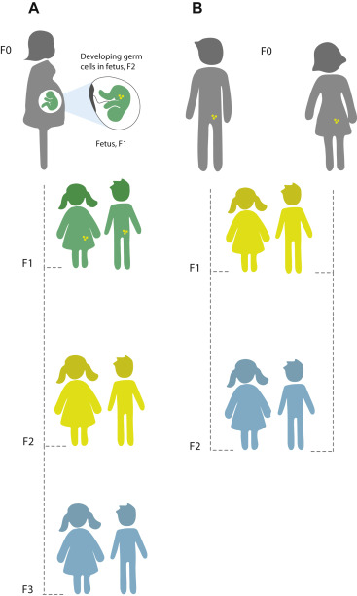
PCDFs ↓
Transgenerational epigenetic inheritance (TEI) in “Kanemi Yusho”
Embryo
Infant
Intergenerational Inheritance
Intergenerational Inheritance
Transgenerational Epigenetic Inheritance.
Knudsen et al.
J. Allerg. Clin. Immunol. （2019）
(Modified)
Transgenerational Epigenetic Inheritance

Slide 79
Secondary Interim report of “Research Group“(June, 2023)
The group are classified as the high-PCDFs group (>50pg in the blood of mothers) and low-PCDFs group (<50pg); number of people: 238 and 54 in the second and third generations.
The relationship beteen the concentration of PCDFs in suffering mothers and that of second and third generations was denyed .
On the congenital anomaly
Lip/cleft palates： show significant increases : 0.8% (high group) vs 0.2% (low group).
VSDs did not increase： high:1.0% vs low: 0.3%. These data are contrary to those of Dr. Fujino (2019).
Teeth defects : （high: 4.1% vs low: 10.0%）. These data are contrary to those of Drs. Miyakawa and Hashidume (up to 50% vs control：2012).
Thrombasthenia: shows petiolar inheritance in specific pedigree (Fujino, 2019).

Slide 80
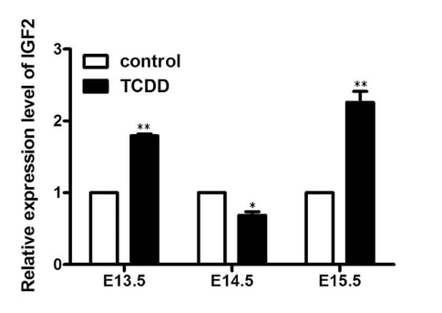
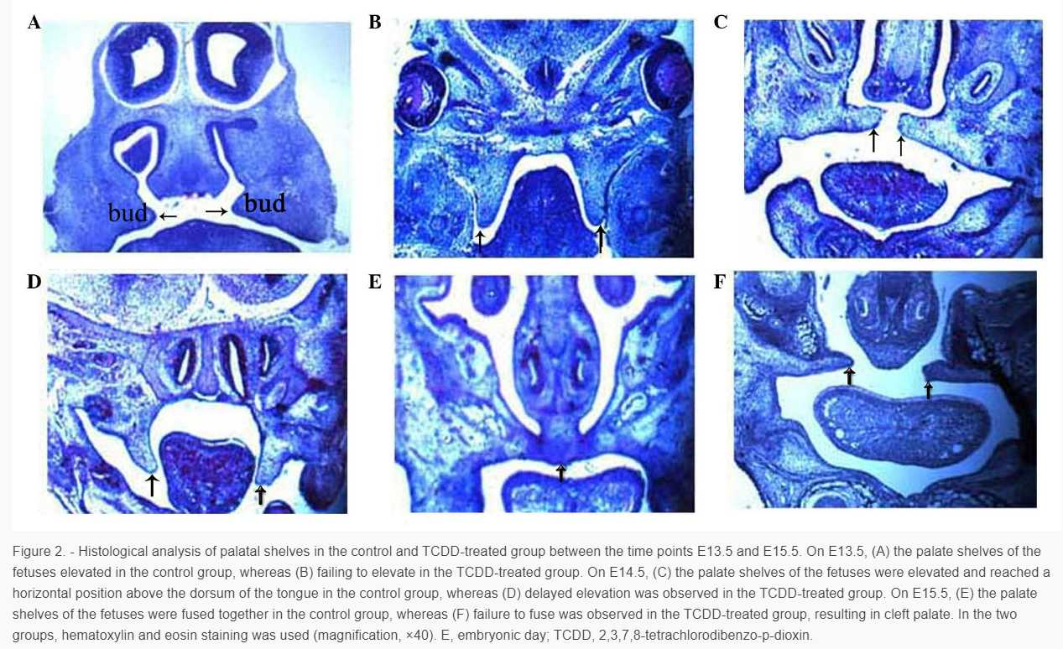
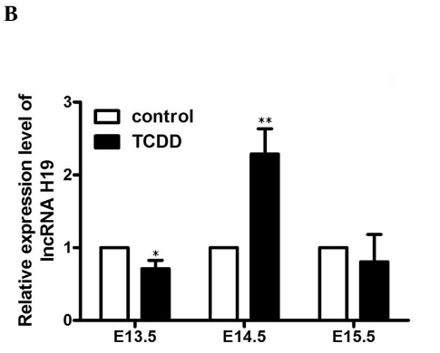
TCDD induces cleft palate anomaly by epigenetic disturbing the imprinted gene IGF2/H19 through activation of AhR (64 ug/kg TCDD at E10.5, effects on embryonic somatic cells)
(Gao, 2017 ; Biomed. Environ. Sci.)
・ Lip/ cleft palate cannot be induced in AhR-null mice by dioxins. （Mimura et al., Genes and Cells, 1997 and Others）

Slide 81
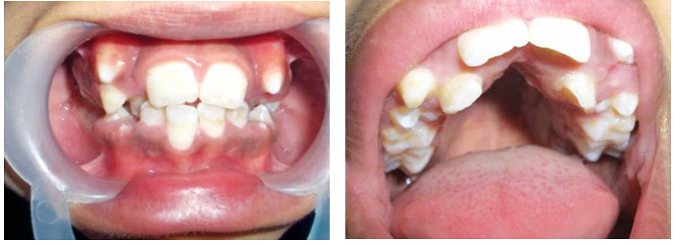
Silver-Russell Syndrome（SRS）
Cause: hypomethylation of the imprinted H19 gene on chromosome 11
（IGF2 -H19 region)
Main symptoms: intrauterine growth retardation (IUGR), left-right asymmetry, short
stature, sexual dysgenesis, an inverted triangular face with relative large head.
A high arched palate, delayed tooth eruption, delayed tooth eruption, micro-
dontia, hypodontia and crowding, microdontia hypodontia and crowding.
Crowding of teeth Deep palatal vault
（Sreedevi, 2011; J. of Indian Academy of Oral Medicine and Radiology ）

Slide 82
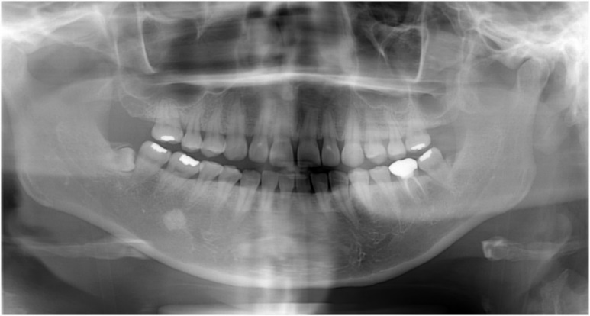
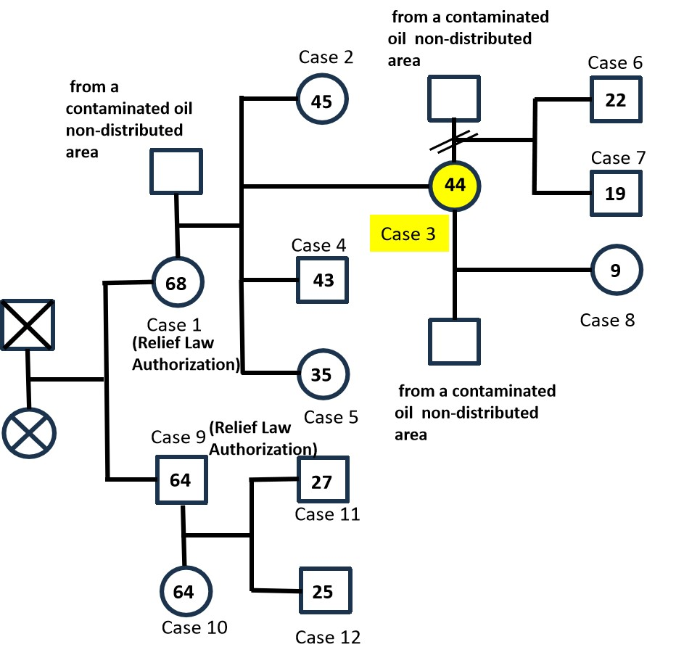
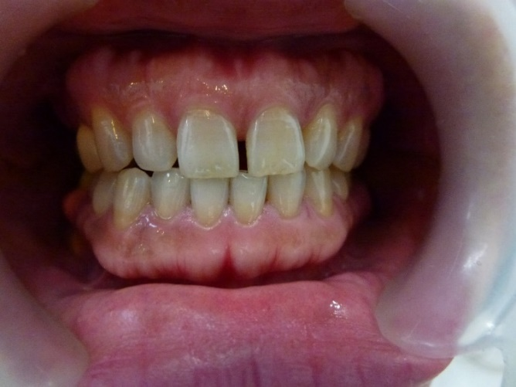
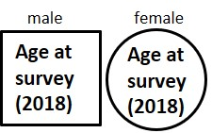
Case3: second daughter of case 1, born in June, 1974; Congenital deficiency in the upper/lower second molar
Observations of congenital permanent tooth defect by
orhto-pantomorentogen

Slide 83
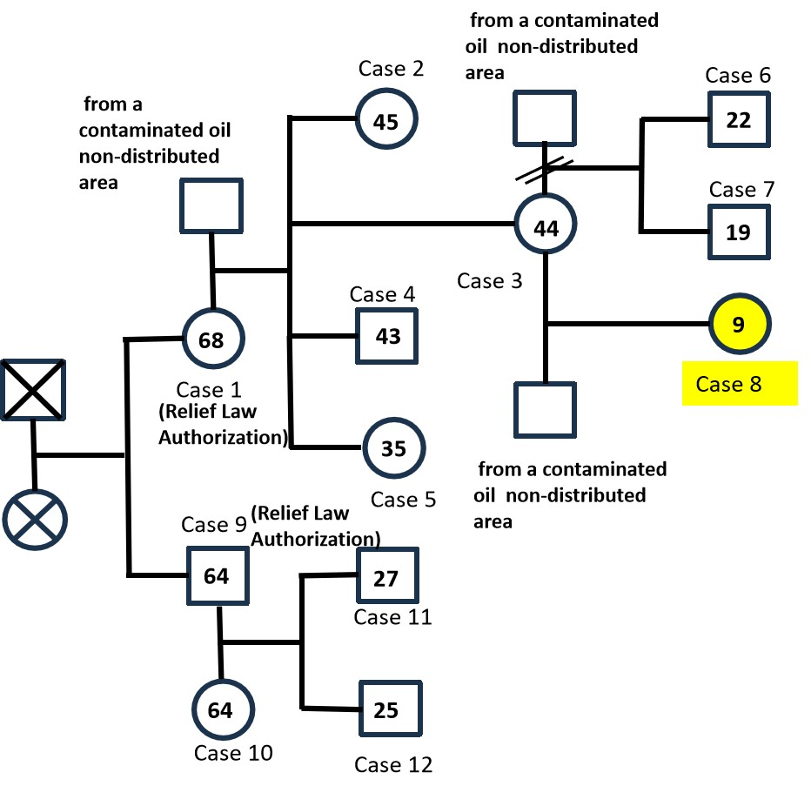
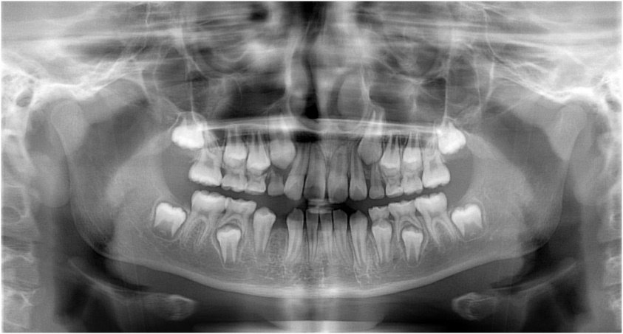
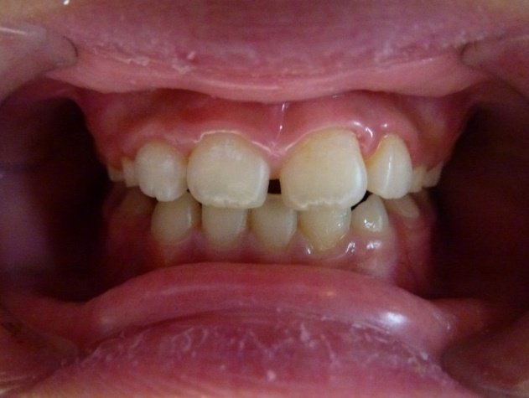
Case 8 : Grand-daughter of Case 1, born in August 28, 2009;
Congenital absence of lower right lateral incisor (right upper first molar and upperright lateral incisor enamel hypoplasia)

Slide 84
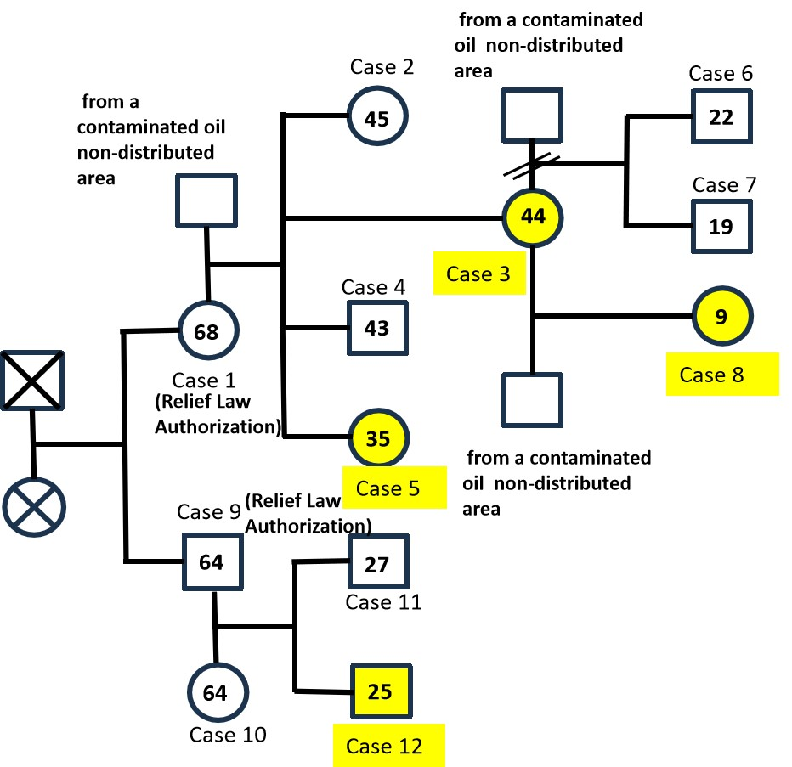
The family tree derived from siblings who ingested contaminated oil during childhood
congenital deficiency 2 teeth
congenital deficiency
1 teeth
congenital deficiency 1 teeth
congenital deficiency 4 teeth

Slide 86
“Kanemi Yusho” and Transgenerational Epigenetic Inheritance
Tohru Shibuya, Yasuichi Miyakawa, Yoshiyuki Hashidume, Reiko Takeda, Jungo Hayakawa, Yukiharu Horiya, and Tadashi Fujino
Kanemi Yusho Study Group, Japan
shibuya@leeg.jp

Slide 87
“Kanemi Yusho”
“Kanemi Yusho” was mainly caused by PCDFs transformed from heated PCB during the deodorization process of rice bran oil in the Kanemi Warehouse, Kitakyushu, Japan (1968) .
Approximately 15 thousand people suffered from various illnesses, especially in the skin, liver, kidney among others. “Kanemi Yusho” is considered to be the greatest food disaster in Japan.
The sale of “Kanemi rice bran oil” was terminated within a half year after the incidence of “Kanemi Yusho” .
In the second and third generations after “Kanemi Yusho”, symptons similar to those in the first generation also appeared with high incidences.
“Research and Clinical Center for Yusho and Dioxin” started generational analysis based on the interview to patients (From 2021).
It is very important to solve the generational problems of “Kanemi Yusho” occurring through TEI to treat and estimate the impact on future generations.

Slide 88
Symptoms of “Kanemi Yusho” (F0 generation)
Chlorine acne, black comedones
Meibomian gland hypersecretion
Chlorine acne, cyst
Pigmentation
(Guidance for Kanemi Yusho ― Symptoms and treatment ;
Research and Clinical Center for Yusho and Dioxin (2020)

Slide 89
PCDFs ↓
Transgenerational epigenetic inheritance (TEI) in “Kanemi Yusho”
Embryo
Infant
Intergenerational Inheritance
Intergenerational Inheritance
Transgenerational Epigenetic Inheritance.
Knudsen et al.
J. Allerg. Clin. Immunol. （2019）
(Modified)
Transgenerational Epigenetic Inheritance

Slide 90
Secondary Interim report of “Research Group“(June, 2023)
The group are classified as the high-PCDFs group (>50pg in the blood of mothers) and low-PCDFs group (<50pg); number of people: 238 and 54 in the second and third generations.
The relationship beteen the concentration of PCDFs in suffering mothers and that of second and third generations was denyed .
On the congenital anomaly
Lip/cleft palates： show significant increases : 0.8% (high group) vs 0.2% (low group).
VSDs did not increase： high:1.0% vs low: 0.3%. These data are contrary to those of Dr. Fujino (2019).
Teeth defects : （high: 4.1% vs low: 10.0%）. These data are contrary to those of Drs. Miyakawa and Hashidume (up to 50% vs control：2012).
Thrombasthenia: shows petiolar inheritance in specific pedigree (Fujino, 2019).

Slide 91
Transgenerational effects of PCDFs by somatic and germ cells in “Kanemi Yusho”
PCDFs
Effects of PCDFs through somatic cells.
(Research and Clinical Center for Yusho and Dioxin, japan)
Transgenerational epigenetic inheritance by PCDFs through germ cells (“Kanemi Yusho” Study
Group Japan)
F₀
F₁
F₂
F₃
::
F_{n}

Slide 92
TCDD induces cleft palate anomaly by epigenetic disturbing the imprinted gene IGF2/H19 through activation of AhR (64 ug/kg TCDD at E10.5, effects on embryonic somatic cells)
(Gao, 2017 ; Biomed. Environ. Sci.)
・ Lip/ cleft palate cannot be induced in AhR-null mice by dioxins. （Mimura et al., Genes and Cells, 1997 and Others）

Slide 93
Silver-Russell Syndrome（SRS）
Cause: hypomethylation of the imprinted H19 gene on chromosome 11
（IGF2 -H19 region)
Main symptoms: intrauterine growth retardation (IUGR), left-right asymmetry, short
stature, sexual dysgenesis, an inverted triangular face with relative large head.
A high arched palate, delayed tooth eruption, delayed tooth eruption, micro-
dontia, hypodontia and crowding, microdontia hypodontia and crowding.
Crowding of teeth Deep palatal vault
（Sreedevi, 2011; J. of Indian Academy of Oral Medicine and Radiology ）

Slide 94
Case3: second daughter of case 1, born in June, 1974; Congenital deficiency in the upper/lower second molar
Observations of congenital permanent tooth defect by
orhto-pantomorentogen

Slide 95
Case 8 : Grand-daughter of Case 1, born in August 28, 2009;
Congenital absence of lower right lateral incisor (right upper first molar and upperright lateral incisor enamel hypoplasia)

Slide 96
The family tree derived from siblings who ingested contaminated oil during childhood
congenital deficiency 2 teeth
congenital deficiency
1 teeth
congenital deficiency 1 teeth
congenital deficiency 4 teeth

Slide 97
Frequency of appearance Pedigree of “Yusho” (4:case3, 5, 8 and 12 /8:case2-8,12) 50.0% vs Control＊ : 10.1% The number of teeth deficiencies per person In four teeth (case3) 12.5 % vs Control＊: 2.9%) In two teeth (case12) 12.5 % vs Control＊ : 0.50%) Various abnormal types of teeth are frequently observed in the pedigree of “Kanemi Yusho” patients. ＊Control values are calculated from Japan Pediatric Dentistry Academic Committee (2010). (Data were collected from 15,544 people.)
Summary of congenital permanent teeth deficiency using dental radiography

Slide 98
Glanzmann Thrombastenia （GT : Nagoya study）
GT are frequently obsevered in the same pedigree observed various teeth abnormality.
In this case, fathers did not ingest rice oil and were not diagnosed with Glanzmann thrombasthenia (GT), The mother, all five children, and two of the three grandchildren (one was not medically examined) were diagnosed with GT in Nagoya University.
Rare disease with difficulty in blood coagulation.
Difficulty in blood coagulation during bleeding.
Responsible gene is an autosomal recessive gene : chromosome 17
Deficiency in glycoprotein in the membrane of platelets (GP1b/IX/V: integrin αIIｂ/β３)
Number of platelets is normal.
Very high incidence in a specific pedigree of “Kanemi Yusho”.
Mutation or biallelic incidence might be included ?
We assumed that various mutations and/or epimutation simultaneously occur in “Kanemi Yusho”

Slide 99
Investigation in Nagoya Nasal bleeding, Glanzmann thrombasthenia, and congenital permanent teeth deficiency

Slide 100
Somatic cells (fetal stage)
F1: Various anomalies and diseases in various mesenchymal
derived organs.
“ Kanemi Yusho” is a department store that lead to various diseases.
(Harada, M)
PCDFs
Activated AhR
Epigenetic mutation in IGF2/H19
ARNT
PGC : Escape of
reprograming
Germ line cells
Escape reprograming at fertilization
F2,F3‥ Epigenetic Transgenerational by epi-mutation
Somatic cells (fetal stage)
F2, F3‥ : Various anomalies and diseases in various mesenchymal derived organs.
One Working Hypothesis of TEI in “Kanemi Yusho” (Horiya and Shibuya, 2023)

Slide 101
Conclusions
The phenomena of TEI caused by various environmental factors has been established.
Notably, almost all EDCs induce TEI in animal studies.
TEI may have a significant impact on human health and disease conditions .
Symptoms of “Kanemi Yusho” observed in the second and third generations may have originated from that of ingested parents through TEI .
Precise epigenetic analysis on the cells of specific pedigrees (various dental anomalies, platelet anomalies, and other congenital anomalies) is required to elucidate the generational problems of “Kanemi Yusho”.

