Slide 1

The Method of passive SAMPLING for measuring mercury concentration in the atmosphere

Slide 2
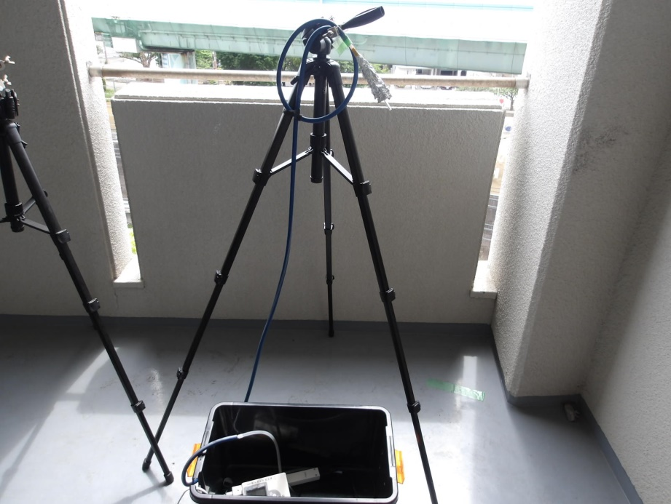
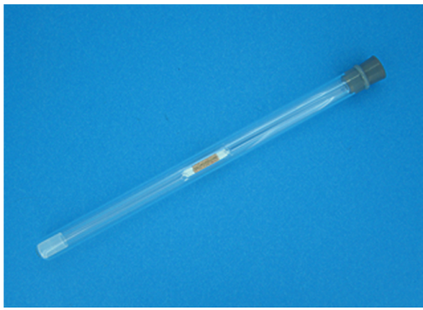
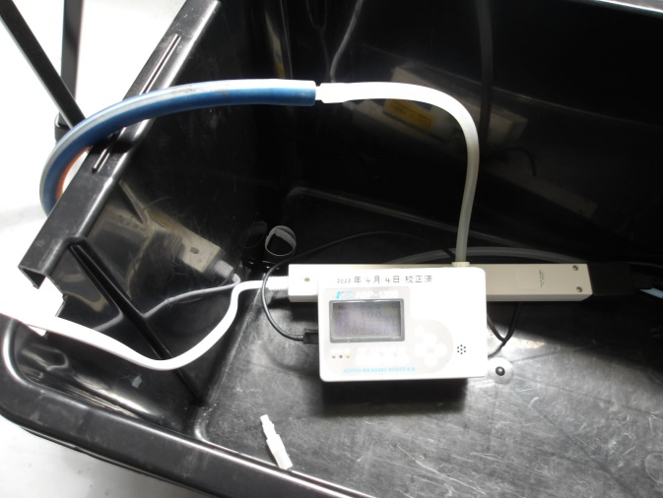
Standard Sampling of Mercury in The Atmosphere (Active Sampling Method)
Sampling tube
Air
Active sampling
Flow rate 0.5L/min
Sampling pump

Slide 3
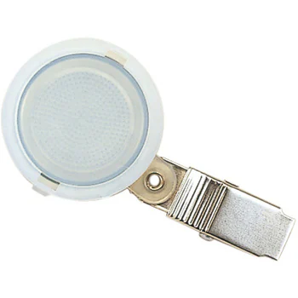
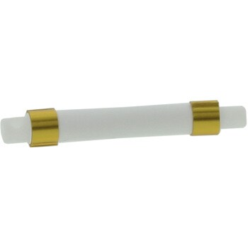
Advantage of Passive Sampling
・No Power Supply
Compact and Cheap
Can Study for Long Term Contamination Level
Wide Range and Multi-point Measurement
Suitable for Personal , Indoor and Field Monitoring
Disk type
Tube type

Slide 4
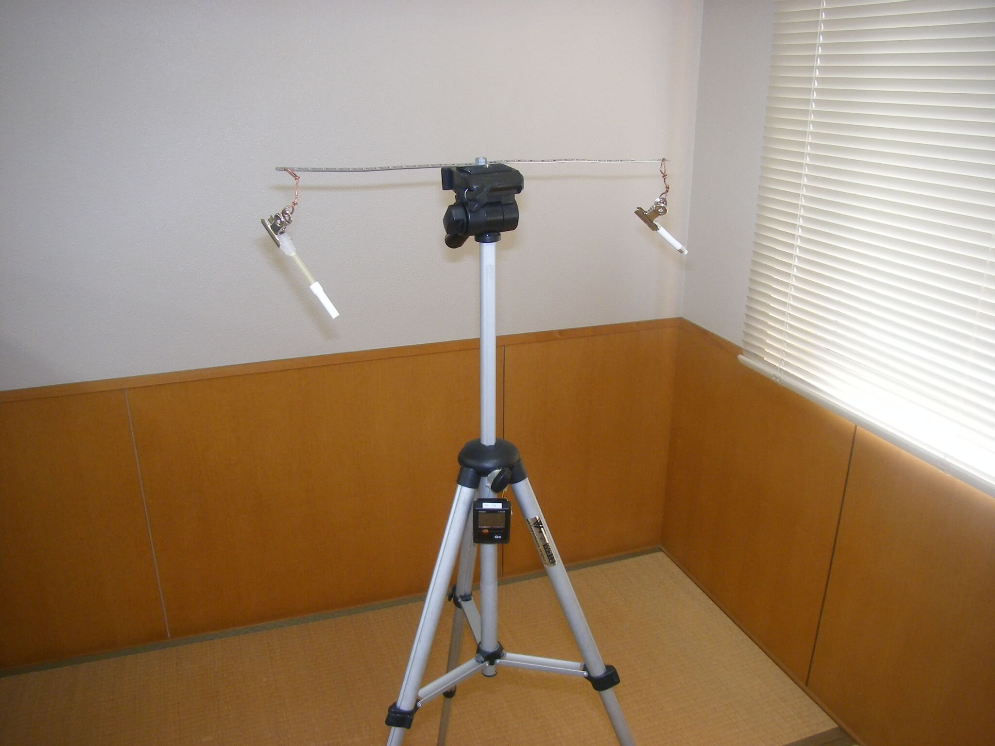
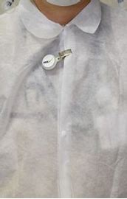
Usage of Passive Sampling
VOC monitoring
Measurement of parsonal exposure

Slide 5
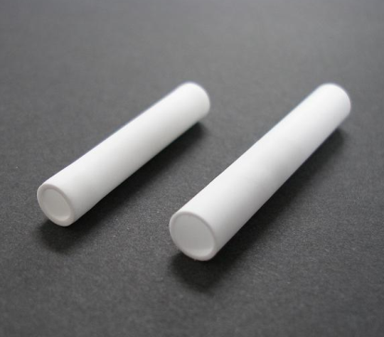
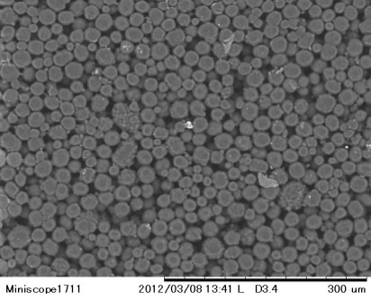
Principle of Passive Sampling
Tube fo passive sampler
Gaseous Hg（Target）
Adsorbing Surface
Electronic microscope image
Diffusive Surface
The target substance permeation the tube and diffuses to the adsorbent surface in the tube and is collected
The amount of collection depends on the sampling time

Slide 6
Calculation of Atmospheric Concentration
C＝（Ws-Wb）/（SR×T）
C：Atmospheric concentration of mercury（ng/m³)
Ws : Amount of adsorbed mercury (ng)
Wb : Amount of sample blank (ng)
SR : Sampling rate (ng/(ng/m³)/day)
T : Sampling time (day)
Before passive sampler monitoring, sampling rate must be determined.

Slide 7
Passive Sampling vs Active Sampling
C (ng/m³)
Ws (ng)
VS
During the same period, passive and active sampling will be performed concurrently.
The amount of mercury collected for each is measured, and the SR is calculated from the correlation.
Ws
C＝（Ws-Wb）/（SR×T）
SR=
(ng/(ng/m³)/day)
(C×T）

Slide 8
Verification Test for SR Determine
Sampling period (day) | 7
Active sampling volume (m³) | 0.998
Amount of mercury (Active) (ng) | 1.43
Atmospheric concentration of mercury （ng/m³) | 1.43
Amount of mercury (Passive) (ng) | 0.727
Sampling rate | 0.073

Slide 9

Now let's move on to the practical training !

