Slide 1
Action plan for post-training period
Measure: building capacity of Central administration, industry and general publuc in the field of environmental protection
Activity 1.1 Organizing presentation for Ministerial staff regarding all topics from this training (end of June 2024)
Activity 1.2 Organizing presentation of PCB and hazardous waste treatment in Japan for our industry in cooperation with Serbian Chamber of Commerrce
(November 2024)
Activity 1.3 Organizing presentation of PCB and hazardous waste treatment in Japan for students of chemical and environmental engineering in Faculty of Technology and Merallurgy.
(November 2024)

Slide 2
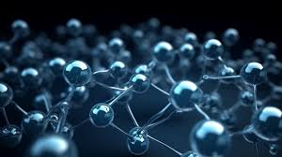

Hvala na pažnji!
Ivan Durickovic

